Slide 1


The CSO Perspective : Drug and substance abuse in Uganda Emerging trends, Human rights implications Submission to Uganda Human Rights commission (UHRC) Prepared by: Dr. Kasirye Rogers Executive Director Uganda Youth Development Link (UYDEL) Mr. Mutaawe Rogers Senior Program Manager (UYDEL) Ms. Barbara Nakijoba Monitoring and Evaluation Officer (UYDEL)

Slide 2
Emerging drug use trends in Uganda
Uganda faces rising drug and substance abuse, with CSOs highlighting prevention, treatment gaps, and human rights issues.
Rising narcotics cases (cannabis, heroin, tramadol, methamphetamine).
Increased youth exposure in slums, sports , music , construction & boda-boda industry
Growth of synthetic drugs and school-based substance use

Slide 3
Drugs and substance use/abuse in Uganda
Substance Category | Examples in Uganda | Common Contexts of Use/Misuse | Key Concerns
Stimulants | Khat (Miraa); Methamphetamine (“Ice”); Amphetamines; High-caffeine energy drinks | Youth in urban areas; transport and boda-boda industry; nightlife settings | Increased risk-taking, dependence, mental health disorders, violence
Central Nervous System (CNS) Depressants | Alcohol (sachet alcohol, waragi, local brews – malwa, tonto, ajon); Benzodiazepines (Diazepam, Alprazolam); Codeine-based cough syrups; Inhalants (petrol, glue, paint thinners) | Slums and informal settlements; street-connected children; nightlife; self-medication | Addiction, overdose, impaired judgment, GBV, school dropout
Opioid Analgesics | Tramadol; Morphine (medical diversion); Codeine; Heroin | Manual laborers; youth; health-facility diversion; urban drug markets | High addiction potential, overdose risk, criminal justice involvement
Source: CSO reports, UYDEL program data, Police Crime Reports, UNODC-Uganda, Ministry of Health (2023–2025)

Slide 4
Drivers of Drug and Substance Abuse
High unemployment and poverty
Peer pressure and urban social environments
Trauma, violence, and mental health gaps
Easy availability due to weak enforcement
Youth in informal settlements face easy access to drugs; boda industry linked to trafficking and distribution.

Slide 5
Juvenile Offenders 12-18 years (charged) by Capital offences.
Crime categories | 2017 | 2018 | 2019 | 2020 | 2022 | 2023 | 2024
Homicide | 43 | 40 | 38 | 38 | 30 | 27 | 45
Sex related Offences | 445 | 545 | 547 | 479 | 443 | 520 | 299
Robberies | 68 | 112 | 142 | 88 | 118 | 168 | 140
Terrorism | 0 | 0 | 0 | 0 | 0 | 12 | 0
Narcotics/Drugs | 54 | 96 | 146 | 30 | 137 | 64 | 131

Slide 6
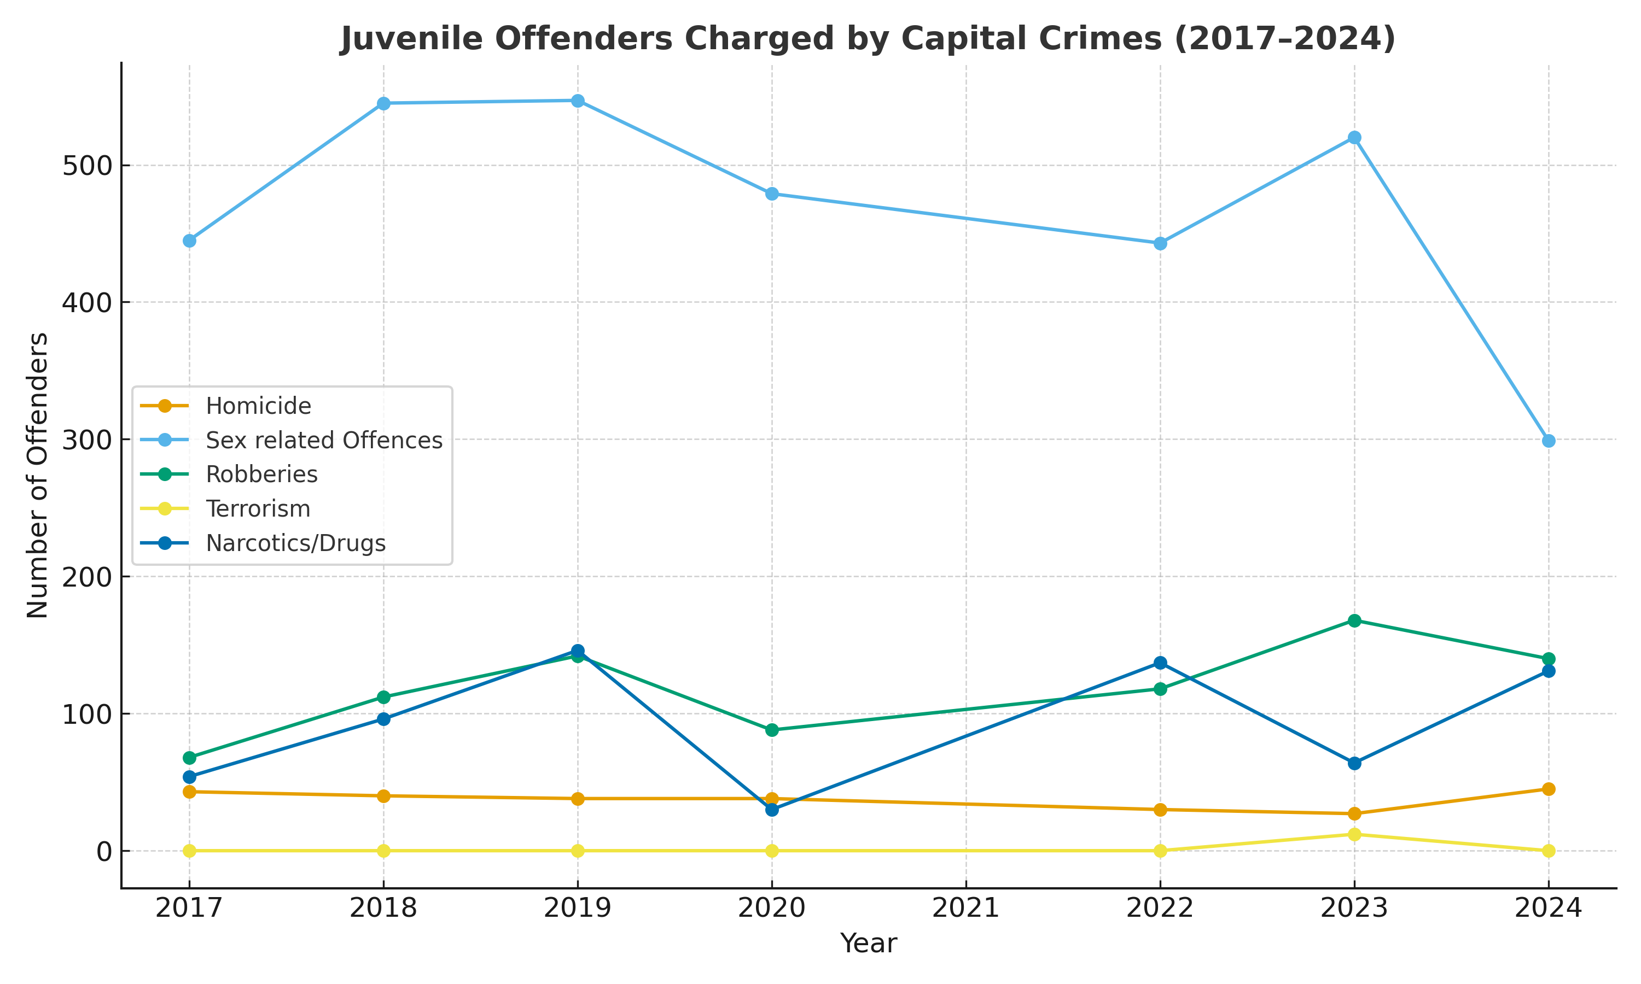
Juvenile crime is dominated by sex-related offences, but recent decline in 2024 signals potential for progress.
Robberies and drug-related crimes show fluctuating trends, highlighting ongoing risks for youth. Narcotics-related crimes fluctuate, peaking in some years. Charged vs Conviction are fewer.
Sustained prevention efforts are needed to curb high-risk behaviors and address root causes driving juvenile offences.

Slide 7
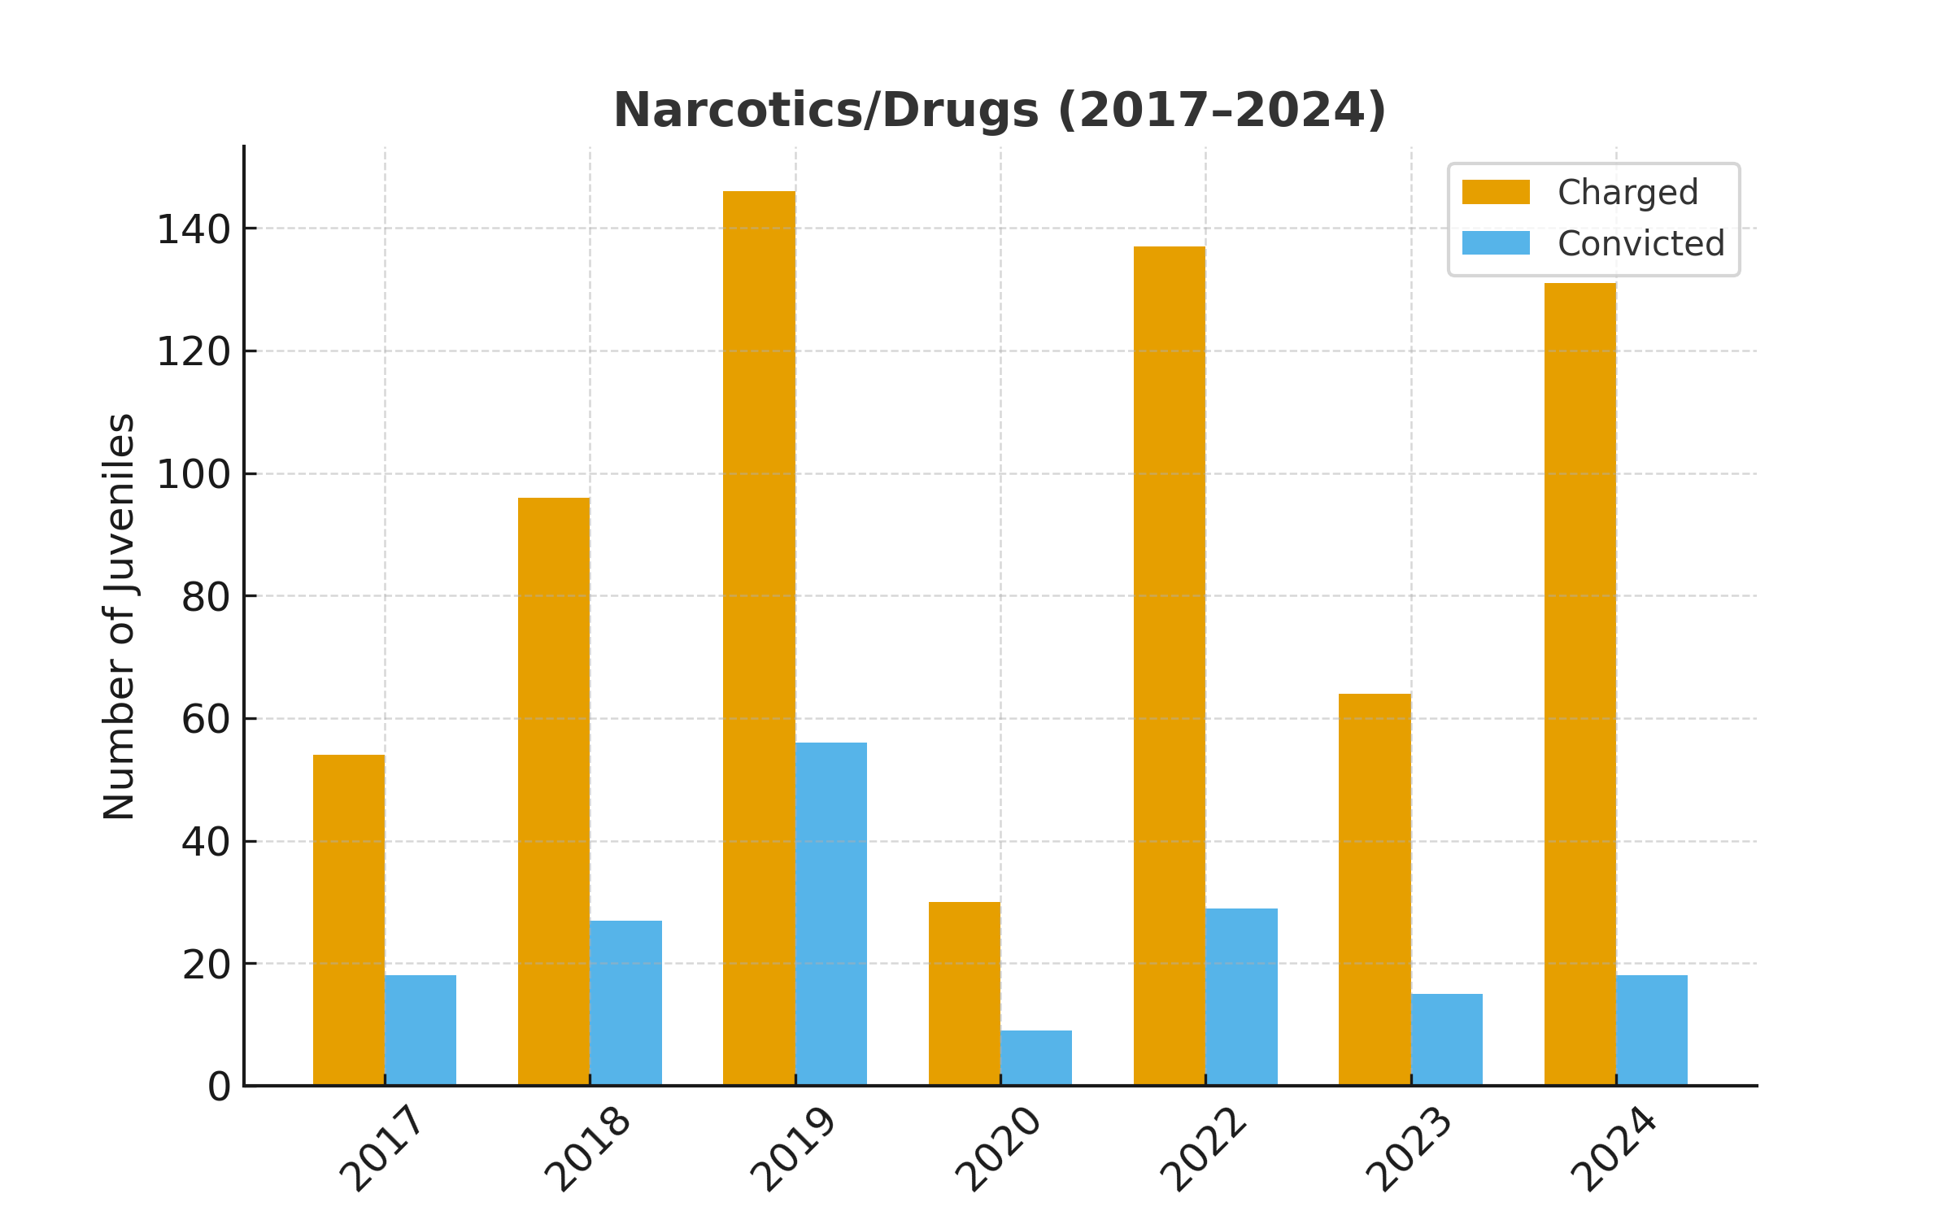
Juveniles charged vs convicted: Narcotics/Drugs

Slide 8
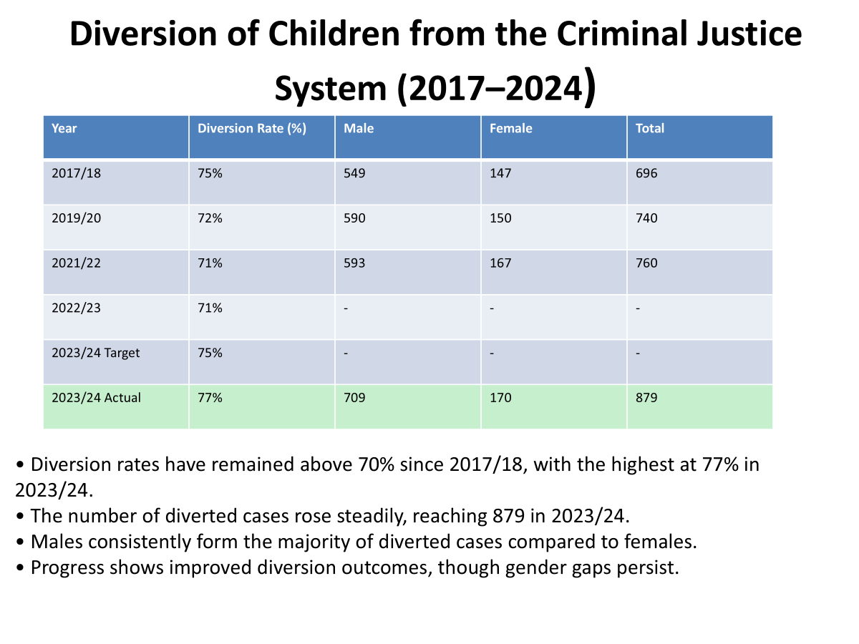
Diversion table

Slide 9
Youth Crime (18-35 years) 2017-2024

Slide 10
Youth charged by nature of crime over the years (2017-2024)
Crime categories | 2017 | 2018 | 2019 | 2020 | 2022 | 2023 | 2024
Homicide | 1620 | 1787 | 1921 | 1891 | 1192 | 1714 | 1108
Economic crimes | 3004 | 3419 | 3612 | 2331 | 2837 | 3918 | 2727
Sex related Offences | 4941 | 6034 | 6257 | 6352 | 5224 | 6035 | 5216
Child related offences | 752 | 824 | 860 | 665 | 699 | 1083 | 718
Breakings | 6233 | 7306 | 7690 | 5646 | 7483 | 9177 | 7023
Thefts | 25314 | 26461 | 27958 | 18583 | 28358 | 35742 | 28264
Robberies | 2176 | 2670 | 2890 | 2147 | 3051 | 3701 | 3112
Assaults | 7696 | 8762 | 8776 | 7329 | 7062 | 8436 | 7728
Other crimes in General | 17423 | 20072 | 20134 | 22746 | 19474 | 22599 | 21563
Terrorism | 53 | 4 | 7 | 0 | 11 | 21 | 37
Political/Media Offences | 70 | 258 | 110 | 1011 | 106 | 97 | 49
Corruption | 6 | 2 | 7 | 4 | 0 | 2 | 2
Narcotics/Drugs | 2210 | 3464 | 3592 | 1641 | 4681 | 3655 | 5608
Other Laws** | 3664 | 4008 | 3642 | 2487 | 7513 | 4951 | 3562
TOTAL | 38760 | 85071 | 87456 | 72833 | 87691 | 101131 | 86717

Slide 11
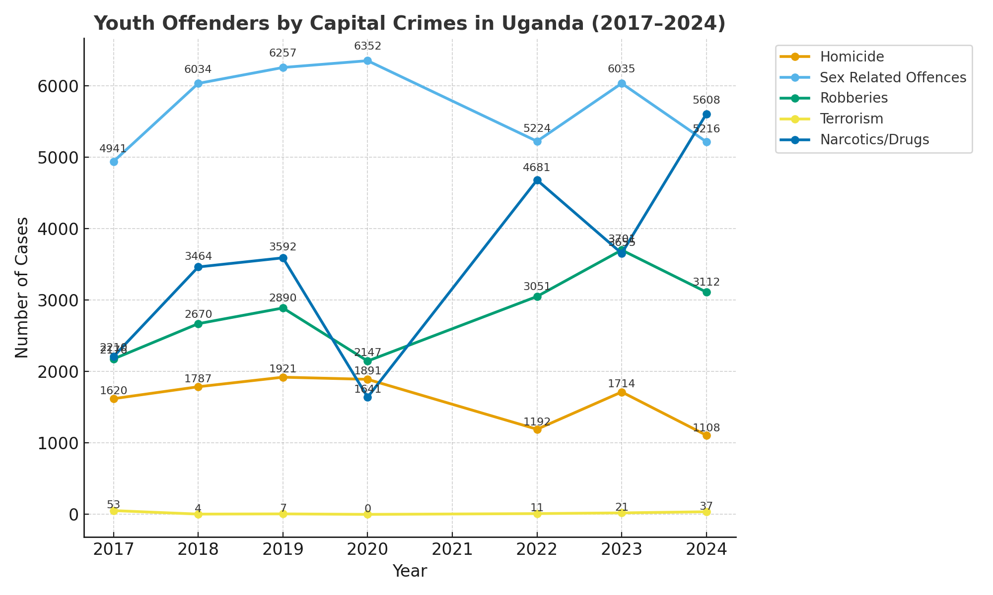
Uganda-Youth offenders on line chart
Source: Uganda youth crime report 2025

Slide 12
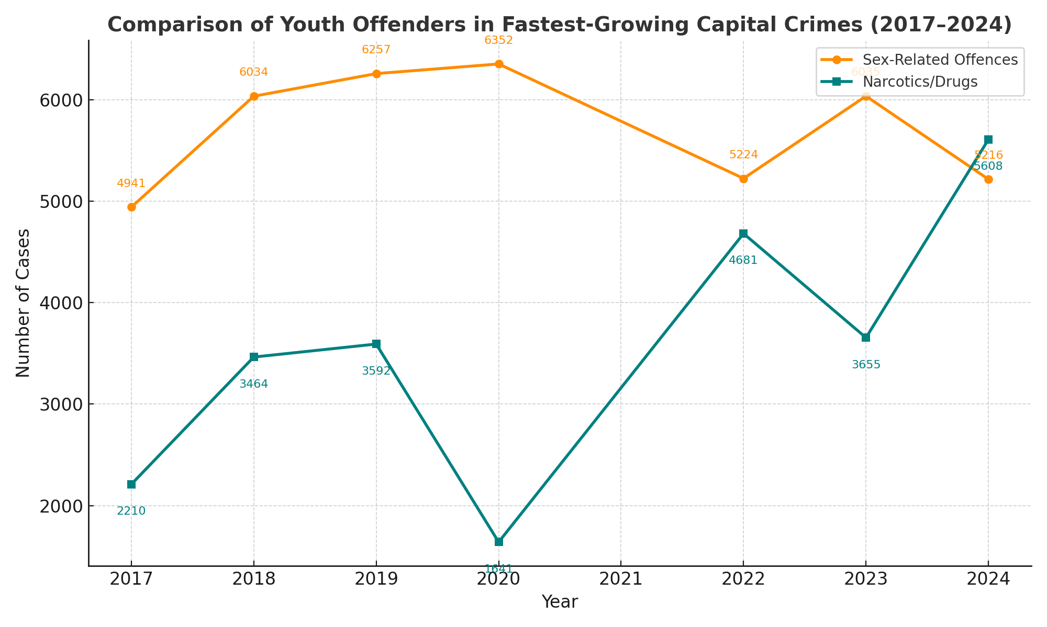
Comparison of Fastest-Growing Capital Crimes
Sex-related offences remain the highest category, with more than 5,000 cases annually, though slightly declining after 2020. (exploitation)
Narcotics offences are among the first growing crimes in Uganda cases nearly tripled from 2,210 (2017) to 5,608 (2024).
Sharp spike in 2022 and 2024 indicates growing exposure to drug markets, trafficking, and youth substance use.

Slide 13
Narcotic/Drug Cases: Charges vs Convictions
Charges continue to rise, while convictions remain significantly lower.
The persistent gap suggests weak investigations, limited evidence, and slow prosecution.
Highlights need for diversion, treatment, and strengthened rehabilitation services. ( Drug Courts-refer to treatment)
Underscores urgency for improved enforcement under the Narcotic Drugs & Psychotropic Substances Act (2024).

Slide 14
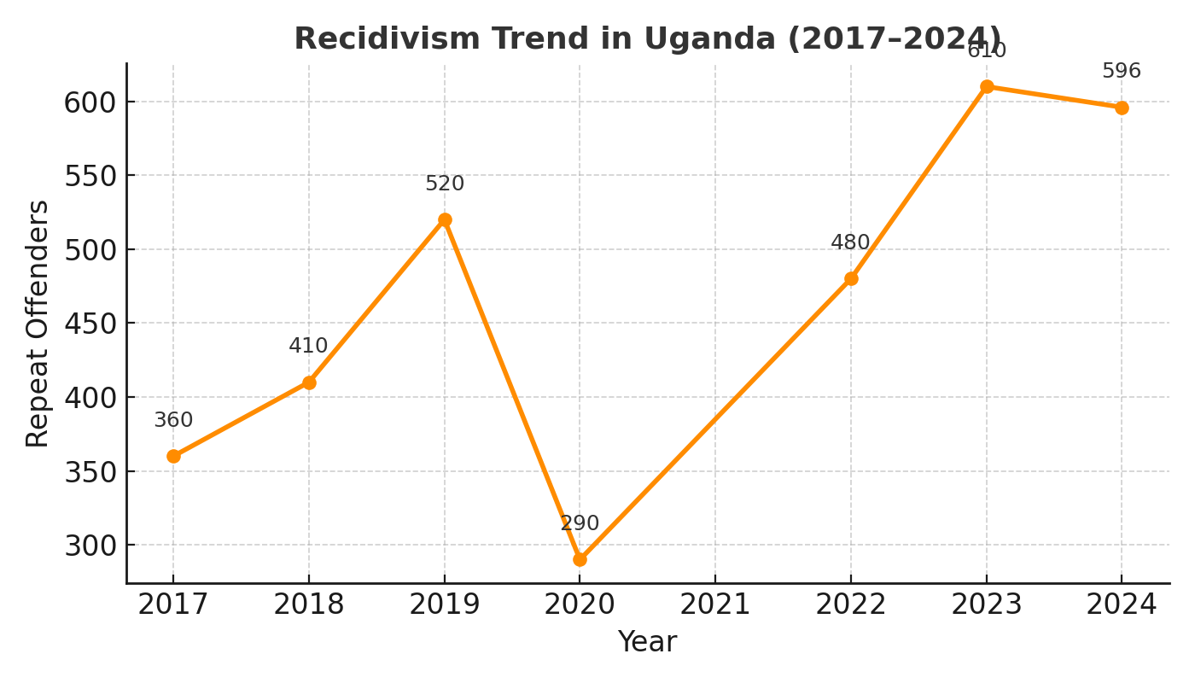

Slide 15
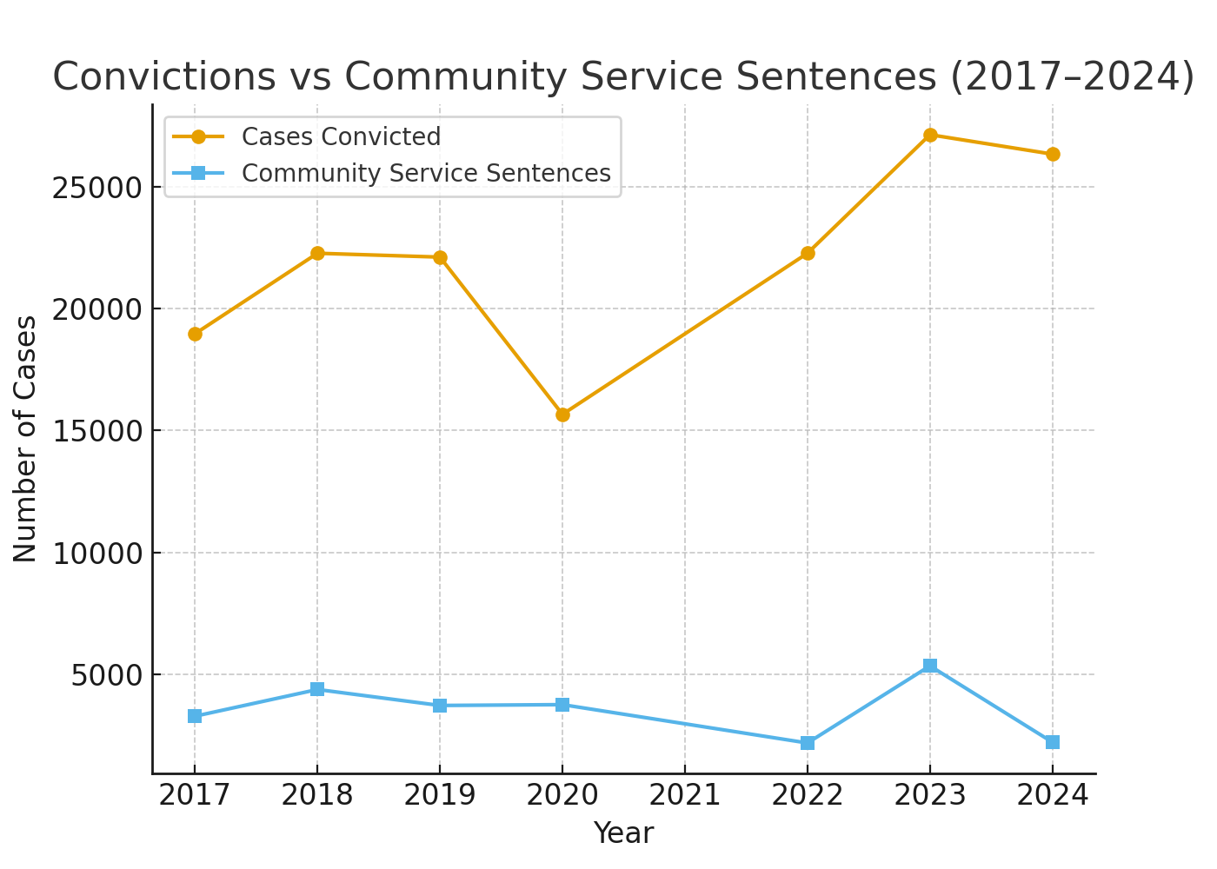

Slide 16
CSO work (UYDEL) and drugs among young people

Slide 17
CSO Role in Prevention & Response
Advocacy for rights-based drug policies.
Training in prevention practioners (UPC and UTC)
Community awareness & school prevention programs.
Sports outreach
Rehabilitation & psychosocial services (e.g., UYDEL, UAAPA).
Treatment (CSOs) adherence to standards is a problem.
Data generation and research to guide policy

Slide 18
UYDEL /UNODC Awareness & Sensitization Summary (Jan-Sept 2025)
Category | Male | Female | Total
Schools | 6,996 | 7,874 | 14,870
Community Sessions | 6,792 | 4,940 | 11,732
Overall Total | 13,788 | 12,814 | 26,602

Slide 19
Out-of-School & Community Engagement (Jan-Sept 2025)
Activity | Male | Female | Total
Community Policing Sessions | 4,141 | 2,617 | 6,758
Peace Ambassadors | 1,040 | 1,046 | 2,500
University Engagements | 290 | 310 | 600
World Drug Day | 341 | 294 | 635
World Day Against TIP | 356 | 144 | 500
Community Drama & Film Shows | 419 | 434 | 853
World Youth Day | 150 | 50 | 200
Vocational Skills Training | 55 | 45 | 100

Slide 20
Key Insights & Way Forward
Reached 26,602 participants with balanced gender participation
Schools remain the strongest platform for large-scale prevention outreach
Community sessions deepen engagement through policing and peer models
Integrated school–community approach strengthens sustainable prevention impact

Slide 21
Human Rights Implications of Drug Use & Control in Uganda
Human Rights Issue | Implication
Criminalization of drug users | Leads to overcrowded prisons, prolonged detention, and violations of dignity.
Limited access to treatment & rehabilitation and Absence of treatment standards/unregulated to (Public and CSO/ Private actors | Violates the right to health and perpetuates addiction and relapse
Double victimization of children | Children are punished as offenders despite being victims of exploitation
Gendered vulnerabilities | Increases sexual exploitation, GBV, and unequal protection for girls and women
Stigma & discrimination | Blocks access to health, education, justice, and social services
Weak enforcement of drug-control laws | Undermines state protection obligations and international commitments (UN-CRC and Conventions on Narcotics-1971
Inadequate youth-friendly mental health & diversion programs | Increases recidivism, school dropout, and long-term social harm. Escalates incidence of crime, puts pressure on justice institutions and staff burn out

Slide 22
Why these human rights issues matter
Overcrowded detention ( violates constitutional rights to liberty & humane treatment)
Treatment gaps fuel addiction, crime, and poor health outcomes
Failure to protect children breaches UN CRC and African Charter obligations/UN Conventions on Narcotics
Gendered harms deepen inequality & perpetuate exploitation
Justice gaps (charges vs convictions) erode public trust.
Lack of rehabilitation ( increased recidivism and community insecurity.
National duty to ensure rights-based drug policy remains unmet.

Slide 23
Harm Reduction: Benefits, Limitations & Uganda Policy Caution
Dimension Needle exchange, naloxone distribution, overdose prevention education, safer-use counseling, supervised consumption services | Benefits (Evidence-Based) | Limitations / Uganda Context
Public Health Impact ( | Reduces overdoses, HIV/STI transmission, and drug-related deaths | Limited implementation; weak integration with prevention and treatment
Human Rights | Promotes dignity, safety, and non-judgmental access to care | Concerns about child protection and community acceptance
Engagement in Care | Improves linkage to health and rehabilitation services | Stigma and low trust reduce uptake among youth
Legal & Policy Alignment | Complements rights-based drug policy approaches | Unclear guidance under national law; limited political support
Sustainability | Cost-effective when combined with prevention and treatment | Requires funding, trained staff, and strong oversight
Conclusion / Policy Caution | Harm reduction can reduce immediate health and rights harms | Uganda must apply caution to avoid normalizing drug use or undermining drug‑free environments, especially for children and youth

Slide 24
DOES UGANDA HAVE Tobacco and AN ALCOHOL BURDEN?

Slide 25
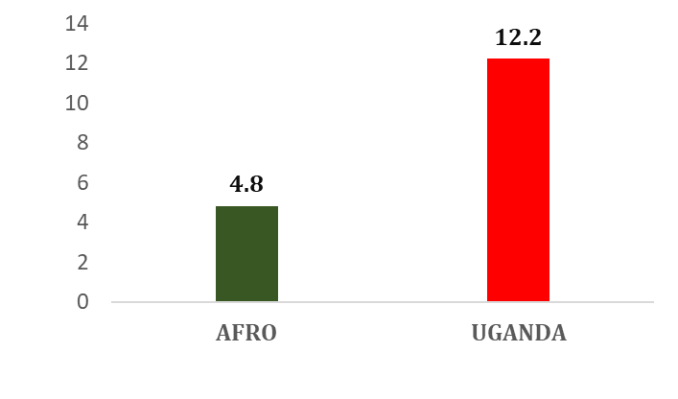
Uganda’s Alcohol Burden – Key Insights
High availability of cheap, potent alcohol –illicit alcohol
Youth exposure to unregulated/unrecorded products
Weak enforcement of alcohol-control laws
Rising health, crime, and social harms
Urgent need for WHO-aligned policy action

Slide 26
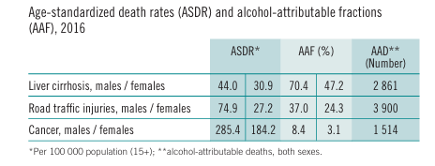
Contribution of alcohol to disease burden in Uganda- WHO, 2018
Deaths connected to alcohol
2861 of liver cirrhosis deaths
3900 of Road traffic deaths
1500 of Cancer deaths
ASDR across 4 major NCDs (Cardiovascular Disease, Chronic Respiratory Disease, Cancer and Diabetes) was 709 per 100,000 in males and 506 in females in 2021 (WHO, 2023).

Slide 27
What can be done to reduce alcohol related problems? (One main suggestion)
Most common
Sensitization -38.6%
Regulate alcohol use 25.7%
Tax more alcohol and
Suggestion | Freq. | Percent
Sensitization | 131 | 38.64
Regulate alcohol use | 87 | 25.66
Create more Job opportunities | 28 | 8.26
Ban factories (Some/all) | 21 | 6.19
Ban alcohol use | 20 | 5.90
Ban sales | 8 | 2.36
Increase Taxes | 8 | 2.36
Ban bars | 5 | 1.47
Religious Intervention | 4 | 1.18
Punitive measures | 3 | 0.88
Others | 10 | 2.93
Missing/Nothing | 5 | 2.47
Doesn't know | 9 | 2.65
Total | 339 | 100.00

Slide 28
Recommendations UHRC – Narcotics/Drugs & Substance Abuse
Enforce the Psychotropic and Narcotic Drugs (Control) Act, 2024, targeting trafficking, distribution, and emerging harmful substances.
Judicial review and approach on sentencing options for drug offenders ( Shift from punishment to protection.
Expand treatment and rehabilitation services, ensuring accessible, youth-friendly support across regions.
Strengthen school and community-based prevention, including awareness programs and early intervention for at-risk youth.
National strategy that address root causes through poverty reduction, youth empowerment, education, mental health, and psychosocial support. (MGLSD/Education/Internal affairs)
Tax more alcohol and use proceeds to do research prevention, rehabilitation
Promote diversion and community-based rehabilitation, improve law-enforcement capacity, and develop multisectoral, gender-sensitive prevention systems.

Slide 29
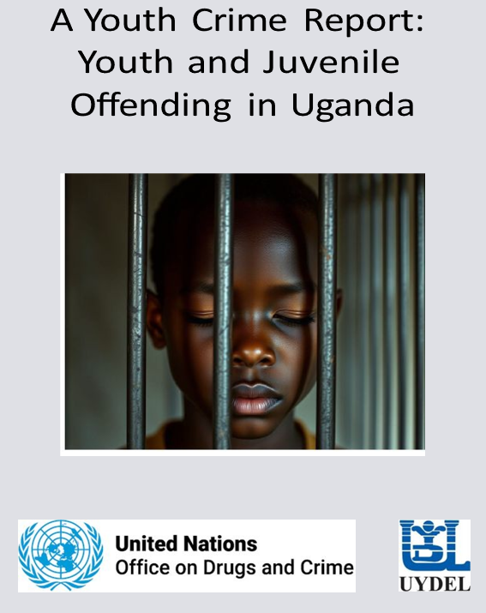


Juvenile and Youth Crime in Uganda…… 2017-2024

Slide 30
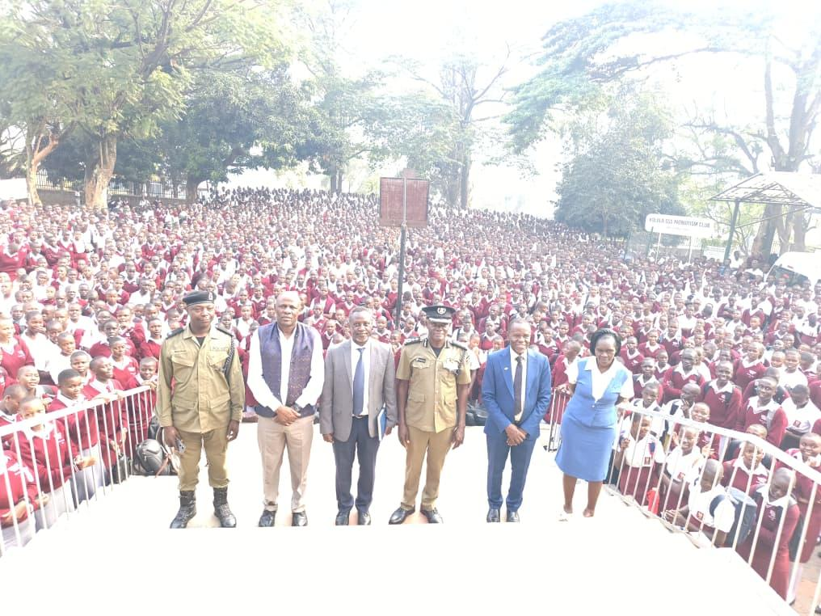

Slide 31
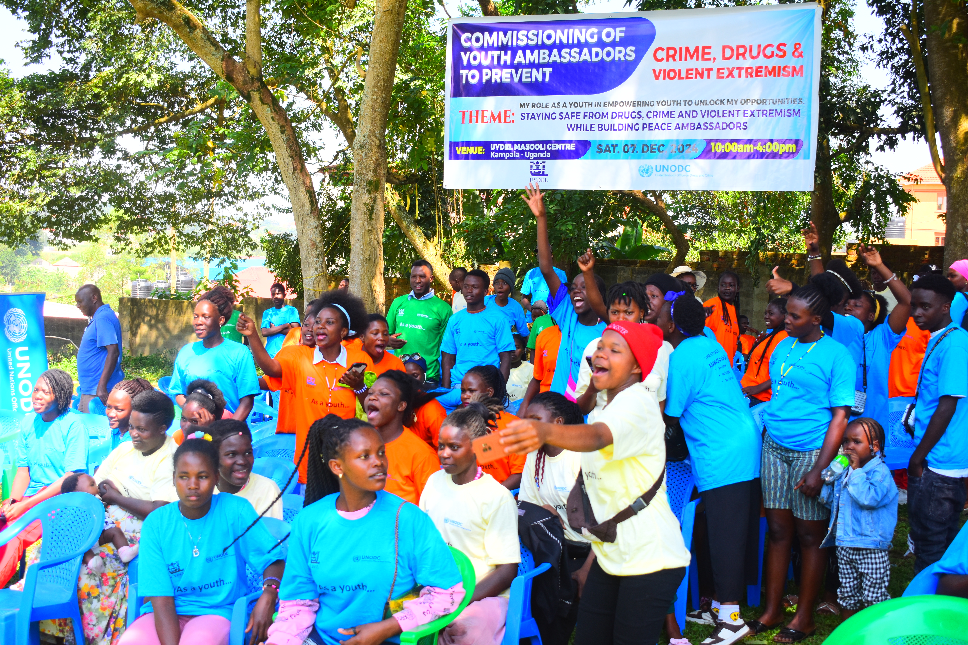

Slide 32
References
Kasirye, R., Katende, A, Mutawe.,R, Serunjonji, U., Nakijoba, B., & Nsonga, G. (2024). Youth crime in Uganda, 2017–2024: Trends, determinants, and policy imperatives. Uganda Youth Development Link (UYDEL).
Mbeta, E. (2023). P93 The burden of non-communicable diseases and attributable risk factors in Uganda from 1990–2019: A Global Burden of Disease 2019 Study.
Aber-Odonga, H., Babirye, J. N., Engebretsen, I. M. S., & Nuwaha, F. (2024). Prevalence of probable substance use disorders among children in Ugandan health facilities. BMC public health, 24(1), 314.
Naimi TS, Ross CS, Siegel MB, DeJong W, Jernigan DH. 2016. Amount of televised alcohol advertising exposure and the quantity of alcohol consumed by youth. J. Stud. Alcohol Drugs 77:723–29
Kabwama, S. N., Matovu, J. K., Ssenkusu, J. M., Ssekamatte, T., & Wanyenze, R. K. (2021). Alcohol use and associated factors among adolescent boys and young men in Kampala, Uganda. Substance Abuse Treatment, Prevention, and Policy, 16(1), 49.
Namara, E. 2020. In Uganda, Addiction Treatment Is a Privilege Few Can Afford (globalpressjournal.com)
UNFPA World Population Dashboard -Uganda | United Nations Population Fund (unfpa.org)
Kaggwa, M. M., Harms, S., & Mamun, M. A. (2022). Mental health care in Uganda. The Lancet Psychiatry, 9(10), 766-767.
Tumwesigye, N. M., Kyomuhendo, G. B., Greenfield, T. K., & Wanyenze, R. K. (2012). Problem drinking and physical intimate partner violence against women: evidence from a national survey in Uganda. BMC public health, 12(1), 1-11.
Nazarius Mbona Tumwesigye¹, Vincent Mubangizi², Wilber Karugahe³, Agnes Napyo⁴, Sam Maling², Aggrey Mukose¹, Catherine Gitige¹, Mary Mbuo⁵, Cissie Namanda¹ and Merlin Willcox⁵. HARMFUL USE OF ALCOHOL IN A RURAL SETTING: A Pilot study around Lake Bunyonyi in Kigezi Sub-region, Uganda – Conference presentation- Glasgow June 2025

