Slide 1
Health and Labour wellbeing Program
“To live without addictions in the workplace”
Carmen Fernández Cáceres
General Director of Centros de Integración Juvenil

Slide 2
Drug use and job performance
70% of employees use alcohol and/or other drugs; their job performance is 30% lower.
Up to 54% of alcohol-related incidents are attributed to occasional use and 87% of occasional and moderate use.
  10% of accidents in the workplace occur in personnel who depend on tobacco, alcohol or other drugs, or are intoxicated at the time of the accident.
  Those who consume alcohol or other drugs have 3 to 4 times more absenteeism, request 3 times more incapacity and receive 5 times more disciplinary sanctions.
(STPS, 2018; OIT, 2012)

Slide 3
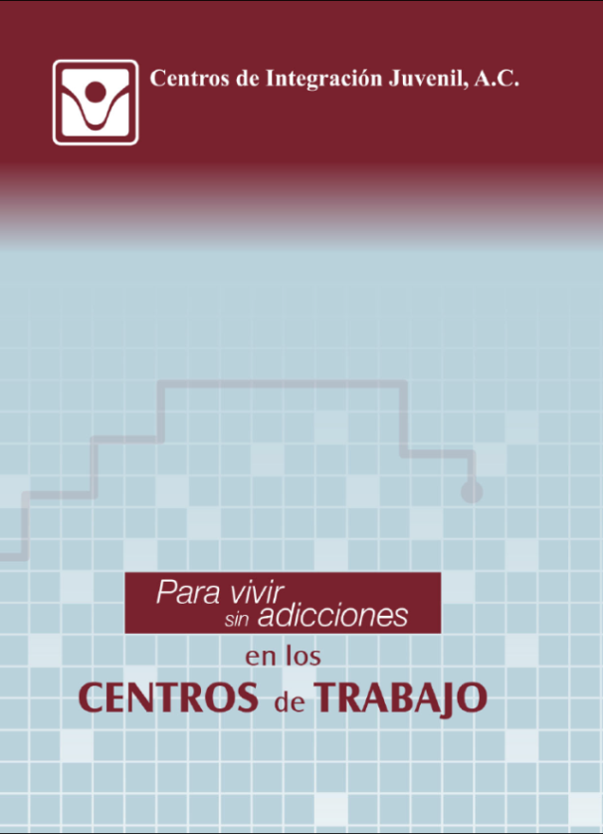
Labor Prevention Program
“To live without addictions in the workplace”
Objective:
Promote healthier, safer and more harmonious workplace environments, free of alcohol, tobacco and other drugs, through the development of emotional, social and labor skills and competencies.
Aimed at:
Directors
Labor Unions
Health and Safety Committees
Health care personnel
Employees
Their families

Slide 4
Labor Prevention Program
“To live without addictions in the workplace”
Strategies
Awareness-raising Information sessions
Preventive Workshops
Psycho-educational workshops for the development of emotional, social and labor competencies
Training and education of strategic personnel
Activities for parents
Topics
Consequences of alcohol consumption at work: Preventive alternatives
Tobacco use and Environmental Tobacco Smoke (ETS)
Marijuana: Risks and effects on laboral life
Responsible handling of inhalable solvents
The danger of non-prescription drugs
Work stress. Risks and consequences
Violence in the workplace: What is workplace harassment?
Healthy practices at work
Emotional intelligence and job performance
Healthy workplace practices: Sleep, nutrition and physical activation
Social and emotional skills at work

Slide 5




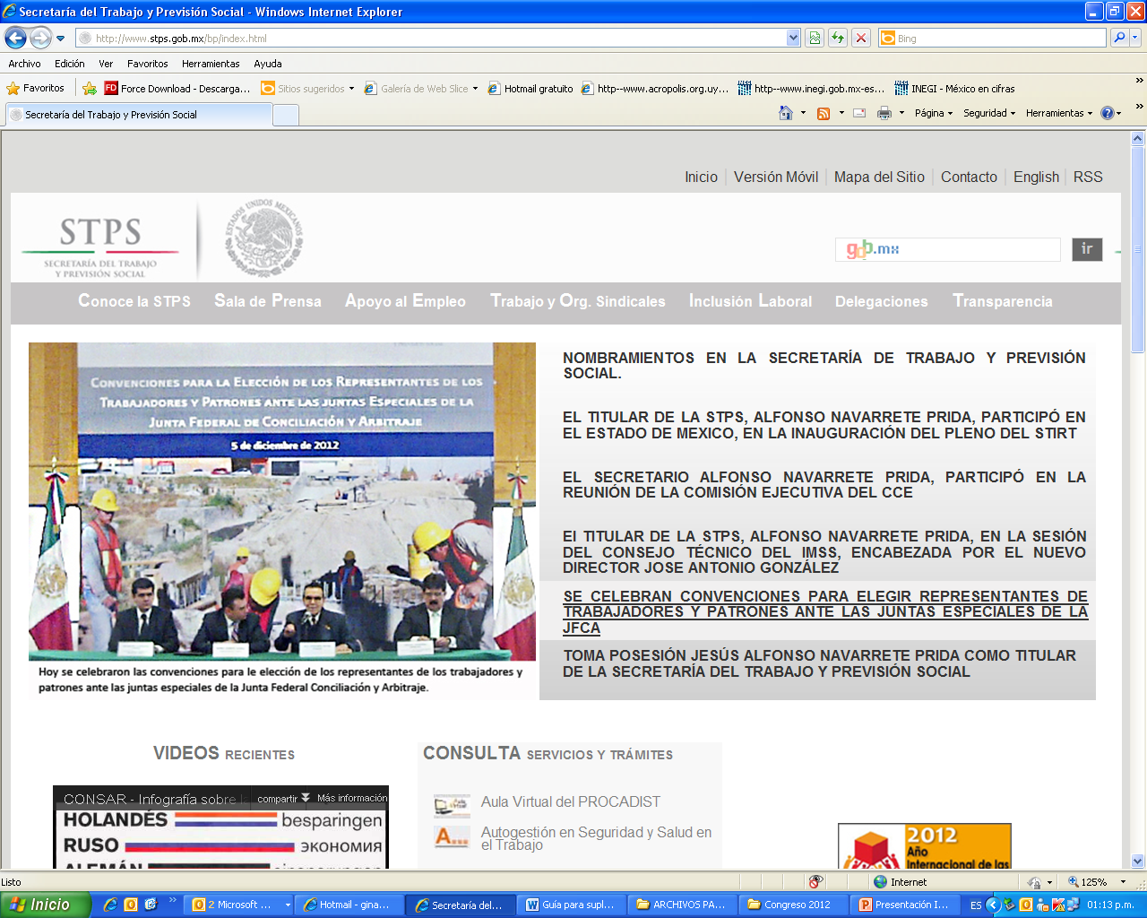






















Annually, we work with :
+1,000 workplaces
+ 300 thousand employees

Slide 6

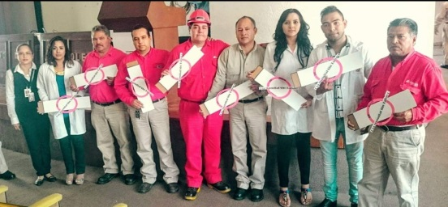
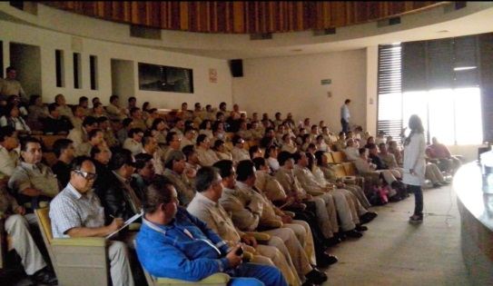
Case Study: Mexican Petroleum (PEMEX)
​​Mexican Petroleum is a producer, transporter, refiner and marketer of oil and natural gas in Mexico. It is the largest and most important company in Mexico.
It has around 600,000 employees nationwide.
Collaboration agreement since 2003.
In the area of prevention, psycho-educational workshops, human resources training and education, preventive workshops.
Summer courses for employees' children.
More than 100 thousand workers have been reached with prevention actions.

Slide 7
Case Study: Mexican Petroleum (PEMEX)
In the area of treatment, PEMEX workers and their families are provided with professional care services for substance abuse and other mental health problems.
How does patient referral works?
PEMEX has its own Medical Units, where drug abuse cases are detected and referred to CIJ.
The National Mental Health Coordination of PEMEX, together with the Interinstitutional Coordination of CIJ, manages the admission of patients either to the Hospitalization or Outpatient Units (according to the severity of the case).
Care in the CIJ Hospitalization Units ranges from 30 to 90 days, in Outpatient Care is determined based on the treatment plan.
During their stay, weekly reports are prepared, which are requested by PEMEX.
Follow-up is performed at 3, 6 and 12 months after outflow of patients.

Slide 8
Patients attended per year
 | Outpatient Consultation | Hospitalization | Total
2016 | 16 | 17 | 33
2017 | 62 | 23 | 85
2018 | 58 | 28 | 86
2020 | 0 | 1 | 1
2021 | 1 | 2 | 3
Total |  |  | 208
PEMEX immediately integrates its workers back to work, once they have completed their recovery process.

Slide 9

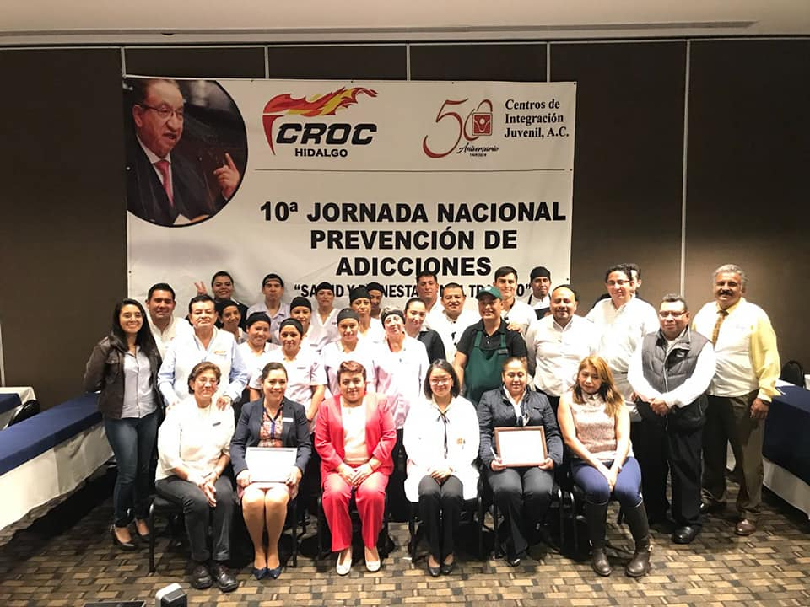
Study Case: Revolutionary Confederation of Workers and Farmers
The CROC (acronym in Spanish) is a labor union that unites 5.5 million workers distributed in 32 States. In addition, it has 17 National Industrial Federations by branch, as well as 3,600 local, national and company labor unions, with which it has 15,000 collective contract agreements. It is one of the largest and most important unions in Mexico.
Collaboration agreement since 2008.
Prevention, detection and referral of cases
to treatment with their members.
More than 1 million members and their families have benefited from prevention actions.

Slide 10

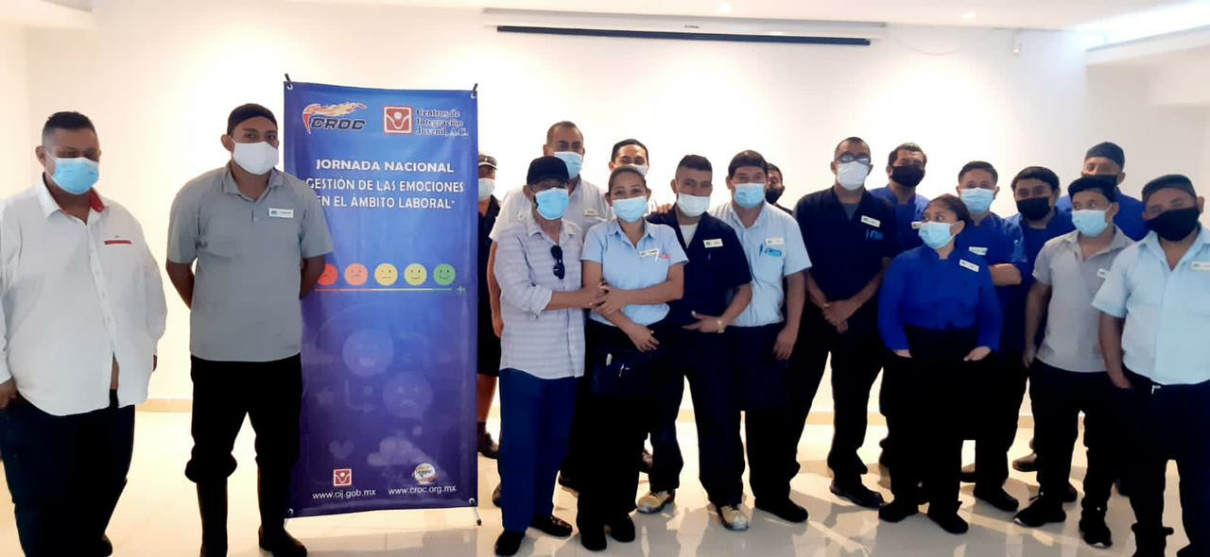
Case Study: Revolutionary Confederation of Workers and Farmers
Each year a National Preventive Program is held for a month, in which, through conferences, workshops, stands and health fairs, prevention and healthy activities are carried out on a specific topic, in order to increase the perception of the risk of drug use and the factors associated with drug use in a company.
Summer courses are offered to the children of CROC members.
CIJ participates in its CROC TV program with informative spots on addictions, which are transmitted online to its members.

Slide 11
Benefits
Short-term
Decrease in drug use in the workplace and in the company's environment
Reduction of the possibility of employees coming to work under the influence of a toxic substance
Decrease in work activities performed under the effects of abstinence
Decrease in consumption-related work accidents
Long-term
Increase productive plant life expectancy
Increase healthy life years for workers
Reduction in the incidence of diseases related to drug use and abuse
Satisfactory work environment and greater corporate security

