Slide 1
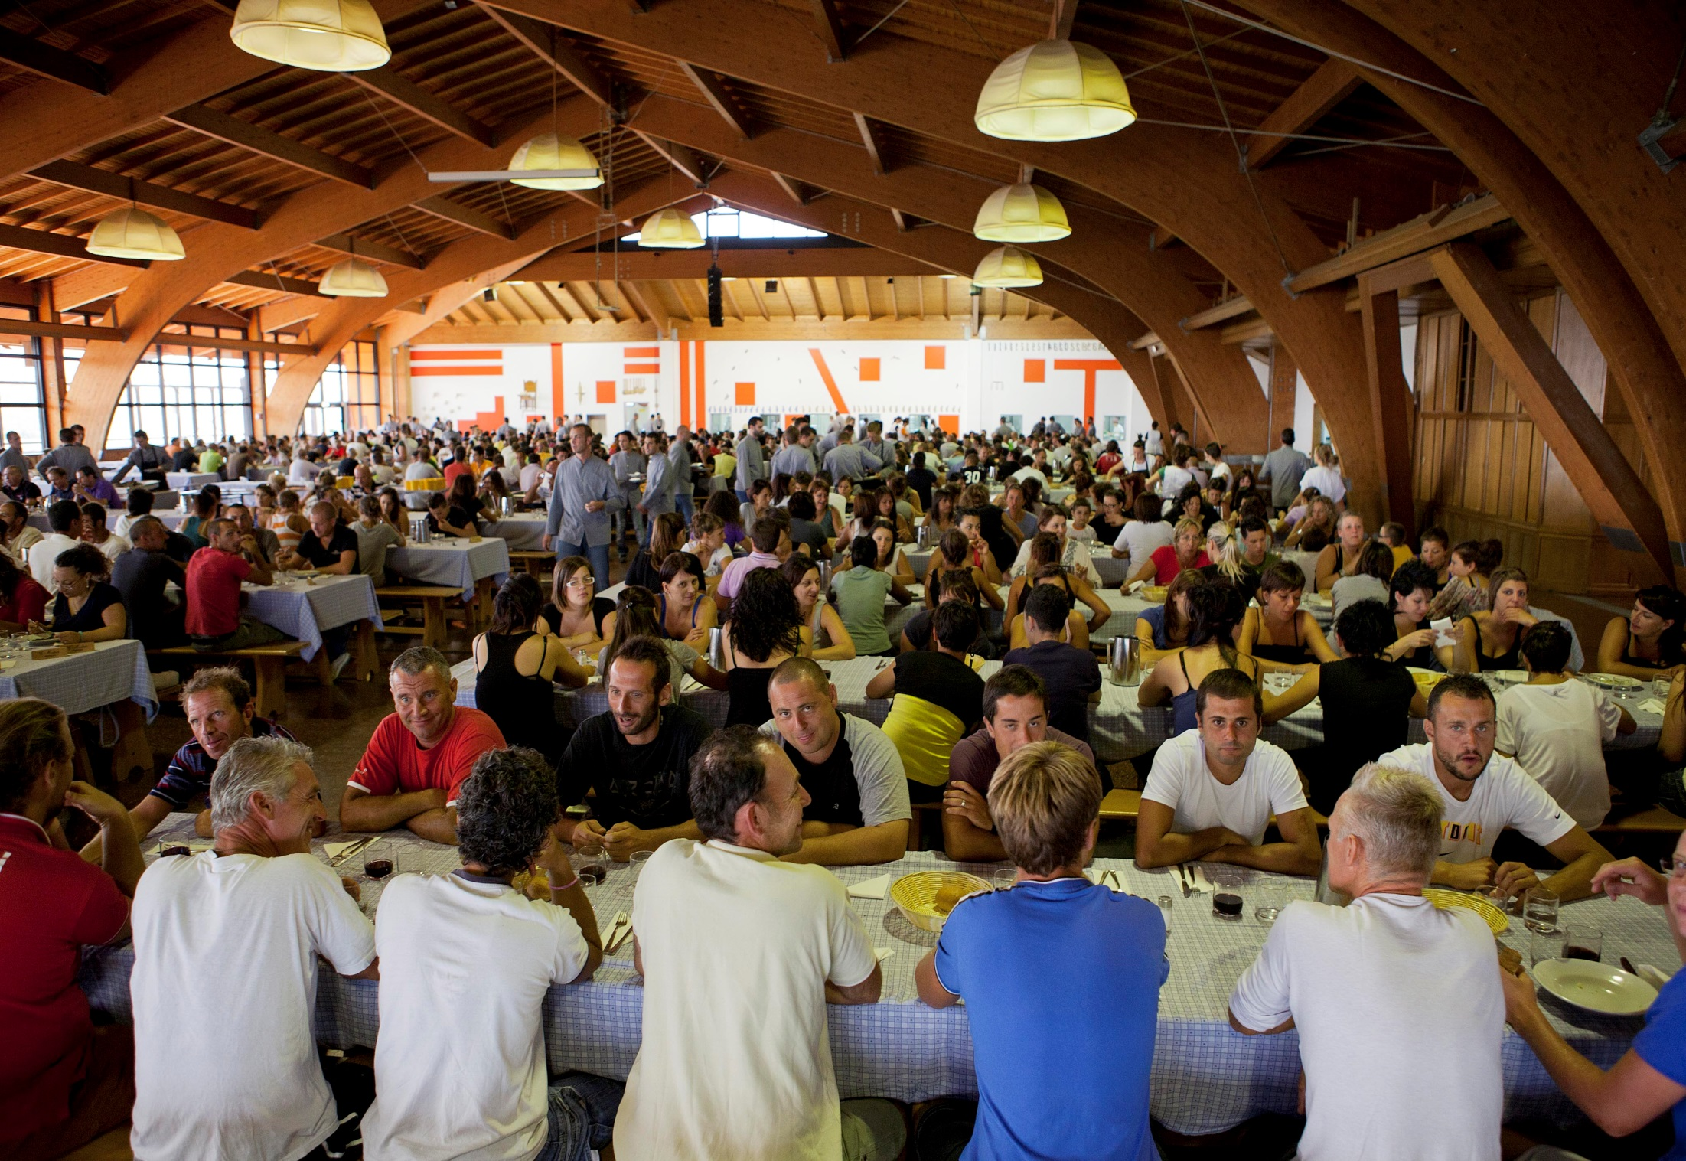
Recovery Ready Workplace
San Patrignano experience
October 26, 2021
Notes:
It’s a place totally immersed in the «external» society, a constant interaction guide our choices.

Slide 2
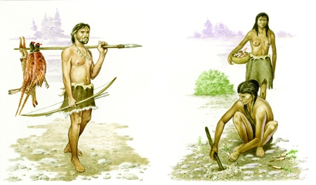
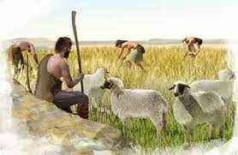
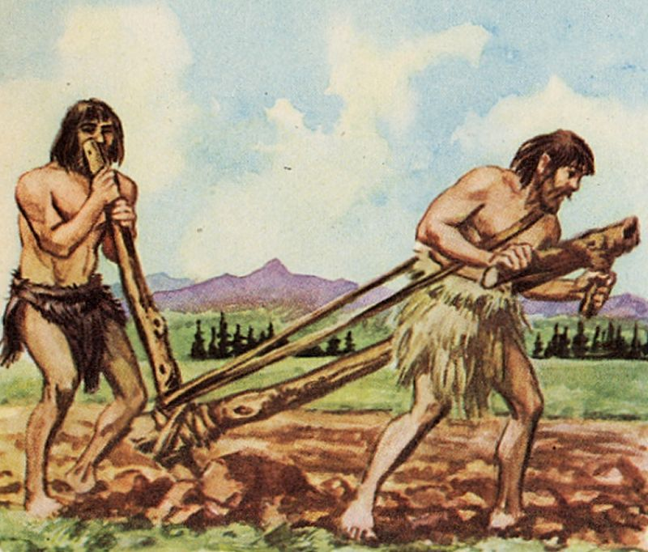
Work and human beings, work is being human
Notes:
Humanity has always strived for survival, and throughout history, the nature of work has been based upon a need to solve societies sustenance problems, such as how to provide clean water and food, shelter, medication, education, trade, entertainment and defence.

Slide 3
“Research shows that physical and mental health are adversely affected by lack of work. You are more likely to suffer from obesity and depression, for example, if you are unemployed. This may be linked to another good that work helps to provide: self-esteem.”
Health, the exercise and development of skills and capacities, self-esteem based on the recognition of one’s achievements, a sense of social connectedness and exposure to the demands of cooperation are some of the intrinsic goods associated with working life that are imperilled by lack of work.
Benefits and dignity of work
https://theconversation.com/a-philosophers-view-the-benefits-and-dignity-of-work-829
Notes:
domestic terrorist attacks - disillusionment of young people who had believed in changing the world in '68 - drug use that started as an opposition to the system becomes something else, an heroin epidemic

Slide 4
…continued
Work is a tool that builds identity. The professional choice and the relative
training pathway is certainly a central aspect of an individual's
"construction of self". It is a choice in which the rational level is strongly
intertwined with the more unconscious level of feelings of identity,
imaginary representations of future work and the related intimate personal
expectations.
Journal of Advanced Health Care
https://jahc.eu/jahc2003-003/
Notes:
Institutions were not prepared – mental health centres – prisons – psychiatric clinics – psycho-pharmaceutical and later methadone

Slide 5
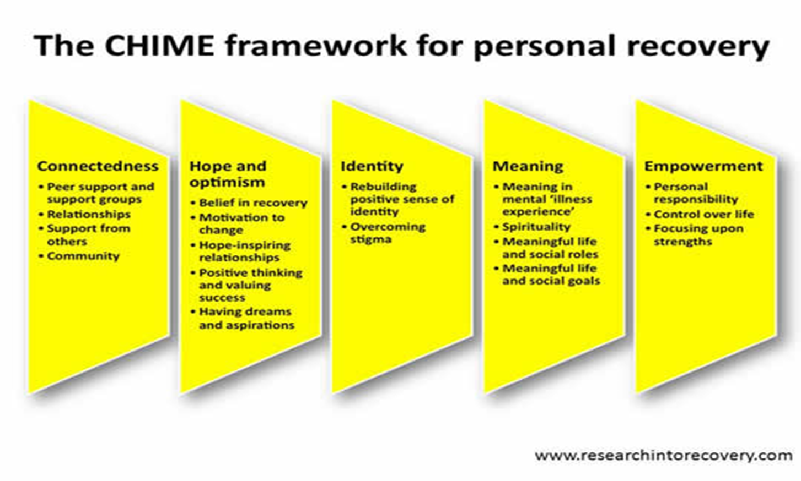

Slide 6
Work leave for SUD
In Italy, according to the current law, art. 124, D.P.R. n. 109/90, workers with SUD who intend to enter therapeutic and rehabilitation programmes are entitled to keep their job for the time necessary for rehabilitation treatment.
The duration of unpaid leave varies according to the duration of the personalized therapeutic program, but must not exceed three years.
The right to unpaid leave, with job retention, is also granted to workers who are members of the family of a drug addict, in order to contribute to the therapeutic and socio-rehabilitation program of the addict, if it is proved to be necessary.

Slide 7
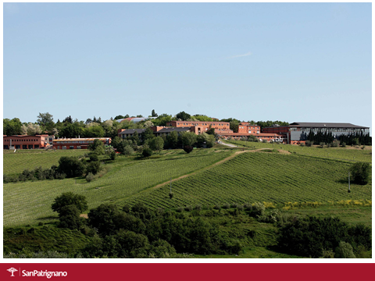

Slide 8
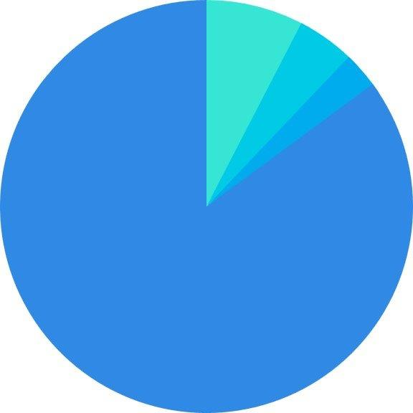
Regularly employed 7.6%
Unregulated job 4.5%
foto
Enrolled students 2.8%
Unemployed 85.1%
Work situation at the time of the admission at San Patrignano
*Sample of 1320 residents, from 14 to 56 years old, 18% women, 82% men (2017)
Notes:
We can see that it is fundamental to offer education and vocational training opportunities, to any age (14 to 56), any social class, any health condition

Slide 9
Work at San Patrignano
“The SP Community is a micro-society[…] where we can train to face the future impact with the macro-society . For us, working is a way to get passionate about life, a way to rediscover interests and enthusiasms, to get used to having relationships with other people. The daily work, providing us with professional skills that give us self-awareness and consciousness of our possibilities, it is a starting point for an economically independent and dignified life”. V. Muccioli

Slide 10
Some key figures of San Patrignano
26,000 people helped since its foundation in 1978
300 hectares, with vineyards, housing facilities, craft and food laboratories and farm houses
40 activities and vocational training opportunities
350/400 new admissions every year
250/300 residents leaves the community at the end
of the program every year
72 % the success rate evaluated by independent studies
0 euros payed by residents and their families

Slide 11
Addressing special needs with tailor made programs
Women, girls and mothers: 4000 women, 1300 mothers with their kids
Adolescents: 550 minors since 1979, currently around 30 minors (male and female) with ad hoc programs
People in conflict with law: 4050 people in conflict with law, more than 4000 years of jail converted into rehabilitation programs
People with health issues: 3.000 people with HIV/AIDS and more than 15.000 people with Hepatitis C welcomed without any discrimination (recently, we totally eradicated HCV within the community as indicated by the SDG30)
Affected families: 40 volunteer associations: counseling and referral for drug addicts and assisting more than 3,500 families, contacting prisoners that want to enter in the program. Facilitating social reintegration of former residents upon completion of the program
Notes:
Since 1978, we have welcomed around ………………Legal assistance and counseling are provided to solve legal issues related to child custody, in the best interest of the child. Parenthood support and parenting programs are available
Two separate centers for female and male minors with problems of addiction and marginalization. The recovery program is tailored to respond to teenager needs: nurturing their talents, stimulating personal growth, investing in education and job training
Always mobilizing our best resources to provide the best quality of life and the best opportunities of care.

Slide 12




What we do to favor social reintegration during the recovery process
Formal education Vocational training
Traineeships
Vocational guidance
Social reintegration

Slide 13
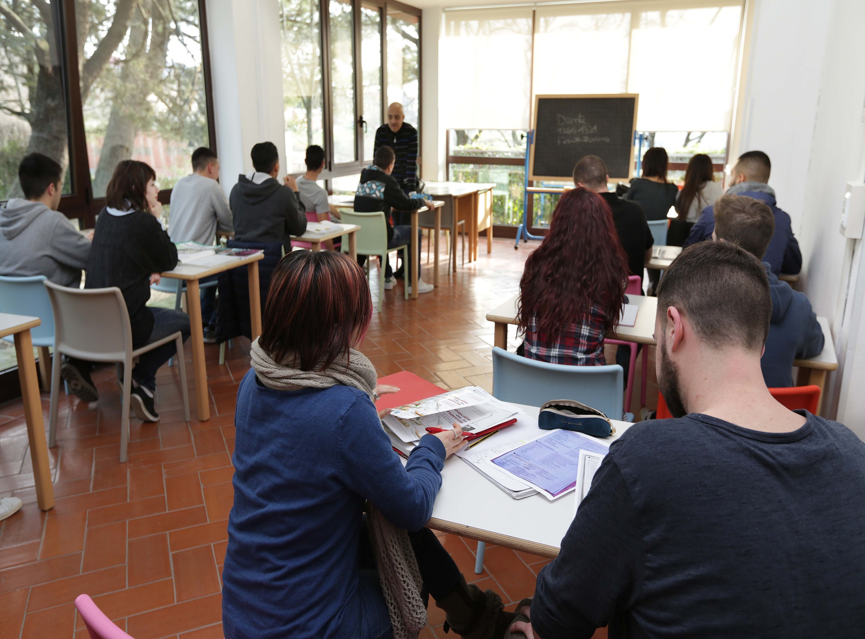
The study centre: middle and high school and also University.
More than 2,000 students since 1989
Notes:
We have three lines of studies that are implemented in agreement with the ministry of education: social services, catering and hostelry, dental technicians. Those who want to attend University, can also take university courses online and take their exams here, as we are an examination centre for our area.

Slide 14
Vocational trainings in 2019 and in 2020
They are funded by Emilia Romagna Region, EU Social Fund,
National Funds for Youth, Private Foundations and
companies
2019 Number of people involved in different courses: 170
2020 Number of people involved in different courses: 114
2019 Total amount of class hours: 4.170
2020 Total amount of class hours: 3,400
2019 Total amount of practical training hours: 1.644
2020 Total amount of practical training hours: 1,504
2019 Number of different courses: 10
2020 Number of different courses: 7
2019 Paid traineeships: 63 people
2020 Paid traineeships: 45 people

Slide 15
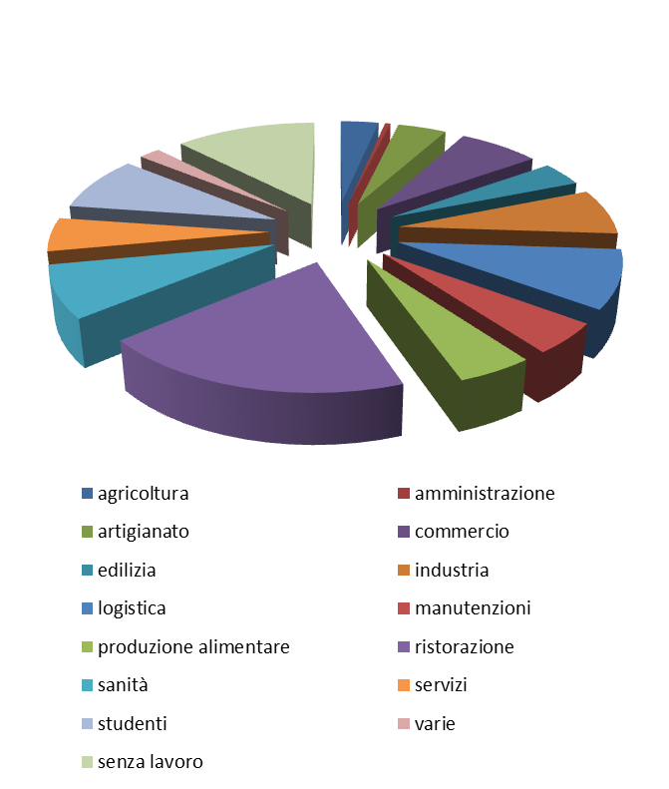
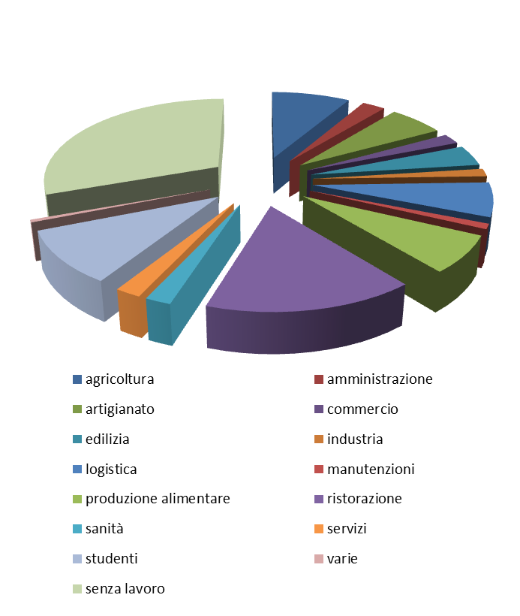
Social reintegration and Covid - 19
2019
2020
agriculture
crafts
construction
logistics
food production
healthcare
students
unemployed
administration
trade
industry
maintenance
catering
services
various
agriculture
crafts
construction
logistics
food production
healthcare
students
unemployed
administration
trade
industry
maintenance
catering
services
various
Notes:
The pie charts show the differences and the consequences of Covdi-19 in the social reintegration

Slide 16
Courses and trainings
Guidance and information activities in support of training and individual work
Labor integration and the activation of apprenticeships in the transition to work
Warehouse and Inventory Specialist
Baker
Sales and Marketing Professional
Sales and Merchandizing Professional
Horticulturist
Meat Processing and Butchery Technician
Printing professional
Graphic Designer

Slide 17
  Dairy Processing Professional
  Blacksmith and Machinist Certification
  Pizza Chef
Hand Printed wallpaper professional
Clothing and Apparel Professional
Make-up Artist
Health Care Professional
Landscape Professional
Electrical systems installation and solar panel Technician
Cooks Certificate in Professional Cooking
First and Second level Shiatsu Professional
Leather Goods Technician
Italian Course for International Residents
Course in Movie and Video Production
Hair stylist

Slide 18
Challenges for the future
Sustainability: 33 to 36% donations and 67 to 63% from our activities
The need to keep on providing employable up-to-date vocational training and/or academic education in addition to a therapeutic pathway .
Keeping the founding principles and ideals intact, and maintaining a balance between the therapeutic mission and the social enterprise

Slide 19
Thank you for your attention!
For further questions mbarzanti@sanpatrignano.org

