Slide 1


Slide 2
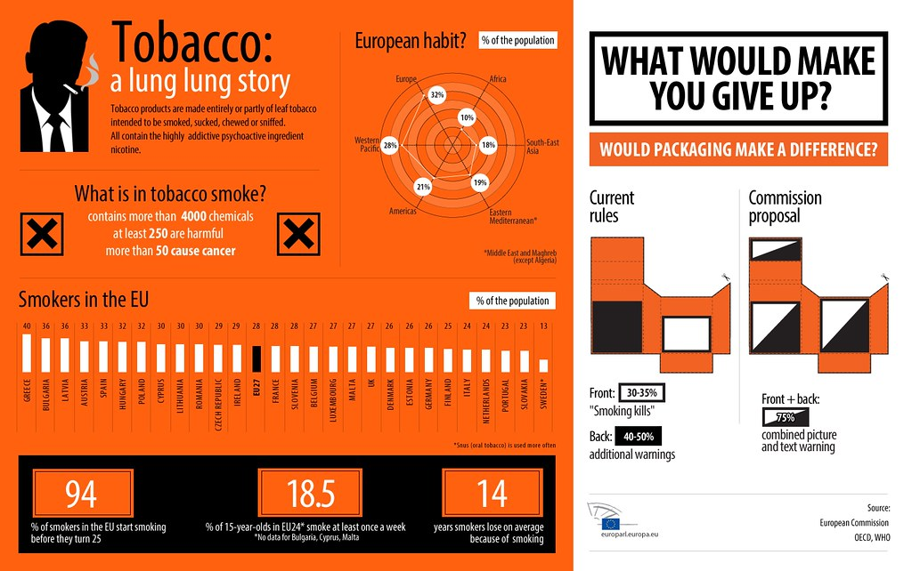

Smoking and Prevention
My Questions:
Why do people start given all the
evidence, information, knowledge, risks, etc.?
Why do people continue to smoke
in spite of what we know about the risks?
Can we PREVENT start up and intervene on use?
If so, how and what do we need to consider?
This Photo by Unknown Author is licensed under CC BY-NC-ND

Slide 3




Prevention - what do we mean?
Usually…..
Stop something happening
A negative message about NOT doing things
But……..
People do not like being told what not to do!
Does the “stop, don’t start” message work?
This Photo by Unknown Author is licensed under CC BY-NC

Slide 4
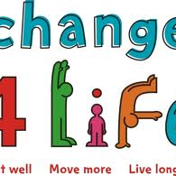
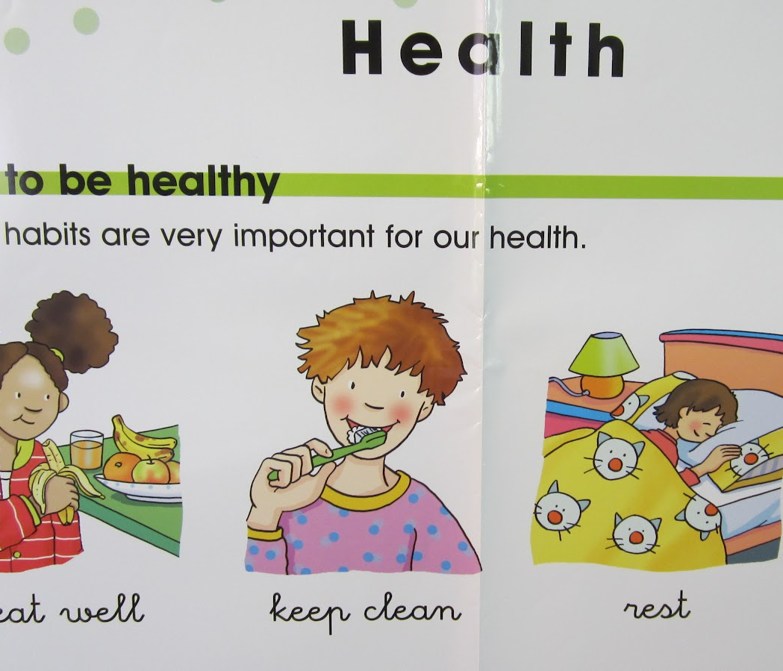

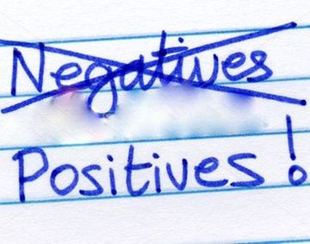
The positive side of the Prevention coin
Promote health and well-being –
positive message concerned with (healthy) behaviour
Can one achieve health and well-being as well as smoke?
Healthy behaviour = Smoking?
So prevention has a positive “do” role as well as a negative “don’t” message.
This Photo by Unknown Author is licensed under CC BY-NC-ND

Slide 5
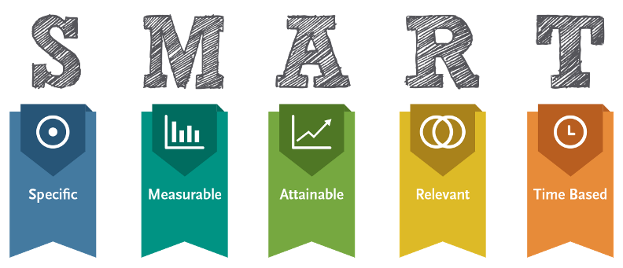



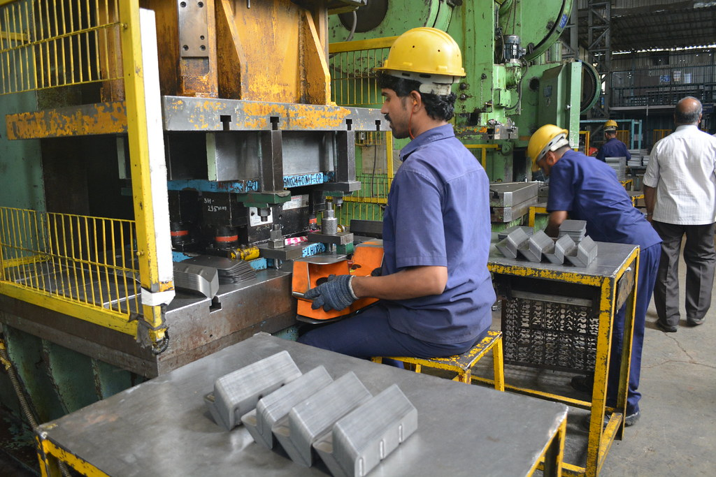


Key considerations for prevention/health promotion
Objectives – clear, specific, achievable
Setting/Influential areas of provision:
  School
  Workplace
  Family
  Community
  Media
  Environment

Slide 6


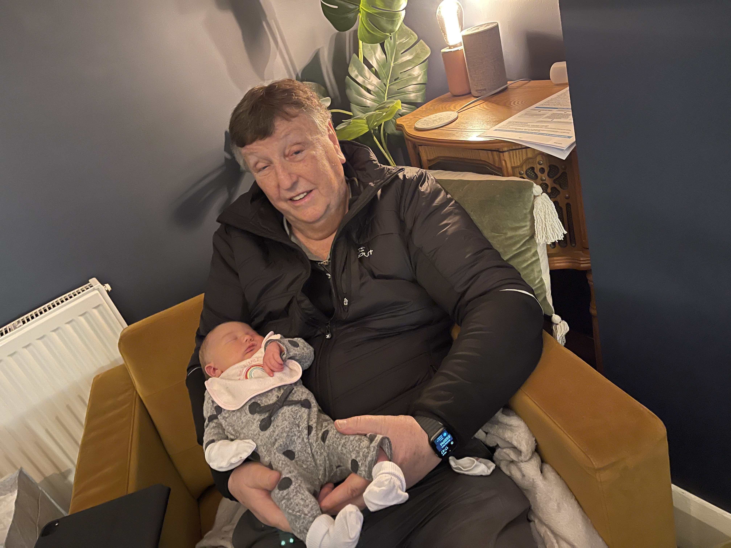

Target Group
  Universal
  Indicated/Selective
  Young pre-use
  Experimentation
  Older age groups

Slide 7


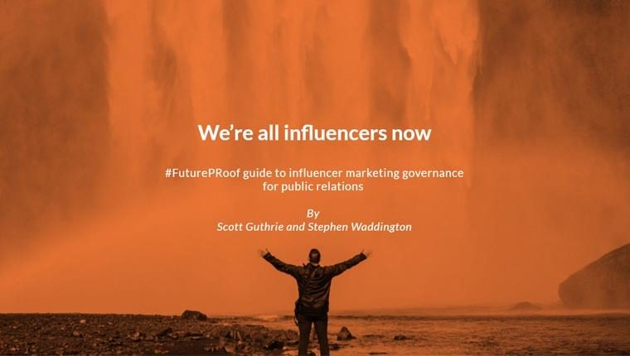
Smoking Prevention
Providers and Influencers
  Providers
  Health professionals
  GPs
  Teachers
  Parents
  Community Leaders
  Decision makers/opinion formers
  Influencers ( Good or Bad?)
  Industry
  Media
  Example
  Laws
  Finances - tax, cost, personal economics, (£9.10 for 20 a day = £63.70 a week = £3,312.40 a year)

Slide 8

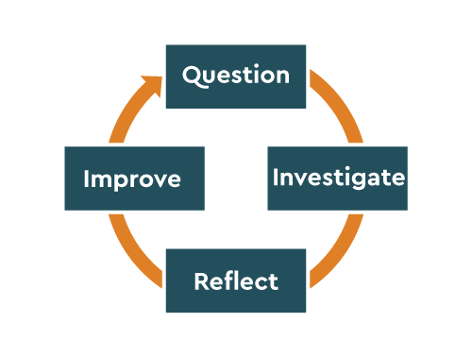
Evaluation and Training
Does prevention work?
Yes, but…..
Need for evaluation of the clear objectives, target group, setting etc.
Prevention does work - if done properly!
International Support - UNODC, EMCDDA, EDPQS, UPC , INEP, etc.
And the need for…..
Training
  Who?
  What?
  How?

Slide 9
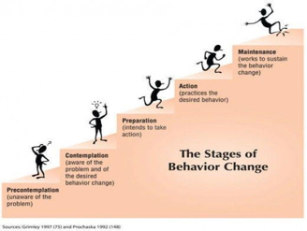

Issues for Smoking Prevention
How far should we focus on “smoking” and how far on a more generic approach to preventing substance use and promoting healthy behaviour?
Information necessary but not enough on its own
Be realistic: Is there time and opportunity to focus on the wide range of health and behaviour issues in certain settings eg school, workplace
or

Slide 10
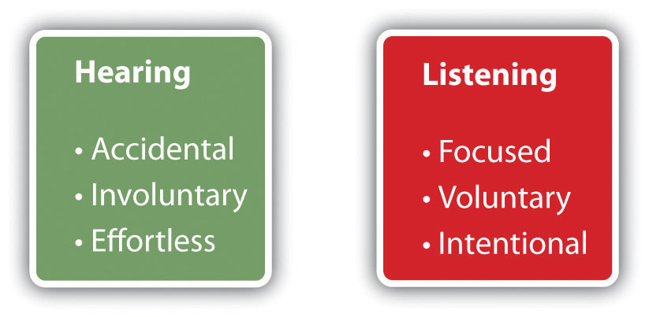
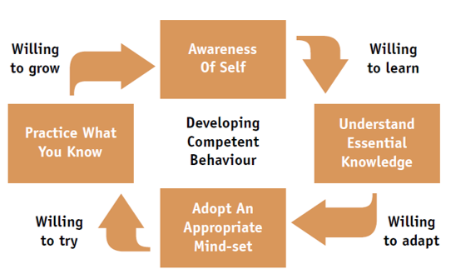
Issues for Smoking Prevention
(contd.)
Is it about addressing the skills, competencies and related issues that effect healthy behaviour?
+ Relevant content?
How can we communicate effectively to different groups to meet different needs?

Slide 11
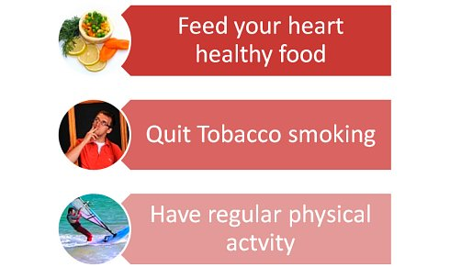
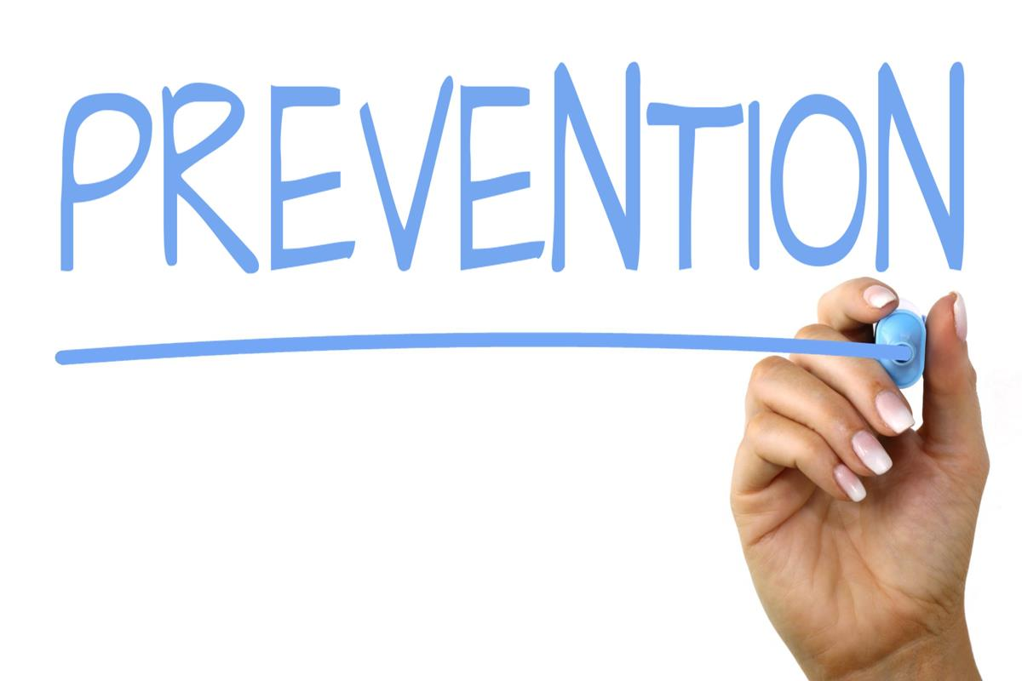
Prevention can and does work!
Effectiveness of program Unplugged for drug use prevention among Slovak schoolchildren: Olga Orosova
M Kulanová, O Orosová European Journal of Public Health, Volume 27, Issue suppl_3,November 2017, ckx189.146, https://doi.org/10.1093/eurpub/ckx189.146 20 October 2017
Unplugged https://www.emcdda.europa.eu/html.cfm/index52035EN.html?project_id=IT&tab=overviewUnplugged is a school-based programme based on the comprehensive social influence approach, targeted to adolescents 12-14 years old and aimed to reduce the initiation, the use and abuse of tobacco, alcohol and illicit drugs. The programme has been evaluated in a large European collaborative randomised controlled trial (EU-Dap), conducted in seven European countries between 2004 and 2007. The effectiveness evaluation showed that the programme is effective at 3 months follow-up in preventing cigarette use, drunkenness episodes and use of cannabis among 12-14 year old students. The effect on drunkenness and cannabis is maintained at a 1 year follow-up.
https://www.issup.net/knowledge-share/resources/2020-09/webinar-school-based-prevention-programs-adolescents-unplugged
This Photo by Unknown Author is licensed under CC BY-SA

Slide 12
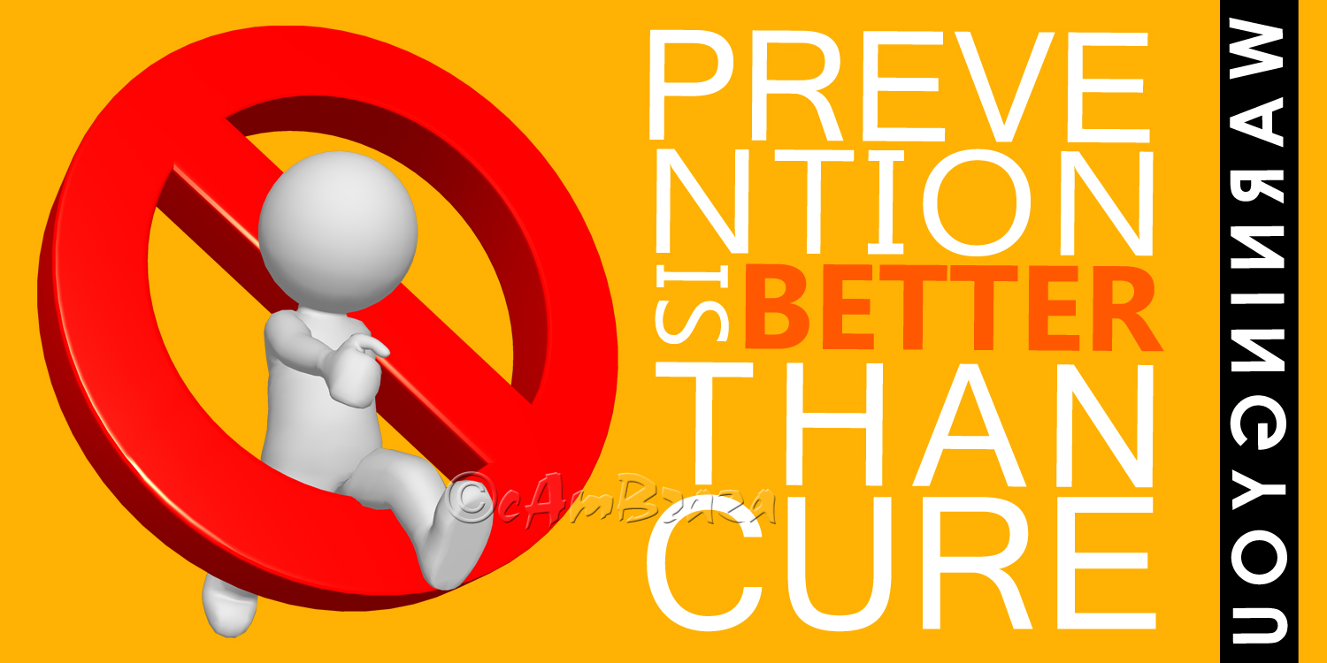
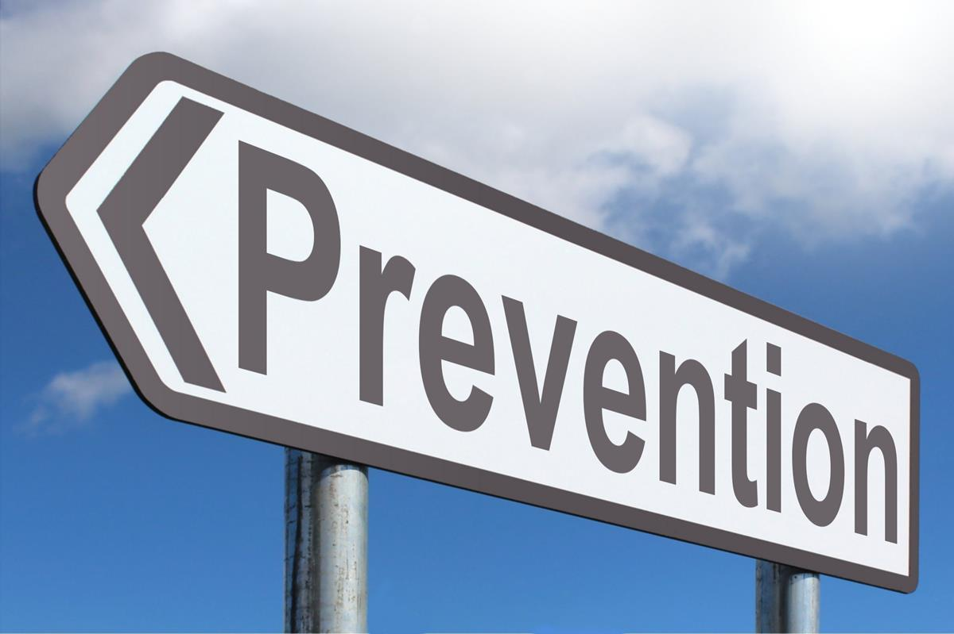


The Prevention Map
What is the Prevention Map?
In process – providing access to prevention and training
Best practice portal https://www.emcdda.europa.eu/best-practice#view-start
The Best practice portal is designed to help you find practical and reliable information on what works (and what doesn’t) in the areas of prevention, treatment, harm reduction and social reintegration. It will help you identify tried and tested interventions quickly, allocate resources to what's effective, and improve interventions applying tools, standards and guidelines.
This Photo by Unknown Author is licensed under CC BY
This Photo by Unknown Author is licensed under CC BY-SA

Slide 13
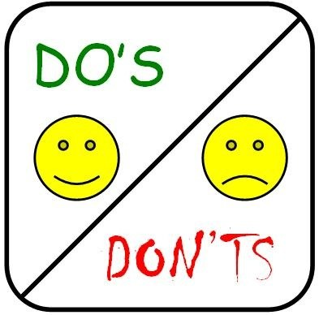
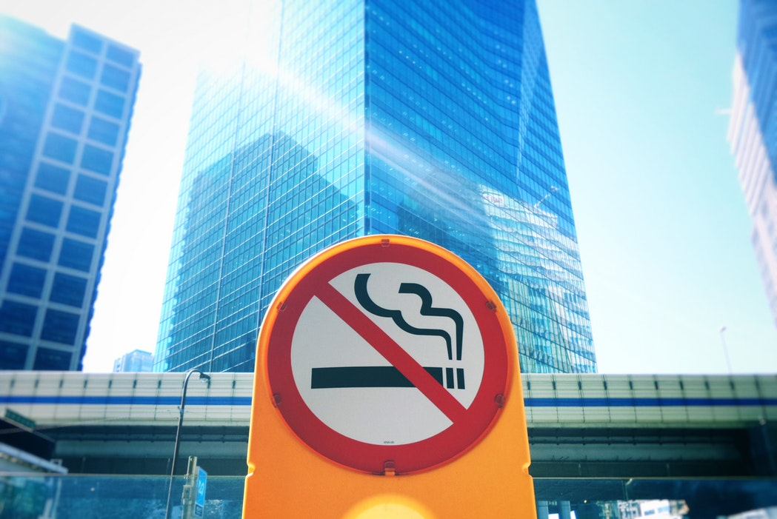
Key Messages
Considering what we have heard about effects ( and costs - human and economic) of smoking can we afford to not invest in prevention?
Providing both sides of the coin!
Prevention is better, and cheaper, than cure!

Slide 14

Thanks for Listening
Jeff Lee
Senior Consultant
ISSUP
jeff.lee@issup.net

