Slide 1
UNODC Drug Use Disorder Treatment System Quality Assurance Training in Pakistan: March 2021
Annette Dale-Perera
Consultant for UNODC

Slide 2
Acknowledgements: Present result of team work
UNODC
  Pakistan: Dr Manzoor Ul Haq, Rashda Saif Naizi, Ahmed Nawaz (consultants: Zahid Khan, Dr Arif Wafa, Dr Nael Hasan)
  UNODC CA: Dr Jeremy Milson and UNODC PTRS Vienna: Anja Busse, Dr Wataru Kashino
Senior Joint Secretary MCN Mr Sabino Sakinda Jalal Ministry of Narcotics Control, Pakistan Government
Dr Samra Mazhar, Deputy Director of Programs, Ministry of National Health Services, Regulations & Coordination
INL funding the work and Christan Martinez LuSane
Expert participants from Pakistan: this was genuine co-production: analysis of systems and redesign recommendations

Slide 3
UNODC System QA Training outline
Aims
Gain knowledge of ‘The Standards’ (WHO/UNODC 2020)
Analyse national/provincial systems against ‘The Standards’
Participants recommend system redesign
Training
National Stakeholder training October 2020 – 14 participants
4 Provincial trainings March 2021: Punjab; Sindh; KPK; Baluchistan – (61)
Internet based training (via MTeams), 4 days x 4.5 hrs a day
Very interactive: plenary, breakouts, feedback, discussion (Urdu/English)
Training evaluation ratings:
National 4.65 out of 5, Provincial training 4.55 out of 5

Slide 4

`the Standards‘ WHO/UNODC 2020 – quick recap
By WHO and UNODC and international experts from all regions
Signed off by all UN Member States
Designed to help countries plan and deliver treatment of drug use disorders systems and services based on scientific evidence
‘the Standards’ 2020 are aspirational and will take time to achieve
Primary focus is drug use disorders but principles also apply to alcohol and mental health disorders
Notes:
Slide 21
Tell participants that the UNODC QA mechanism is based on ‘the International Standards'
The next slides cover the contact of this important guidance document
Stress ‘the Standards’ is core international guidance.
Stress ‘the Standards are aspirational and something to be worked towards over time
Primary focus is illicit drugs but much of the contact applies to alcohol etc

Slide 5
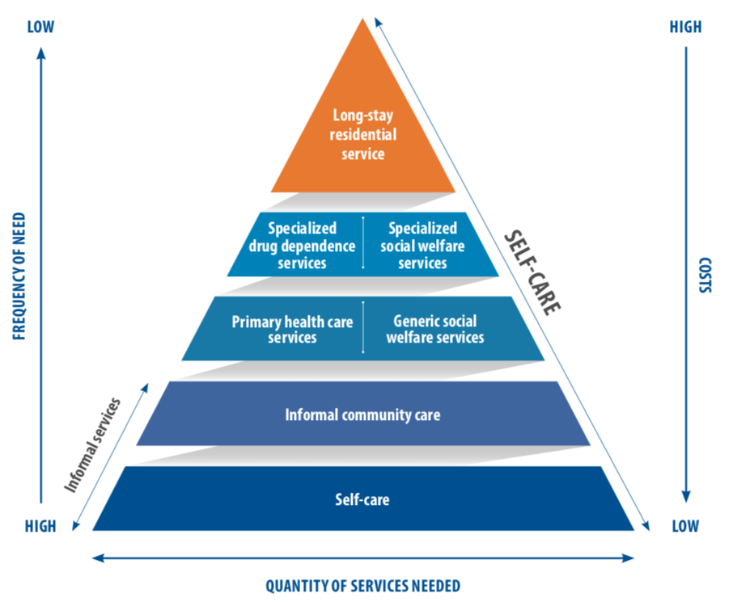
System organization pyramid
Key points
Offer the most effective, least invasive and lowest cost intervention first – in line with Public Health principles
Public investment should match the volume and type of treatment needed
Most people can be treated in the community
We need a system approach to meet need - not individual services working in isolation
Notes:
Slide 25
Delegates have seen the pyramid before – from `the Standards’
Trainers should describe service organisation pyramid
Say this will be revisited many times in the training – especially when we look at Systems QA
Go through the Key points
Drug use disorders are a spectrum disorder from low to high severity and complexity
Drug treatment is cost-effective compared with untreated drug problems
Offer the most effective, least invasive and lowest cost intervention first – in line with Public Health principles
Public investment should match the volume and type of treatment needed
Most interventions are required at lower levels and most people can be treated in the community

Slide 6
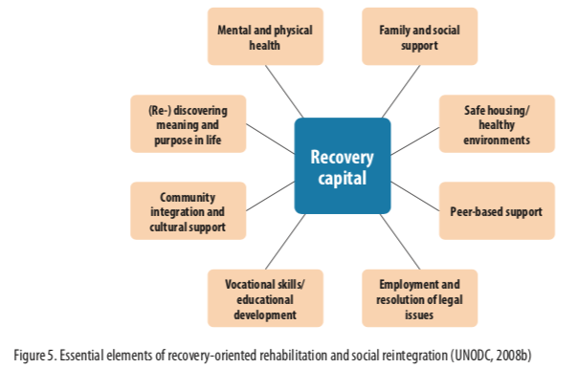
Drug use disorder treatment systems
Drug use disorders are complex bio-psychosocial health conditions
Drug use disorders are a spectrum disorder from low to high severity and complexity of need
Organise local systems to meet the varied needs
Recovery-orientated system for those with chronic and relapsing dependence – support over time and help to build recovery capital
Use or Intoxication
Harmful use
Dependence syndrome
Notes:
Slide 22
Present the slide
Explain the importance of designing systems that can meet a range of needs
For example
Diverting people with harmful use eg with SBIRT can prevent dependence syndrome
The diagram is from WHO

Slide 7

System and service standards
Drug treatment system planning & funding influences all service & patient outcomes.
Service
System
Notes:
Slide 35
Present the slide – delegates have seen this before – this is a reminder
Stress that services and systems are linked and that the quality of the system influences the quality of services and patient outcomes.

Slide 8
UNODC System QA standards
System standard statements
Sys1 | The area has mechanism that co-ordinates and oversees the planning, funding, monitoring and review of the drug use disorder treatment system
Sys2 | The area has a recent comprehensive needs assessment that informs drug use disorder treatment and guide system planning
Sys3 | The drug use disorder treatment system features a tiered or ‘pyramid’ model, with settings, modalities and interventions outlined in ‘the Standards’ (WHO/UNODC 2020)
SyS4 | The area has a funded plan to develop and sustain its drug use disorder treatment system in line with ‘the Standards’(WHO/UNODC 2020)
SyS5 | The system has planned and monitored mechanisms to enable and improve quality, including addressing inhuman or degrading treatment, stigma and discrimination
Notes:
Slide 37
Give the overview of the System standards Say there are 5 system standards – each with criteria under lying these.
Outline the system standards
Say over the next 2 days we will go through these standards in turn and delegates will examine systems in their country

Slide 9
Each standard discussed and systems were rated
Strategic planning mechanism
Need
Non-specialized setting interventions
Specialized setting
modalities
Specialized Interventions
Recovery orientated?
Resources
Initiatives to promote quality & reduce stigma
Recommended system redesign
Notes:
Slide 15
This is a recap on the system redesign work that has been completed
Ask groups to refer to all their work

Slide 10
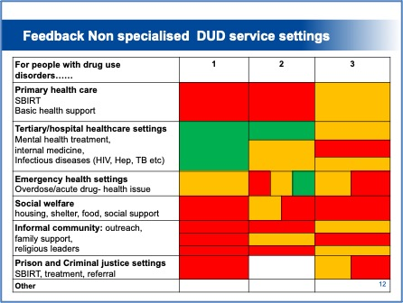
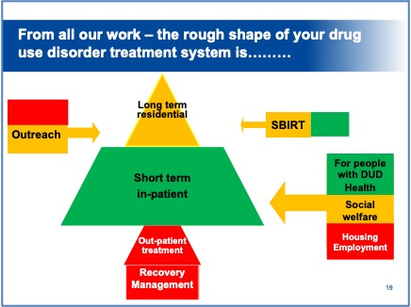
Rate the system on each standard
Narrative responses and
BRAG rating
Blue = Not Applicable
Red = Not met/ Inadequate
Amber = Partially met/ partially adequate
Green = Met/ Good
Summary graphic of system also produced – how far off the WHO/UNODC ‘pyramid’?
Notes:
Slide 1.63
Describe how a BRAG rating system may result in a score card that would look like the picture on the right
Services would be asked to prioritise creation improvement plans for anything marked red – or safety critical

Slide 11

Results – what did participants say?

Slide 12

System Standard 1: Strategic Planning
Who plans
There is a (good) national policy and ministries plan but often in isolation
Provincial planning but in ‘silo’s’
Co-ordinated planning mechanism involving all stakeholders was lacking though started by health in some Provinces
Who funds:
Multiple funding sources: uncoordinated. Health (20 beds in all Mental Health tertiary hospitals); Anti-Narcotics Force (ANF), social welfare departments; private funding; donor funding, charitable funding/local benefactors

Slide 13
Use and need for drug use disorder treatment
Recent data on use is lacking
Anecdotal feedback from participants
More adults using drugs than 2012 - Increase in population
Opioid use still a major problem
‘Widespread’ cannabis use
Increase in stimulant use: methamphetamine use (students and young adults), New psycho-active substances (Flaka)
Increase in non-medical use of illicit prescription and over the counter medication (inc opioids)
All groups impacted: real concern about young adults

Slide 14
Need and coverage of need
Very little data on drug-related mortality and morbidity.
Many groups impacted: men, women, students, homeless
2012 estimate was 1.8%
Participant feedback on how many people who need drug treatment get it
No data on how many people receive drug treatment a year
National group: 2-10% of people who need treatment get it
Provinces: range of estimates 1.8 to 10%.
Less access to treatment in rural areas and in some provinces.

Slide 15
Non-specialized drug treatment settings: ratings
Primary care for people with DUD:
inadequate SBIRT except 2 areas
Basic health care: partially adequate, better in urban areas, KPK MH-Gap
Tertiary MH hospital rated highest (good/partially adequate) dedicated beds in MH hospitals – but often not dedicated wards

Slide 16
Non-specialized drug treatment settings: ratings
HIV/AIDs and internal medicine: Mixed picture. Inadequate in Baluchistan
Emergency Dept – including overdose responses. Good some areas but rated as poor in rural areas and Baluchistan
Social welfare – generally rated inadequate, some good Informal community settings rated inadequate/partially inadequate – stigma talked about as a major issue
Prison/criminal justice setting
treatment: inadequate
/partially inadequate

Slide 17
Specialized drug use disorder treatment services
Notes:
Slide 28
Present the slide
The triangle on the right is an articulation of the top of the pyramid
Influencing community, mainstream health, social care and criminal justice to play a role in drug use disorder treatment is very important but the drug use disorder specialist treatment services are critical and we will focus on them.

Slide 18
Specialized drug treatment – core settings
Participants rated
Outreach and recovery management as inadequate or partially inadequate
In-patient and residential rehabilitation as adequate or partially adequate – except in Baluchistan
Treatment in ‘other settings’ inadequate/partially inadequate
Table 11: Specialised drug treatment settings
Provinces | Punjab |  |  | Sindh |  |  | KPK |  | Baluchistan
Groups | 1 | 2 | 3 | 1 |  | 2/3 | 2 | 3 | 1
Outreach
Out-patient drug services
In-patient drug services
Residential rehabilitation
Recovery management
Specialised drug treatment in other settings
Do you have a pyramid shaped system

Slide 19
Recommended specialized drug treatment interventions
Interventions coverage as inadequate or partially inadequate.
Amber or Green: NSP; assessment and treatment planning , psychosocial interventions, pharmacological withdrawal, some recovery management
Punjab & Sindh rated higher, Baluchistan mainly Red

Slide 20
Resources
Some public resources for free or affordable treatment
In-patient beds in MH hospitals
ANF activities
Doner funding – particularly for training
Private sector services – unknown size and quality
BUT - Little knowledge in participants about how much resource. Comments about resources in silo’s. Some questions about how resources are used
Clarity would be helpful to aid planning

Slide 21
System quality interventions
No national data system for specialized drug treatment.
Some work on quality standards – HealthCare Commission particularly Punjab
Workforce development activities but not strategic approach
Activities to tackle stigma and discrimination thought critical but rated inadequate/ partially inadequate
Table 13: System quality interventions
Provinces | Punjab * |  |  | Sindh |  |  | KPK |  |  |  | Baluchistan
 | 1 | 2 |  | 1 |  | 2/3 | 1 |  | 2 |  | 1
System data system for drug use disorder treatment
Quality standards and a quality improvement mechanism
Workforce Development
Activities to reduce stigma and discrimination

Slide 22
What ‘shape’ current Provincial systems?
Punjab Sindh

Slide 23
What ‘shape’ current Provincial systems?
KPK Baluchistan

Slide 24
Participant recommended system redesign
Better co-ordinated planning and transparency
Create a ‘pyramid’ shaped system in each Province
‘Increase treatment coverage (different ways suggested)
  Expand specialized out-patient treatment
  Expand recovery support and mutual aid
  Expand primary care interventions and social care (use national infrastructure)
  Increase treatment for people with mild to moderate issues
  Targeted help women, students, poor, rural areas
Tackle Stigma
Need data on need and numbers in treatment

Slide 25
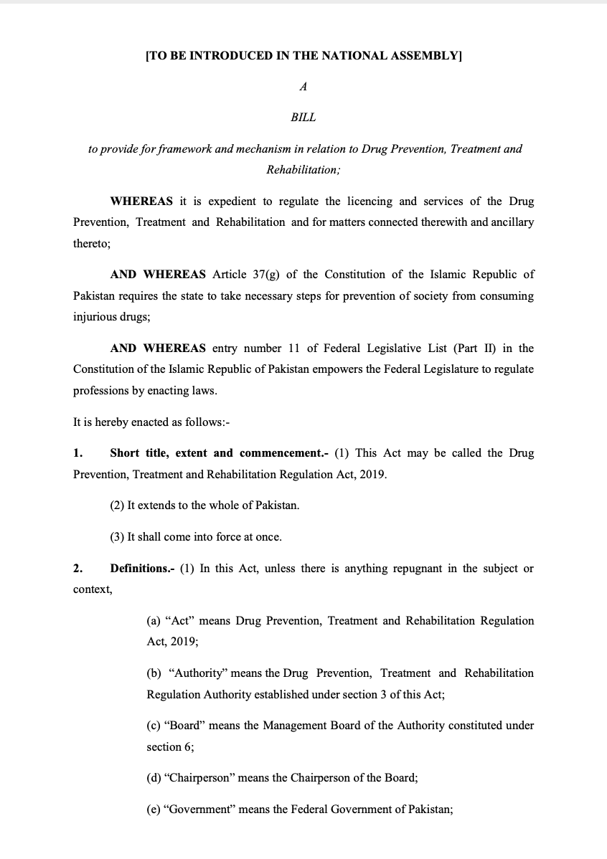
Conclusions
Treatment model is ‘acute’ rather than ‘recovery-orientated’.
Current system is high cost, low volume
Lack of aftercare and recovery support likely high levels of relapse and overdose death
Significant lack of opioid medication assisted treatment and overdose prevention medication, mutual aid and recovery support
Few options for people not seeking abstinence
Tackling Stigma thought critical
Improve across all 5 system standards

Slide 26
Conclusions
Work to do
Consensus from participants to bring system in line with international guidance
Government commitment for this work
  Senior Joint Secretary MCN Mr Sabino Sakinda Jalal MNC
  Dr Samra Mazhar, Deputy Director of Programs, NHSRC
  National Anti-Narcotics Policy and draft Bill for New Agency
Support from UNODC and INL
ISSUP Pakistan – many excellent professionals committed to improving quality – please think systems as well as services
Thank you for the opportunity to facilitate this work

