Slide 1

01
Emerging Realities
in Prevention, Treatment & Recovery
ISSUP PHILIPPINES PRE-CONFERENCE 2021
The Colombo Plan – Drug Advisory Programme
Notes:
To all corners of the world, good morning, good afternoon and good evening! I am pleased be here to connect with my fellow Filipinos and our friends from across the globe. I feel privileged to share The Colombo Plan- Drug Advisory Programme’s Emerging Realities in Prevention, Treatment and Recovery. And be among our distinguished plenary speakers, Giovanna Campello from the UNODC, Dr. Miriam Cue from the PRC, Dr. Gilda Gayle Gomez from the PAP SIG on Substance Use and Recovery, Hydie M. a family member in recovery, and Hon. Mayor Vico Sotto from the LGU of Pasig City. I’d like to acknowledge our partners in the Drug Demand Reduction work and advocacy, the US Embassy- INL Manila, the Dangerous Drugs Board and ofcourse the organizer who has made this possible ISSUP Philippines National Chapter.

Slide 2


Emerging Realities in Prevention, Treatment & Recovery
Who We Are
CP DAP in the Philippines :
Innovations, Solutions & Alternatives
Programs
Curriculum Development
Online Activities
The Silver Lining: Insights & Takeaways
OPPORTUNITIES, CHALLENGES & TAKEAWAYS
02
Notes:
On this third day of the Pre-conference event, we have already heard of the issues, contributions and realities from the Global and national levels. In this presentation, allow me to share with you 3 things: 1. Who We Are as CP DAP 2. The Colombo Plan – Drug Advisory Programme’s innovations, solutions and alternatives to continue delivering our programs and activities here in the Philippines and other member countries and lastly, 3. The Silver Lining: Our insights and takeaways.

Slide 3
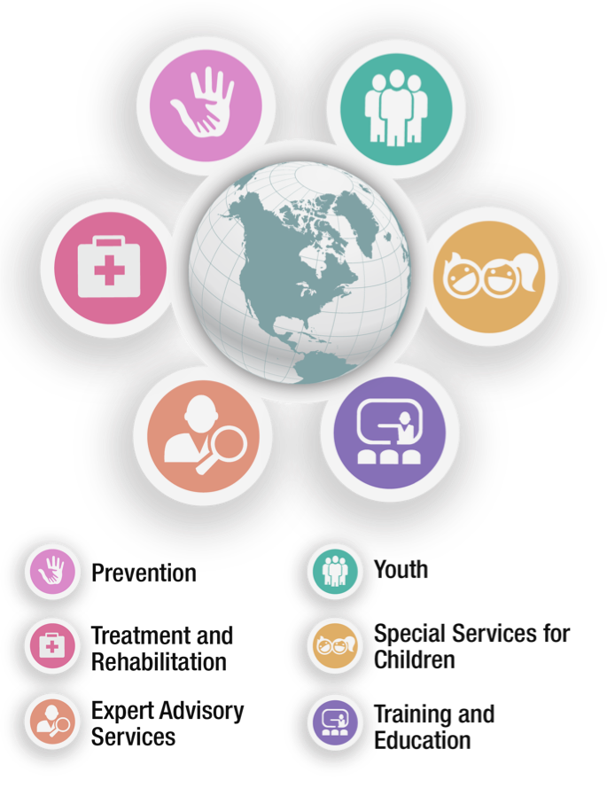
CAPACITY BUILDING TRAINING PROGRAMS
ORGANIZING INTERNATIONAL Conferences and Meetings
PROVIDING TECHNICAL ASSISTANCE
ISSUP PHILIPPINES PRE-CONFERENCE 2021
Main Thrusts
03
Notes:
First of all, I’d like to tell you about who we are and what we do. The Drug Advisory Programme was established in 1973 to address the growing problem of substance use in the region. Since then, DAP has continued to respond to the needs of our members countries and beyond by strengthening efforts in drug demand and supply reduction through a variety of programmes. We continue to be a prime mover in the field of drug demand reduction to this day.
Our initiatives ensure a holistic approach to fulfill our main thrusts of capacity building, international conferences and meetings, and providing technical assistance to various countries by : Developing effective prevention programs, Engaging youth participation in drug demand reduction, Improving access to treatment and rehabilitation, Providing treatment services for children, Rendering expert advisory service, and Training for the drug demand and supply reduction workforce.

Slide 4
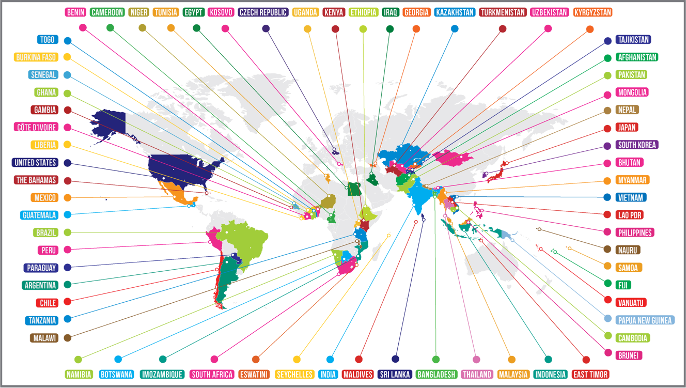
ISSUP PHILIPPINES PRE-CONFERENCE 2021
The DAP Network:
Countries with DAP Programmes
04
Notes:
DAP provides technical assistance and capacity building for its member countries and beyond. DAP programmes began mainly in South and South-East Asia and to date, exist in Africa, South America and Central Asia.
We would normally meet face to face and gather in conferences and meetings similar to how we are meeting virtually the past three days.

Slide 5


“
DAP remains relevant and innovative in delivering effective drug demand and supply reduction interventions — and therein lies its global impact
ISSUP PHILIPPINES PRE-CONFERENCE 2021
”
05

Slide 6
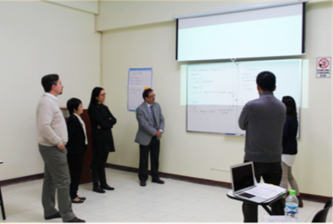
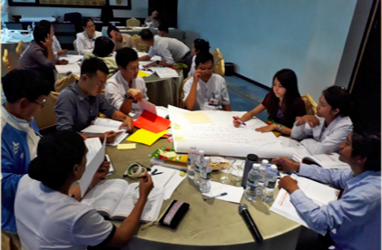
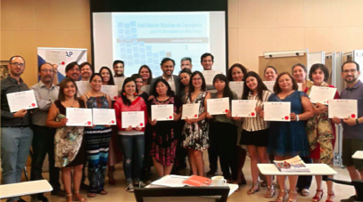
Since the COVID-19 global pandemic. . .
ISSUP PHILIPPINES PRE-CONFERENCE 2021
HOW IS COLOMBO PLAN - DAP MAKING AN IMPACT?
06
Notes:
Since the COVID-19 global pandemic, we have not been able to travel, meet face to face and connect like we used to. Now, how is Colombo Plan –DAP making an impact? Just like in all the previous presenters and organizations we have in this event, DAP experienced similar barriers and challenges to deliver our programs and activities.

Slide 7
07
Innovations, Solutions & Alternatives
ISSUP PHILIPPINES PRE-CONFERENCE 2021
PROGRAMS
CURRICULUM DEVELOPMENT
ONLINE ACTIVITIES
Notes:
Carrying out our project activities required innovation, strategic solutions, and alternative routes to implementation. Allow me to share with you the programs, activities in curriculum development, and online activities organized and facilitated by DAP in 2020 since the pandemic.

Slide 8
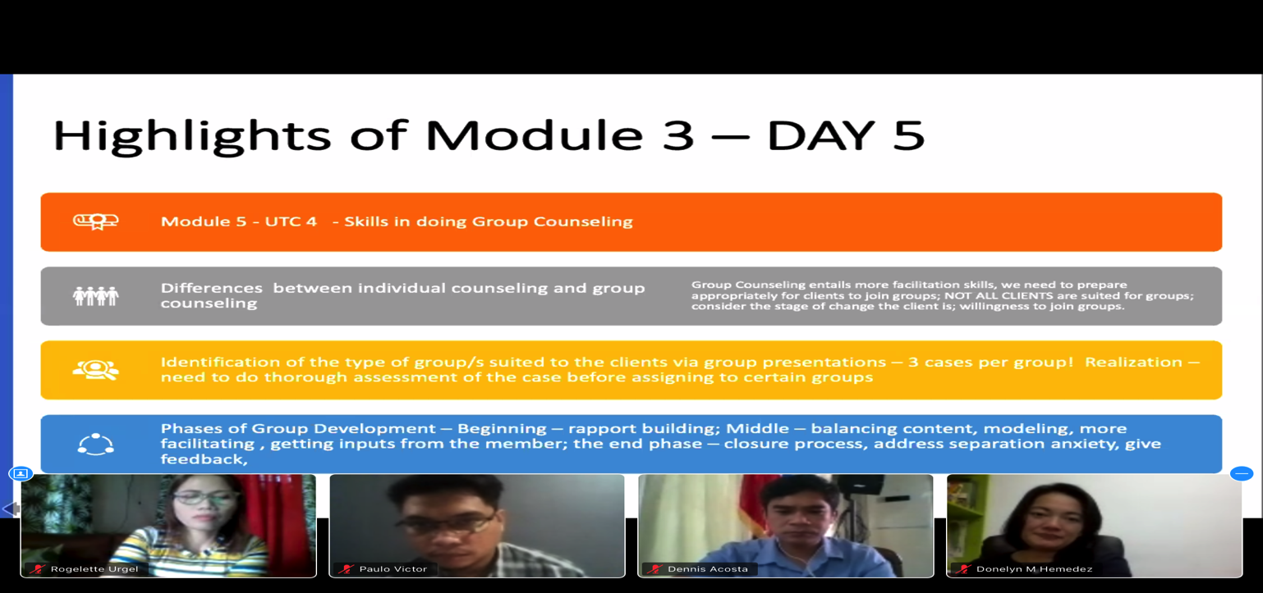
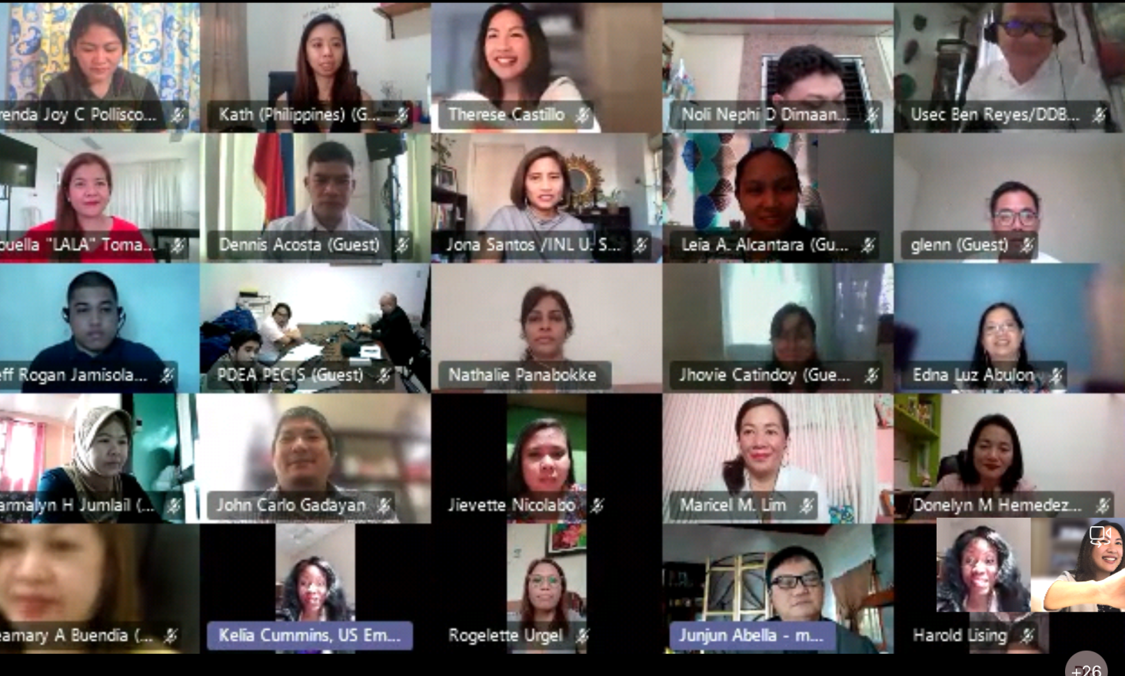
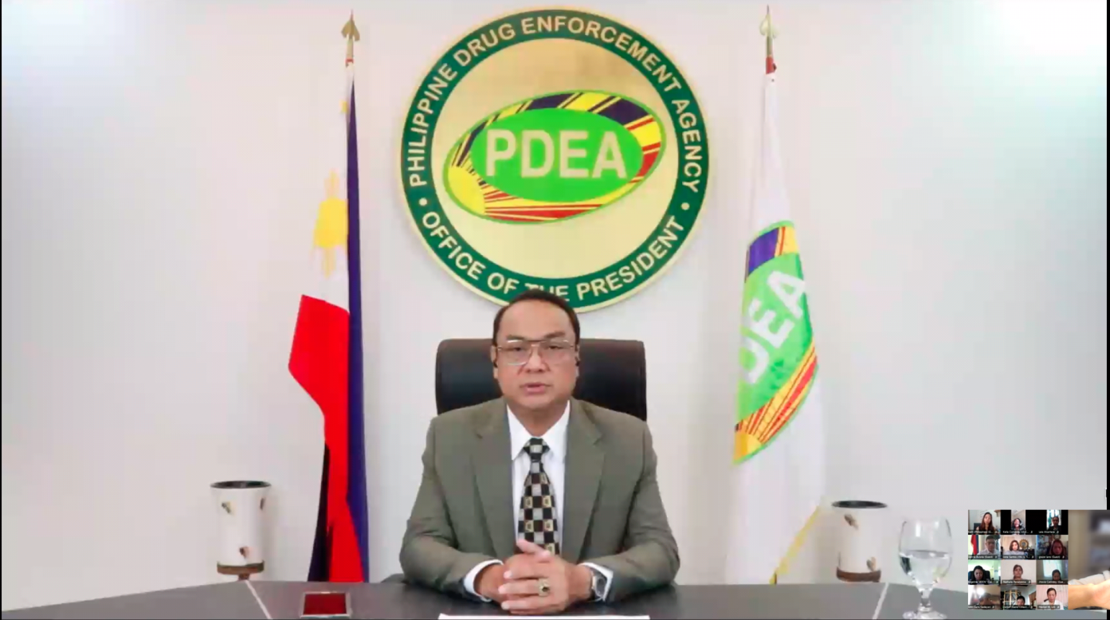
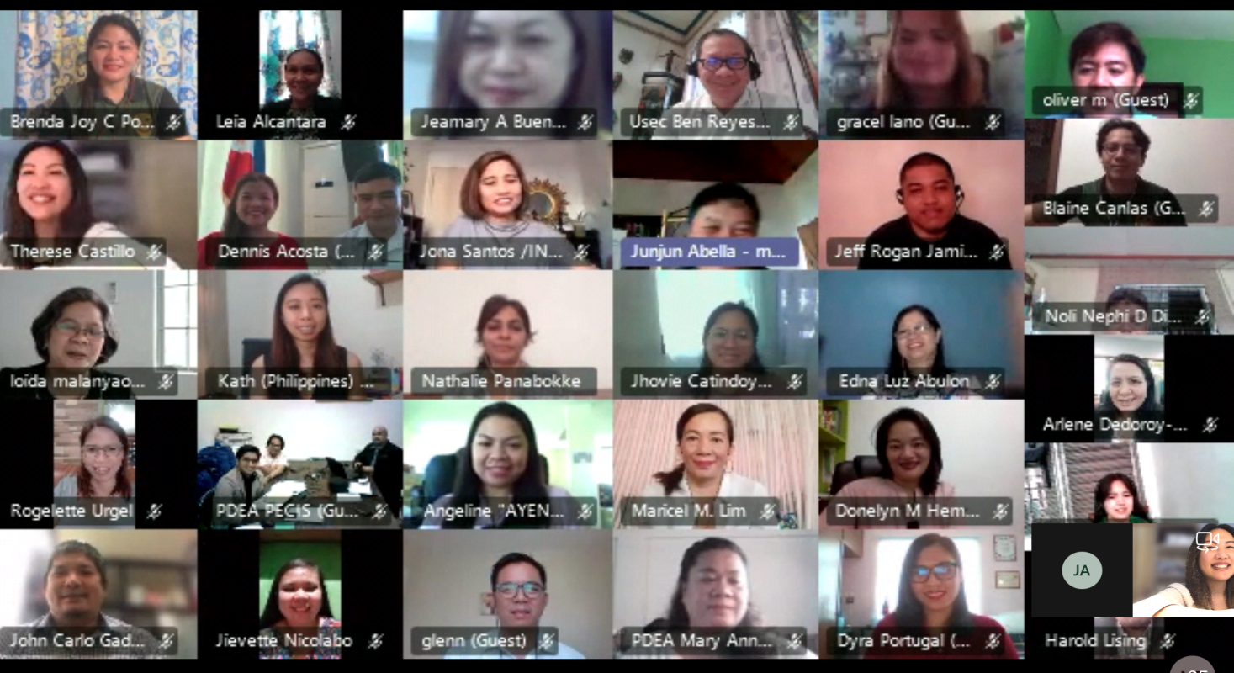
Virtual Training on UTC 4: Basic Counseling Skills for Addiction Professionals and UTC 6: Case Management for Addiction Professionals
12
9TH TRAINING COHORT FOR THE CRIMINAL JUSTICE SYSTEM IN THE PHILIPPINES
Notes:
The Drug Advisory Programme (DAP) of the Colombo Plan Secretariat with support from Bureau of International Narcotics and Law Enforcement Affairs, US Embassy Manila organized this a virtual training on the UTC 4: Basic Counseling Skills and UTC 6: Case Management for Addiction Professionals in response to the request of the Philippine Drug Enforcement Agency (PDEA) as a continuation of the Basic UTC Course trainings for the Criminal Justice System that started in 2018. Due to the COVID- 19 pandemic, we held the 9th batch of training cohort for the Philippines through the virtual platform, adapting a blended learning approach – synchronous activities for two hours for a total of 12 days of sessions, with off-line or asynchronous activities for small group collaborative learning. 31 participants completed the training.

Slide 9
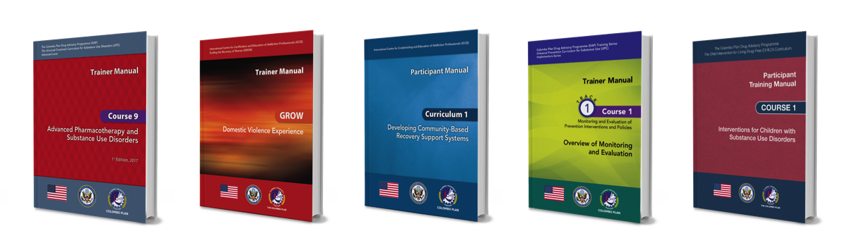
9th Training Cohort for the Criminal Justice System in the Philippines
Regional TOT on CHILD Curriculum for 32 Master Trainers
Training of Maldives – National Drug Agency counselors on ASI
PDE training for 155 participants from 17 provinces in Afghanistan increasing DAP’s presence to 29 provinces
149 treatment practitioners trained from 5 countries (Cameroon, Egypt, Kenya, Seychelles, Tunisia) in Africa increasing DAP’s presence to 22 countries
299 participants from 5 countries (Bahamas, Chilé, Ecuador, Mexico & Panama) in Latin America
Trainings
ISSUP PHILIPPINES PRE-CONFERENCE 2021
09
Notes:
Apart from the this, there were trainings conducted in other parts of the world as well – such as Maldives, Indonesia, Afghanistan, 5 countries Africa, and 5 countries from Latin America to name a few of the DAP training initiatives.

Slide 10
From F2F to Virtual Trainings
Format
Time
Engagement
Group size
Adult-learner approach
ISSUP PHILIPPINES PRE-CONFERENCE 2021
09
Notes:
Since there is no standard guide or manual yet to conduct the our courses through online or blended delivery mode, we had to adapt to creating the usual adult-learner approach we know of from our training courses. This involved restructuring training agendas, reducing the time per training day, applying alternative strategies for participant engagement, adjusting the group size when possible and working through the challenges in technology and learning. In Indonesia, video tutorials were created to support the UTC online training.

Slide 11
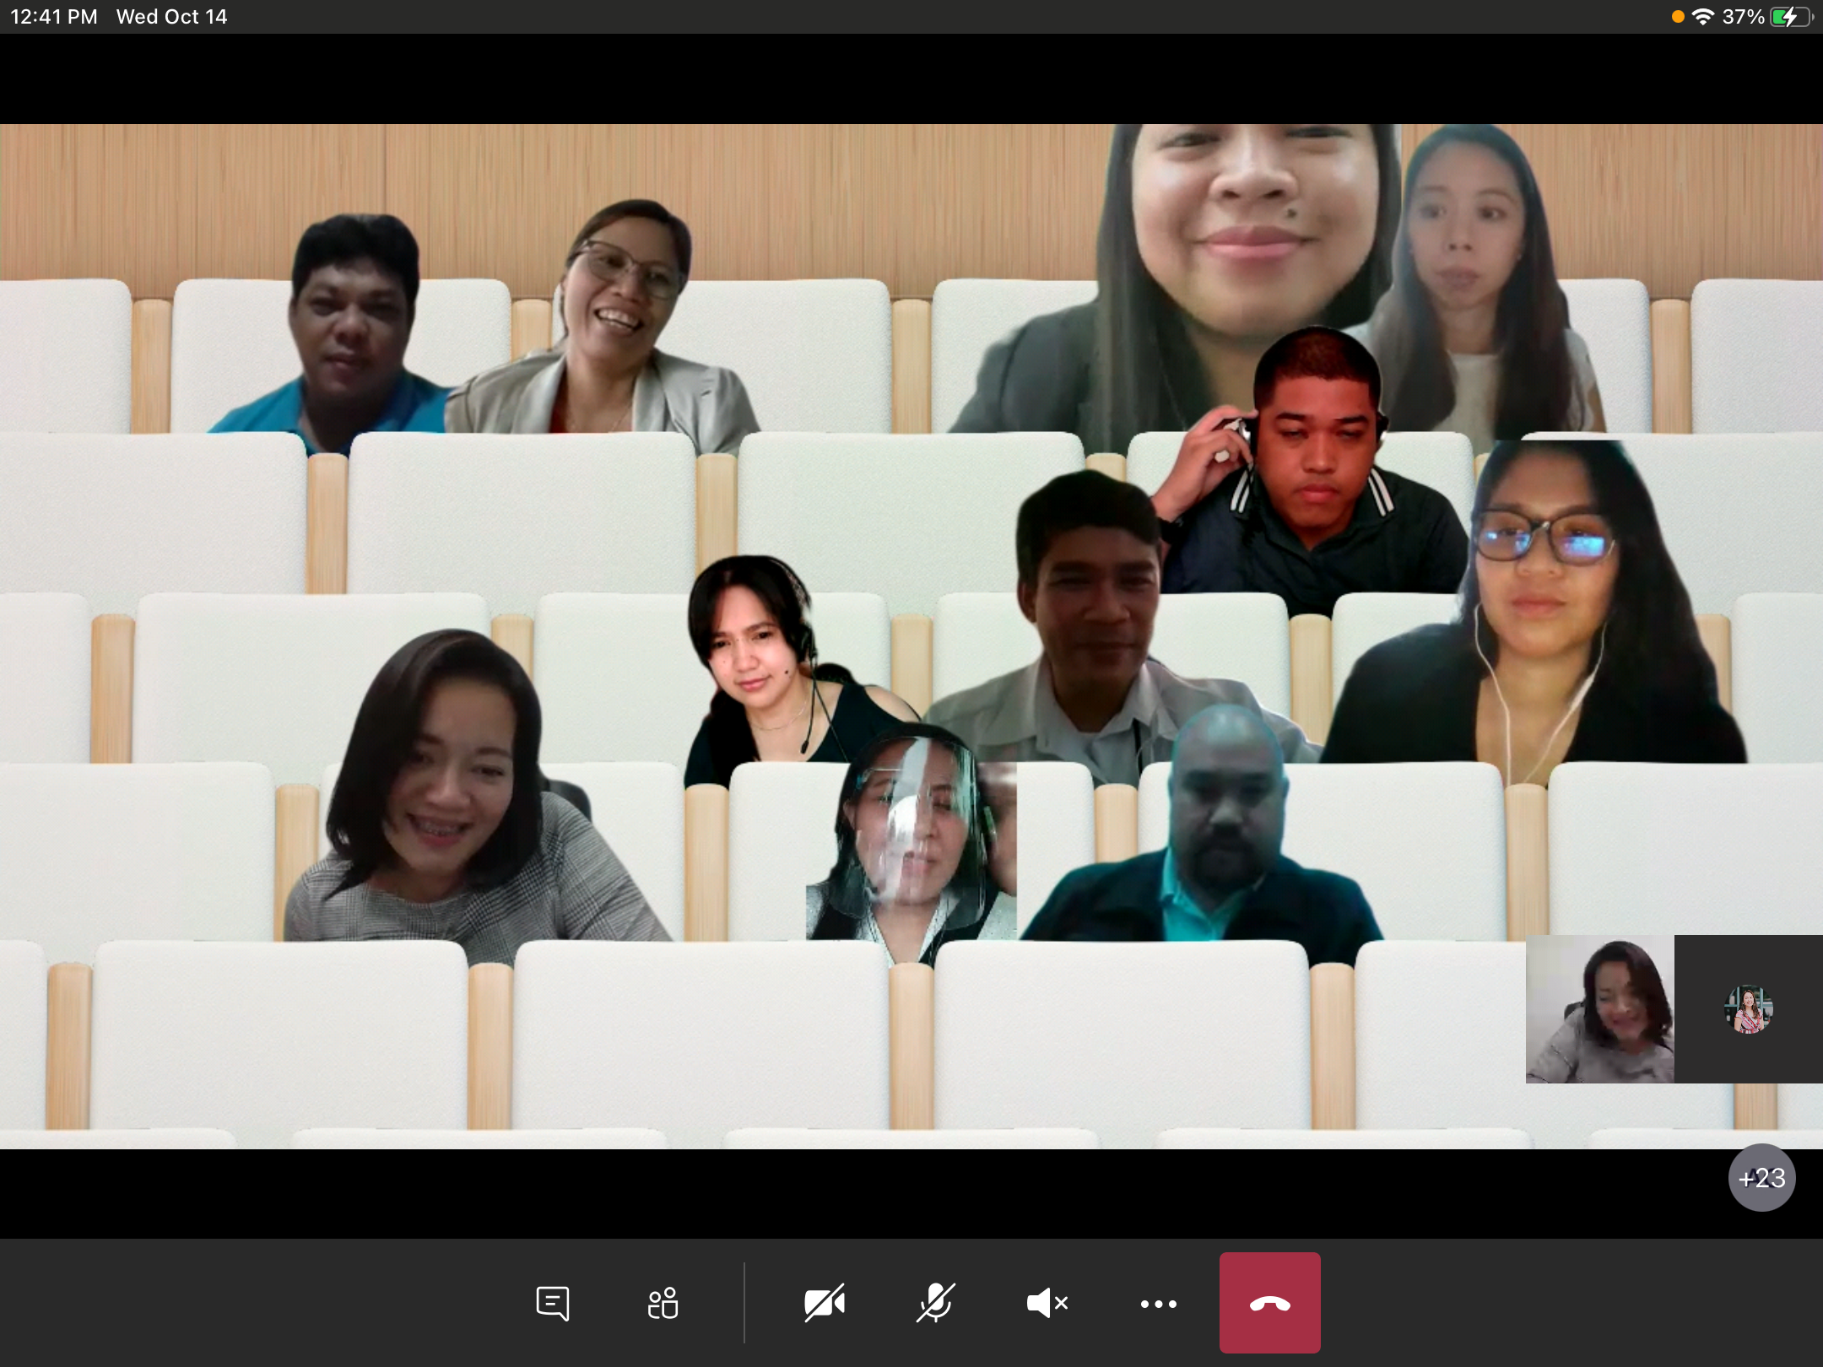
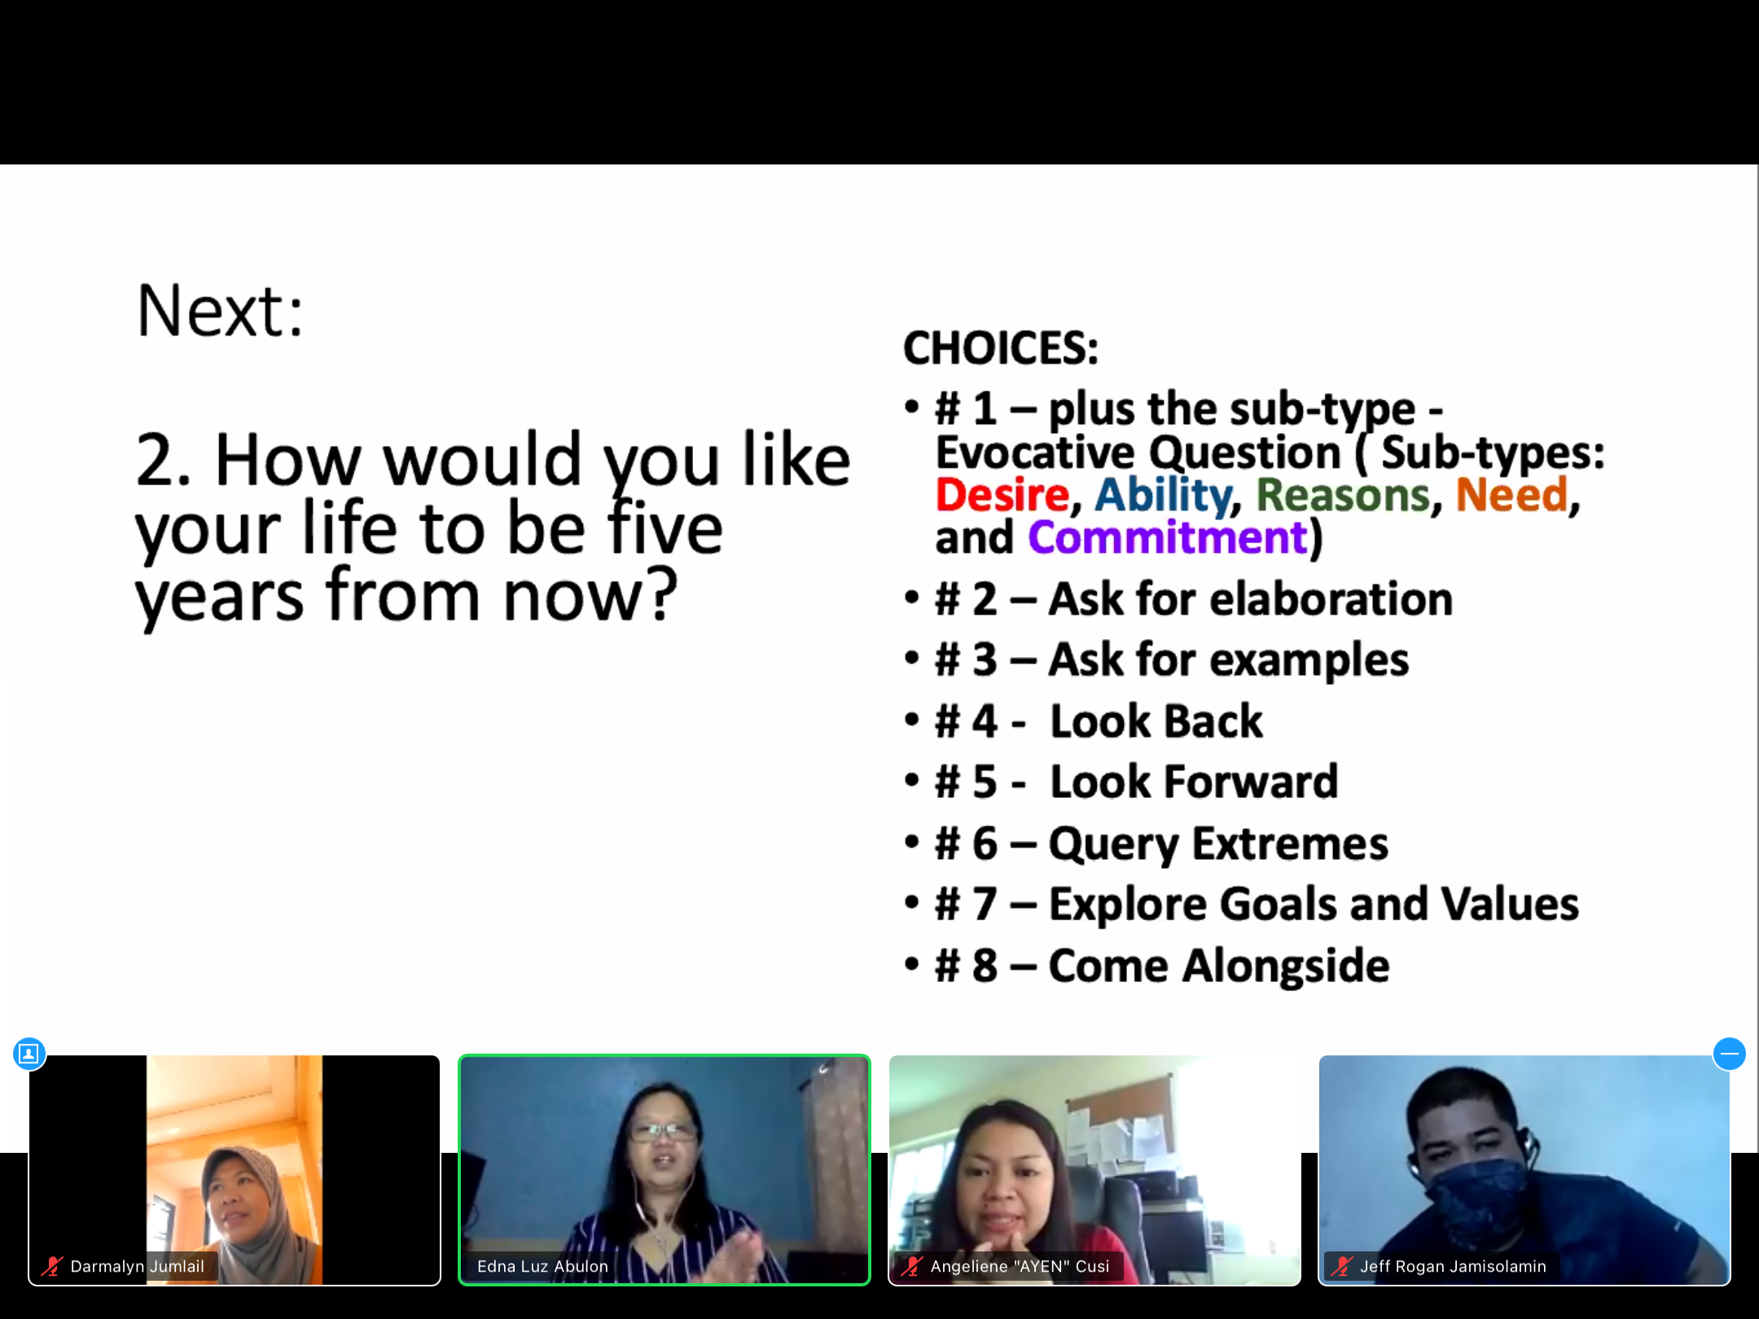
Challenges
Limitations to internet connectivity
Training hours per day reduced with increased number of training days
Adjustment to a “new DAP training experience”
Adjustment to technology tools and platforms
Remote locations where there is no access to internet at all
Notes:
Moving to a virtual platform does not come without its challenges. The number one barrier on some days is the limitations to internet connectivity, adjustment period and familiarizing with tools for learning, and managing the time to be most effective for both trainer and participant.

Slide 12
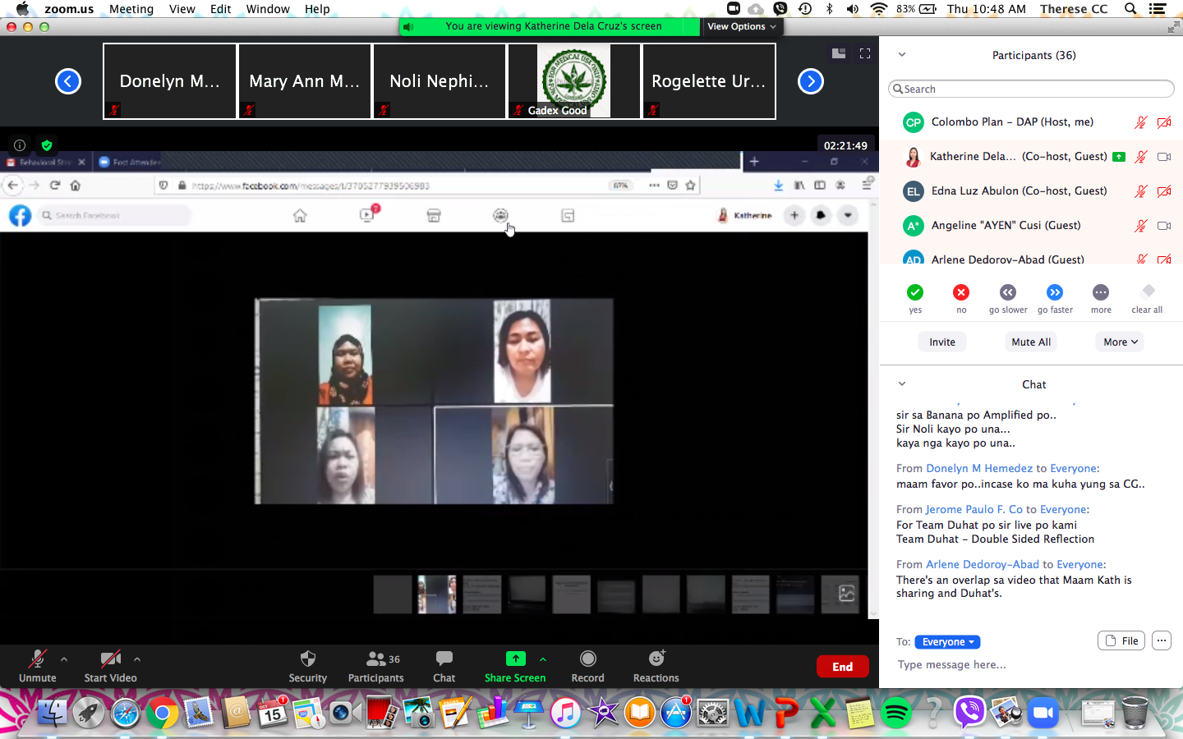
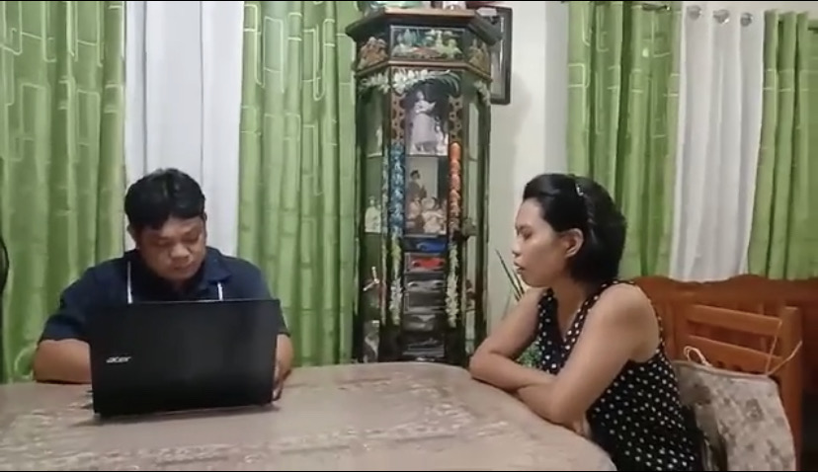
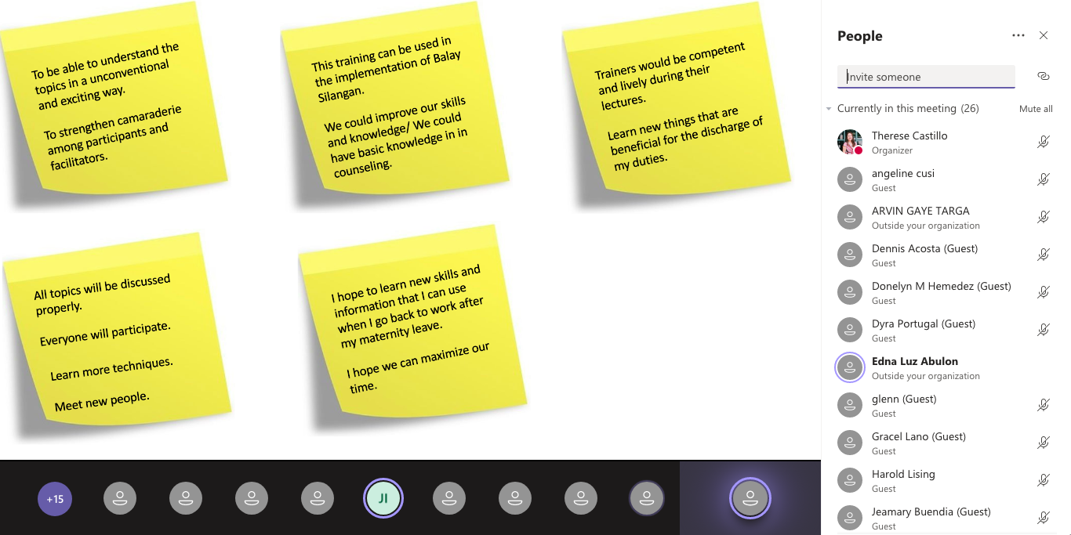
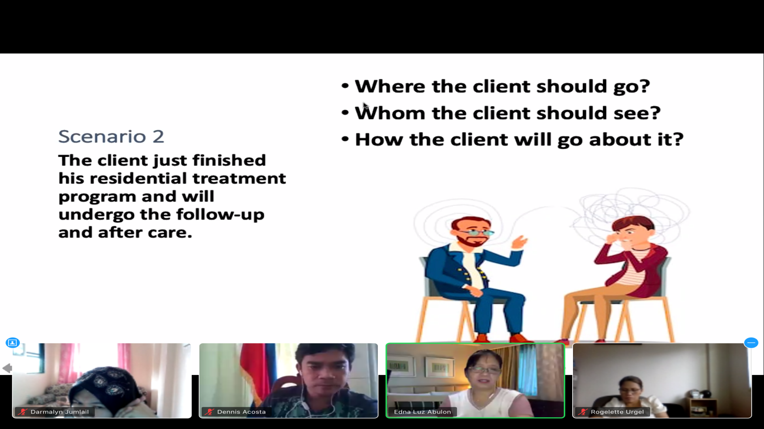
Opportunities
Blended learning approach
Engaging and highly interactive sessions
Adult-learner approach in an online platform
Creativity and resourcefulness in training and delivery
Skilled trainers to deliver courses through a virtual platform
Messaging apps for group chats – “creating an energetic and enthusiastic atmosphere”
Notes:
Despite challenge, there are definitely a number of opportunities in this change of training experience, for both the trainer and the learners. The use of supporting tools to help facilitate training better are used – like messaging apps for creating and sustaining an energetic and enthusiastic atmosphere, making use of videos, taking screen breaks, and still making use that the experience is high in impact. Since we’ve conducted trainings last year without a standard guide yet for online dissemination, we look forward to the standard training formats that will be available soon through self-guided training and trainer-led trainings that is being worked on by ISSUP, DAP and our partners.

Slide 13
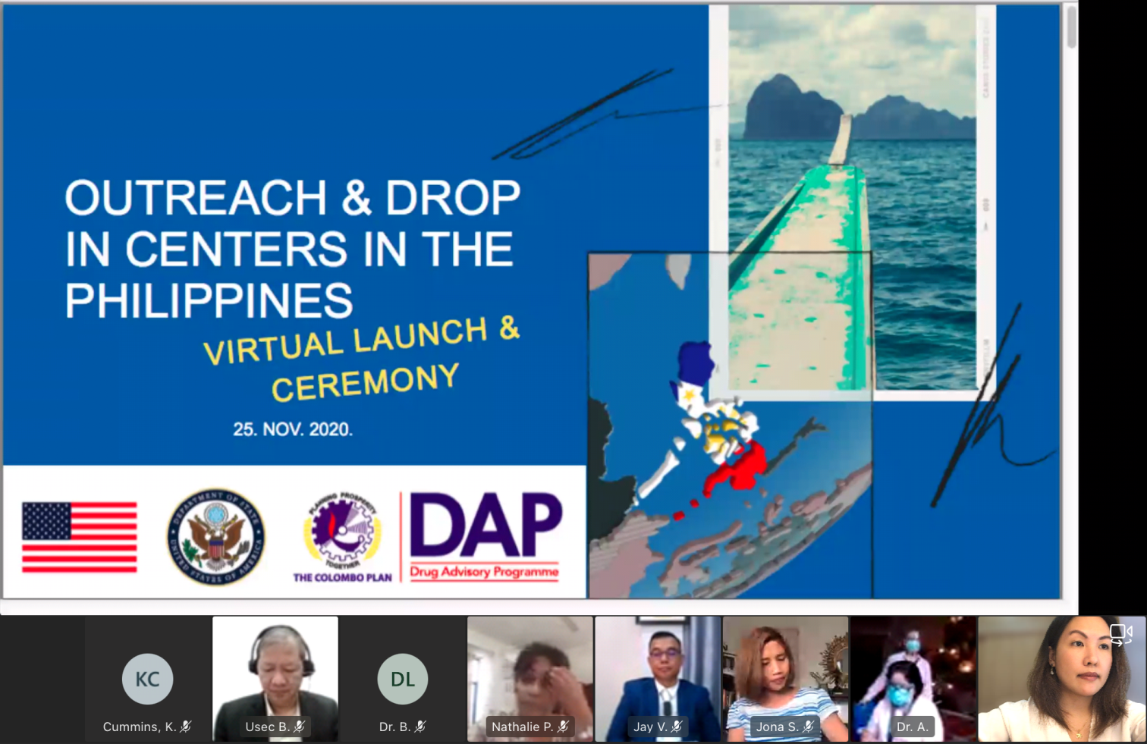
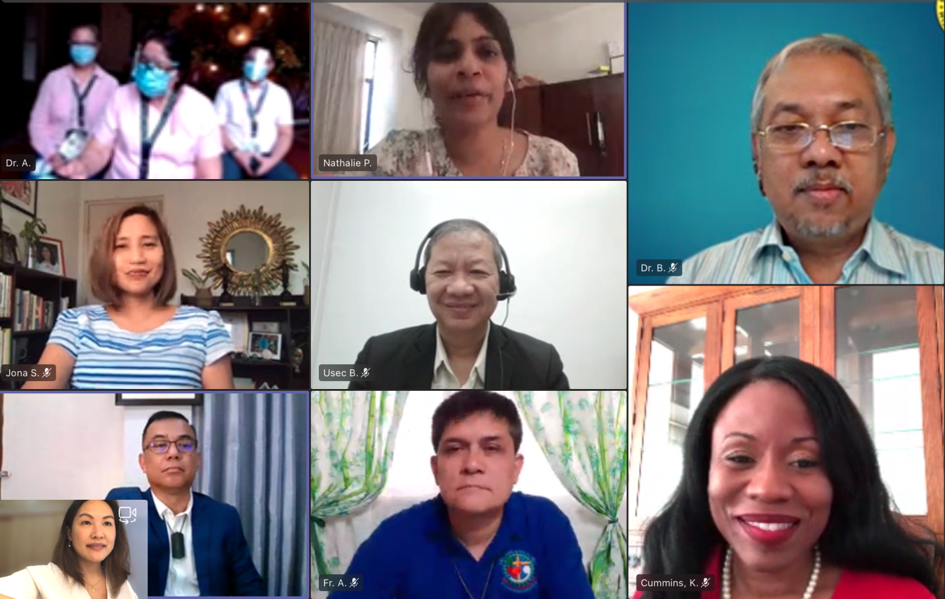
ISSUP PHILIPPINES PRE-CONFERENCE 2021
Outreach and Drop in Centers in the Philippines
09
Notes:
In 2020, we were also able to launch four Outreach and Drop In Centers in the Philippines as part of our efforts to strengthen drug demand reduction with the support of the Bureau of International Narcotics and Law Enforcement Affairs (INL), US Department of State in Manila. We have conducted a selection process panel interviews, virtual facility tours, and review of documents, together with INL, and our partners from the Dangerous Drugs Board and the Department of Health DDAPPTP.

Slide 14

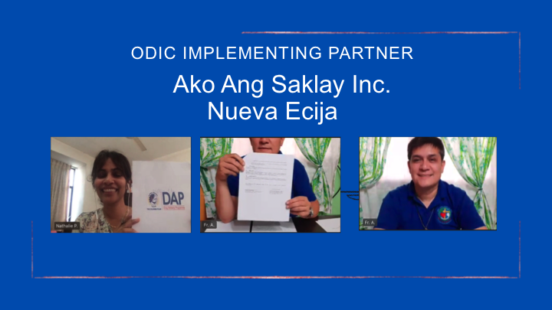
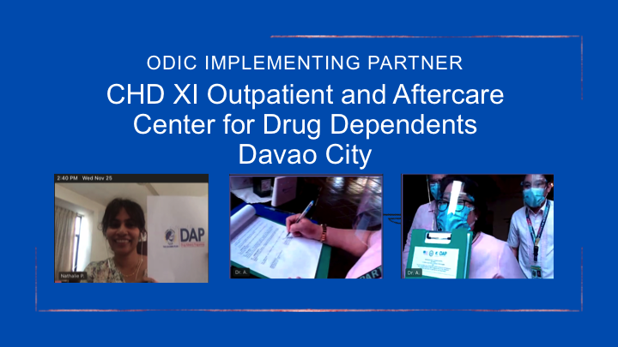
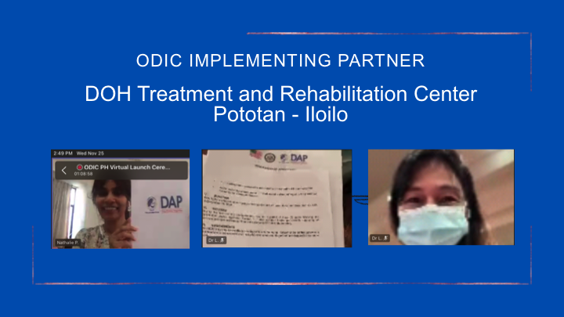
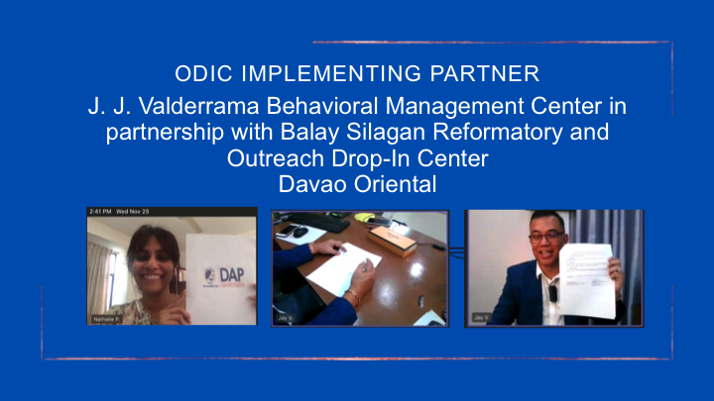
LUZON
MINDANAO
21
VISAYAS
MINDANAO
Notes:
The ODIC model allows communities to build connections, extend services to the marginalized populations, and provide information and access to services (across the continuum of care from screening to recovery support services ) to our communities in the Philippines from Luzon, Visayas and Mindanao. Last November 25, 2020 was the first virtual launch and ceremony for the Outreach and Drop In Centers in the Philippines. The virtual event commenced with welcome remarks by Ms. Nathalie Panabokke, Acting Director of Colombo Plan – DAP. Messages of support from Ms Kelia Cummins, INL Director and Dr. Bienvenido Leabres, Program Manager of the DOH - Dangerous Drugs Abuse Prevention and Treatment Program (DDAPTP).
The four ODIC implementing partners across the country were:
Ako Ang Saklay, Inc., Nueva Ecija
CHD XI Outpatient and Aftercare Center for Drug Dependents , Davao City
J. J. Valderrama Behavioral Management Center in partnership with Balay Silagan Reformatory and Outreach Drop-In Center , Davao Oriental
DOH Treatment and Rehabilitation Center Pototan – Iloilo
All our ODIC implementing partners have been working actively with their respective Local Government Units to better serve their barangays and communities and DAP aims to support them further in providing evidence-based treatment practices. In this event, we had a virtual signing of MOU between DAP and the implementing partners. The ceremony concluded with closing remarks by our focal point and partner, Usec Benjie Reyes, Permanent Board Member of the Dangerous Drugs Board.

Slide 15
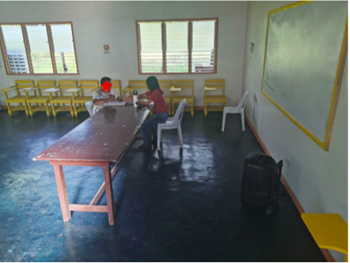
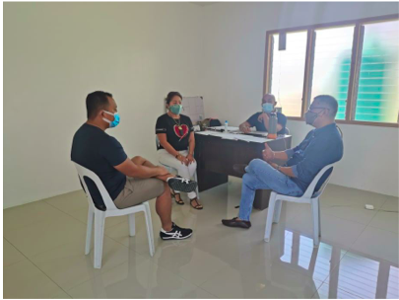
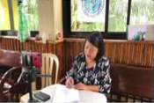
ODIC Implementing Partners
in the Philippines
19
Opportunities
Linkages and collaborations
Active partnerships with the LGUs and community networks
Challenges
Travel restrictions
Threats to health safety
Virtual Services : Screening, Psychoeducation, Referral to services
Internet connectivity
Community quarantine restrictions
“Call & Text” resources
COVID-19 health risks
Implementation designed for face to face format
ISSUP PHILIPPINES PRE-CONFERENCE 2021
Notes:
Because the COVID-19 pandemic has been persistent in affecting our lives, we had to adapt and continue to pursue our projects at DAP strategically. We are only in the beginning of this project so much is to be done to achieve our goals. However, so far, we have found opportunities in catering to communities better through strong linkages and collaborations, the ODIC’s active partnerships with the LGUs and community networks, maximizing the use of virtual services : screening, psychoeducation, referral to services , etc. and making use of “call and text” resources where internet is unstable and inaccessible.
Operating ODICs in the time of a pandemic is nothing less than challenging. First of all, most of our services and activities have been designed for a face to face format, travel is still limited, there are obvious risks to health safety, and community quarantine restrictions may vary in each area. Much is to be learned in the process and DAP has been active in extending its assistance to the four ODIC’s despite challenges.

Slide 16
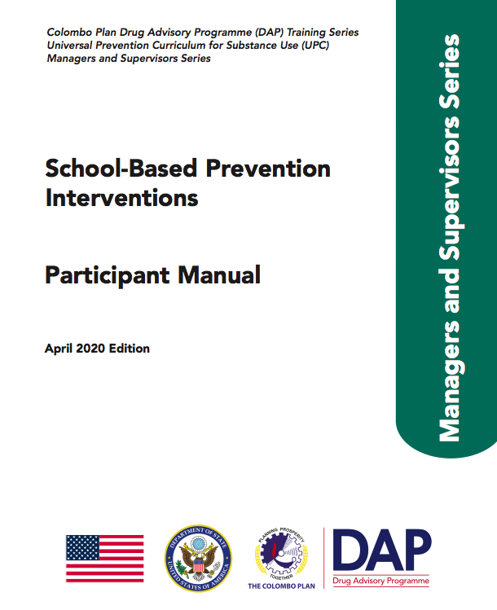
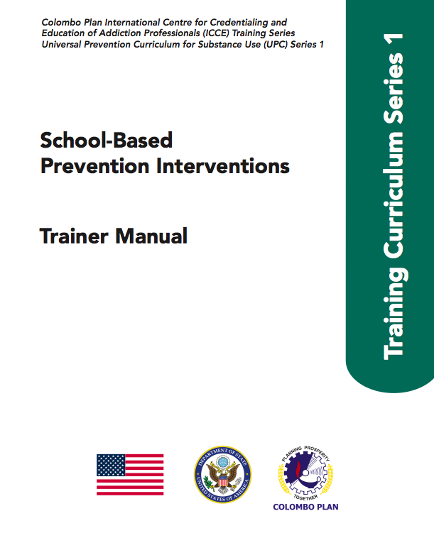
CURRICULUM DEVELOPMENT
UPC MANAGERS & SUPERVISORS COURSE 5 ADAPTATION
School-based Prevention Interventions
07
Notes:
Last August 5, 2020, a virtual expert working group meeting was initiated for the local adaptation of the UPC-C Course 5: School-based Prevention Interventions. This was a five-day virtual meeting including representatives from partner agencies such as the Philippine National Police (PNP), Philippine Drug Enforcement Agency (PDEA), representative from the Department of Education, Dangerous Drugs Board (DDB), and the Global Master Trainers for UPC from the Philippines.

Slide 17
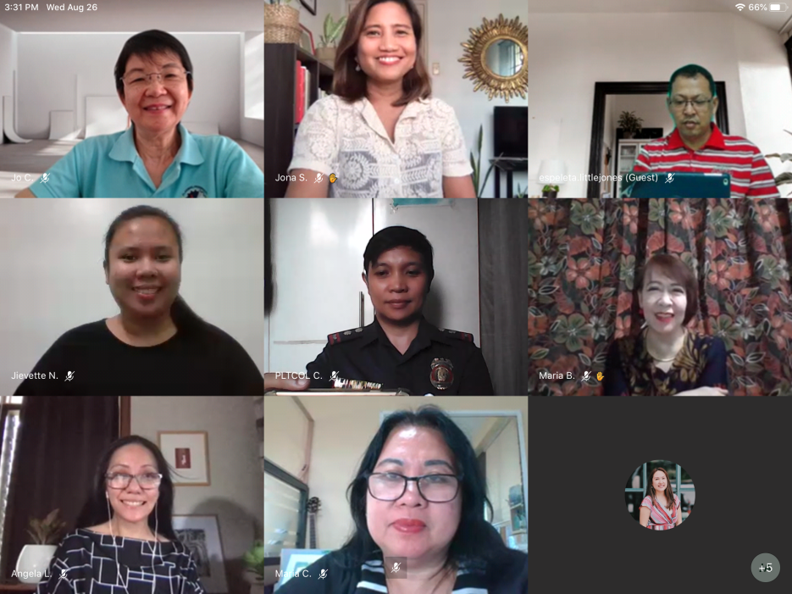
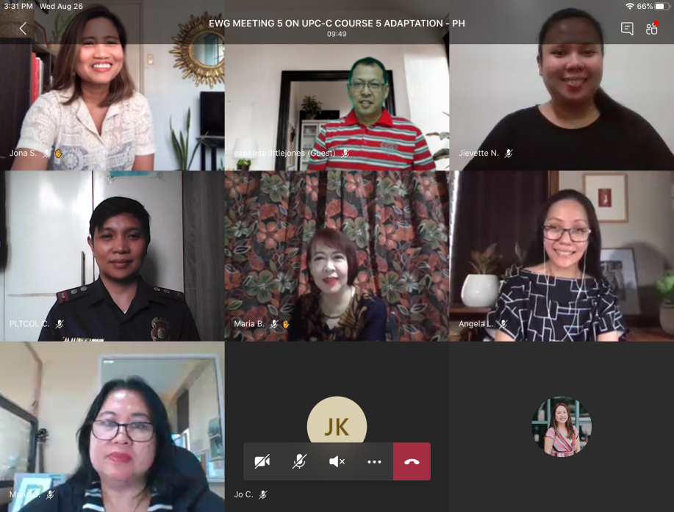
UPC C5 Adaptation Project
School-based Prevention Interventions
19
ISSUP PHILIPPINES PRE-CONFERENCE 2021
EXPERT WORKING GROUP MEETING
ADAPTATION WORK: COPYEDITING, CONTENT REVIEWS & GRAPHICS
TRAINING & DELIVERY
(3 COHORTS)
Completed
Q1 2021
Ongoing
Notes:
It was initially scheduled for a face to face meeting last April 2020. However, given the current global limitations due to the COVID-19 pandemic, the alternative to conduct the EWGM activities through the online platform was necessary in moving the initiative forward in a timely manner. The participants were given ten (10) working days to do deskwork activities outside of the online sessions with their assigned groups. The meeting concluded with presentations of the adapted manual and handed over to the editor for the final phase of the project. The adapted course materials will be utilized in the upcoming training cohorts with the Philippine National Police (PNP) and Philippine Drug Enforcement Agency (PDEA) in 2021. This reminds me of the first day of the Pre-conference event on the much needed dialogue of law enforcement and school prevention and it seems like we are on the right track.

Slide 18

CURRICULUM DEVELOPMENT
ISSUP PHILIPPINES PRE-CONFERENCE 2021
Pilot training of Recovery Curriculum: PEER/ALLIES, Mentorship, Masculinities, Advocacy Curriculum
Revision of Youth Curriculum
Updating of UTC Series
(Basic and Advanced)
Integration of ICAP credential and ODIC programme into national framework in Indonesia
800-item Test bank for UTC – Basic
Translation of Universal Curricula into Bahasa Indonesia, French, Dari and Pashtu
Evaluation of CHILD Curriculum
11
Notes:
Outside the Philippines, there are number of activities on curriculum development by DAP including pilot testing the Recovery Curriculum, revision to the Youth Curriculum, updates on the UTC/UPC series, integration of the ICAP credential in the national framework in Indonesia, translation work, and evaluation of the CHILD curriculum.

Slide 19
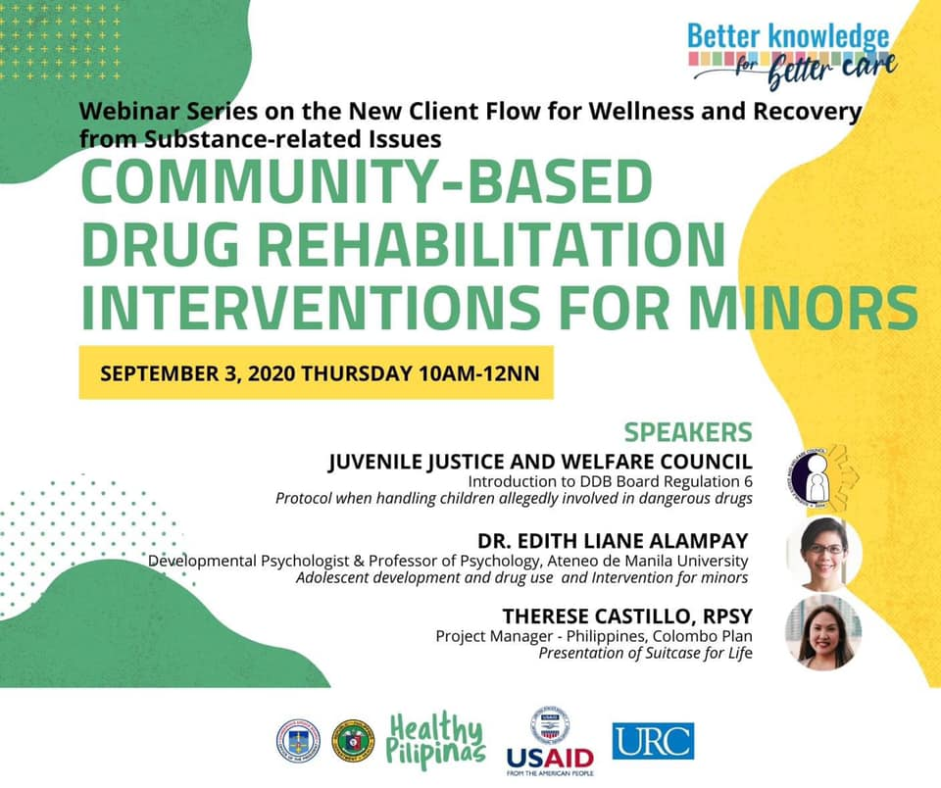

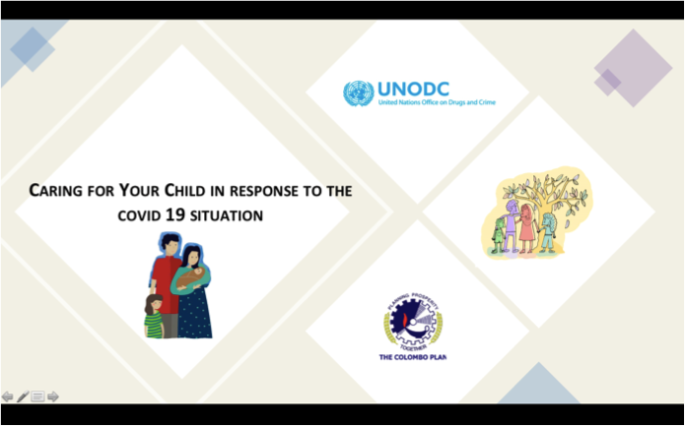
When we couldn't meet face to face,
we found ways to connect here and around the world. . .
ISSUP PHILIPPINES PRE-CONFERENCE 2021
16
Notes:
Last also participated in several activities by our partners and friends such as the webinar on “Caring for your Children in Response to the COVID-19 situation” last June 2020 and the Community-based Drug Rehabilitation Interventions for Minors to present the CHILD curriculum. This event was led by the US AID RenewHealth , DOH and other partners.

Slide 20
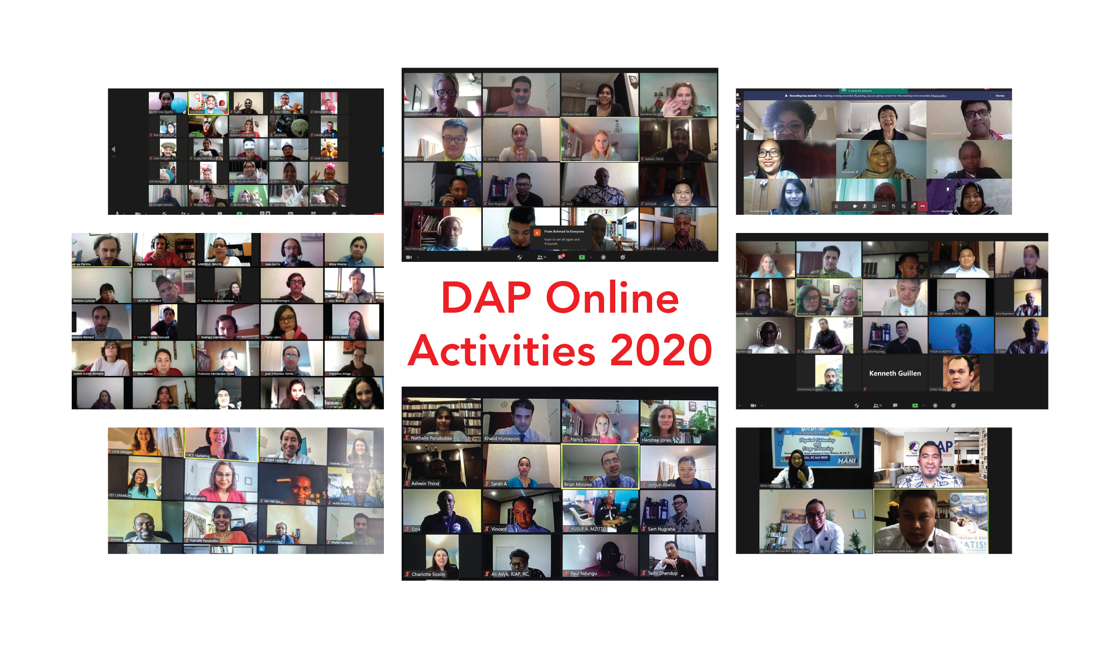
DAP ONLINE ACTIVITIES
107 Monitoring visits for 82 treatment centres in 28 provinces in Afghanistan
Member country consultations Afghanistan, Maldives, Philippines, Sri Lanka
Adaptation of Universal Curricula for online dissemination
Development of automated online UPC – Core
ATI training conducted for 40 participants
Online instructor led UPC Core Course
15
Notes:
Some of the online activities done by DAP in other areas were : monitoring visits for centers in Afghanistan, adaptation work for the UC , automating UPC – Core course among many others. Member country consultations from Afghanistan, Maldives, Sri Lanka and the Philippines also took place last year.

Slide 21
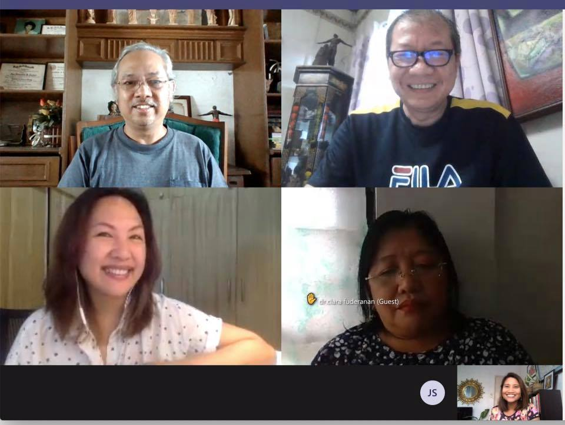
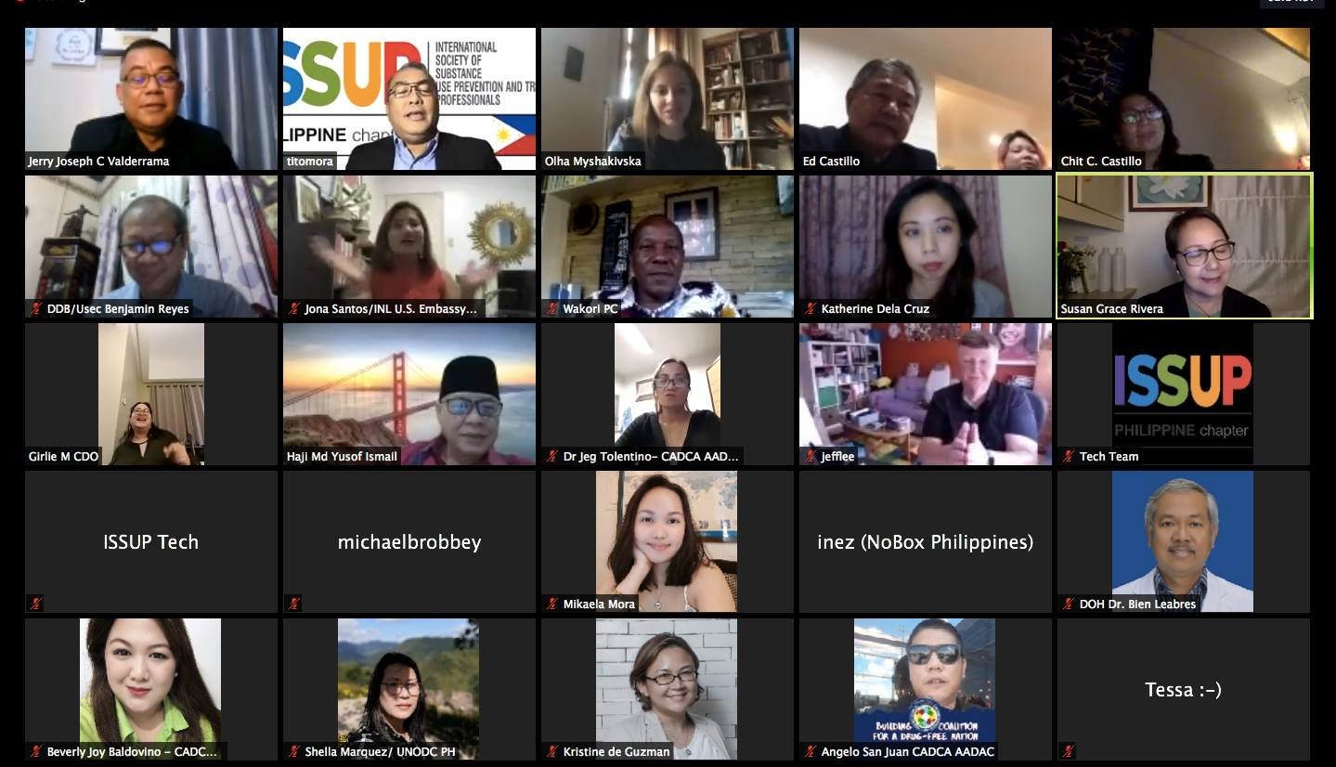
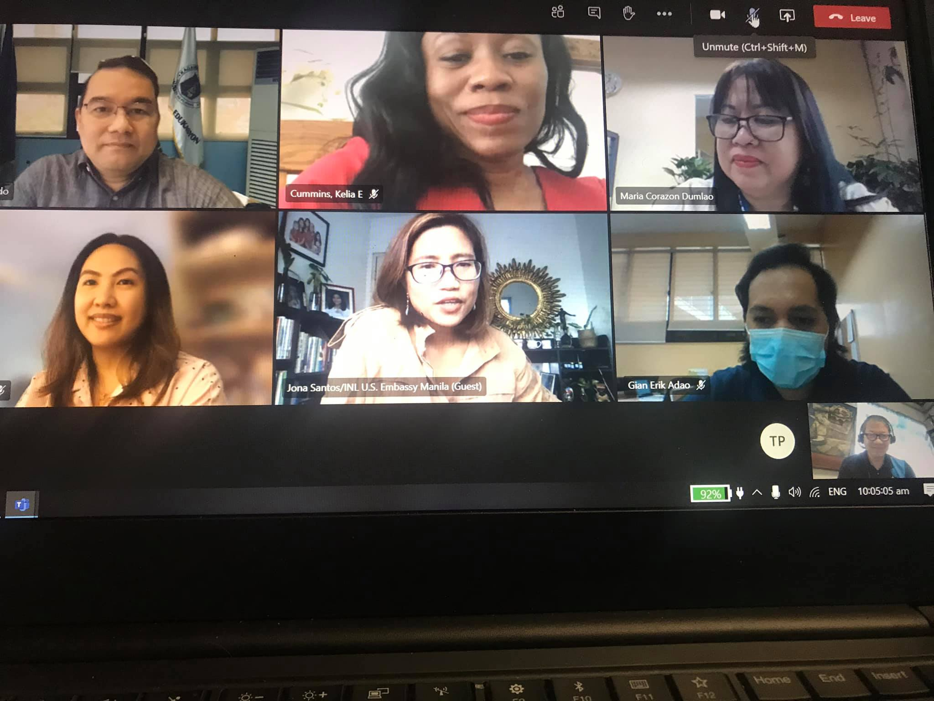
COLLABORATIONS
PHILIPPINES
PARTICIPATING
IN VIRTUAL EVENTS & MEETINGS
BUILDING CONNECTIONS
FOR NEW PROJECTS
17
Notes:
In the Philippines, we continue to collaborate, learn through the virtual events and meetings organized by our partners and build connections for new projects. In fact, there are several major project activities to look forward to that we hope to confirm and launch when possible.

Slide 22
The Silver Lining
INSIGHTS & TAKEAWAYS
1. STRONGER WITH COLLABORATIONS
2. INCREASING REACH & CONNECTION DESPITE ISOLATION
3. RECREATING EXPERIENCES IN THE NEW WORLD
Partners, Allies & Communities
Use of technology and communication tools
Adapting to the times to continue to deliver DAP’s main thrusts
23
Notes:
The pandemic hit us like an unexpected storm, getting us caught off guard and unprepared for what lies ahead. In the presentations we’ve heard the past few days, in the midst of the struggle, fear and anxiety, I couldn’t help to feel a sense of belongingness, strength and support from our partners, colleagues, and friends in the field of prevention, treatment and recovery. There are 3 takeways we have so far : 1. We are stronger with collaborations, just like the quotation on the first day, “None of us is as smart as all of us”. 2, Despite isolation, we increase our reach and connection with our available resources . Third and lately, we recreate experiences in prevention, treatment, and recovery as we adapt to the times and the new world.

Slide 23
25
Your global leader in planning healthy,
safe and strong communities
ISSUP PHILIPPINES PRE-CONFERENCE 2021
Connect with us:
Twitter: @cp_dap
Facebook: @DrugAdvisoryprogramme
Website: http://www.dap-colomboplan.org/
Email: therese.castillo@colombo-plan.org
Notes:
Thank you and we invite you to connect us through our social media platforms: Follow us on twitter, like our facebook page and check out our website to know more about The Colombo Plan – Drug Advisory Programme , your global leader in planning healthy, safe and strong communities.

