Slide 1
Issues and Realities amidst the Covid-19 Pandemic in Drug Abuse Treatment and Rehabilitation
JOSE BIENVENIDO LEABRES, MD, FPCAM
Program Manager
DOH - Dangerous Drugs Abuse Prevention and Treatment Program (DDAPTP)

Slide 2
R.A.9165
Comprehensive Dangerous Drugs Act of 2002
Sec. 2:
“It is further declared the policy of the State to provide effective mechanisms or measures to re-integrate into society individuals who have fallen victim to drug abuse or dangerous drug dependence through sustainable programs of treatment and rehabilitation.”

Slide 3
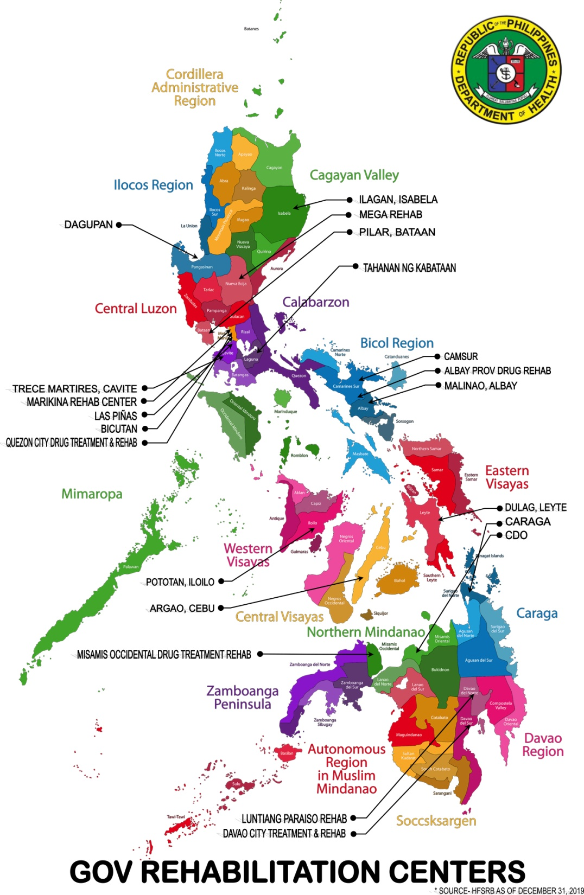
DOH Pre-COVID-19
18 Drug Abuse Treatment and Rehabilitation Centers
8 Outpatient Rehab Facilities and Recovery Clinics
Community Based Drug Rehabilitation Programs Nationwide

Slide 4

Corona Virus 2019
Jan 20, 2020: First COVID-19 Case detected in the Philippines
Mar 6, 2020: First Local Case was confirmed
Mar 15, 2020: Quarantine initiated

Slide 5

Outbreak Response
March 17, 2020:
DOH- DM2020-0118 – Suspension of Admissions and Group Activities
Conversion/Upgrading of selected DATRC into a COVID-19 TTMF
Reassignment of some staff to the COVID-19 response

Slide 6

Facility Response
Enhancement of Infection Prevention and Control in facilities
Enhancement of the DOH – Substance Abuse Helpline 1550
Telemedicine / Telehealth

Slide 7
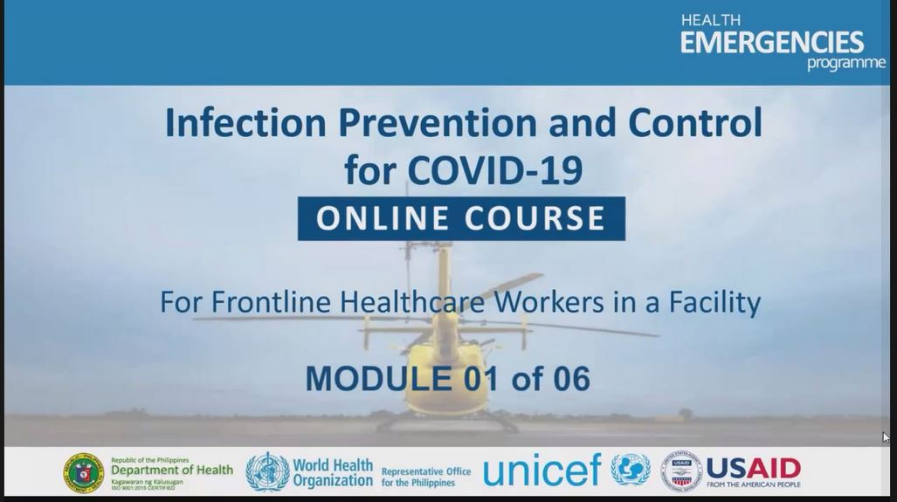
Facility Response
IPC Training for all facilities
Development of Online Training Courses
Telemedicine / Telehealth

Slide 8
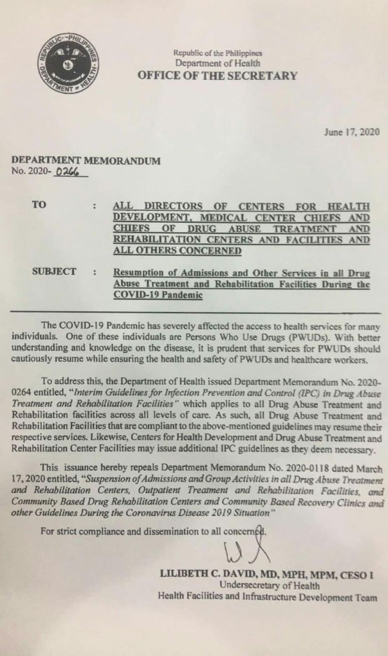
Post - Quarantine
June 1, 2020: Downgrading to General Community Quarantine (GCQ)
June 17, 2020: DOH DM 2020-0266 Resumption of Admission and Other Services in DATRCs
Selective resumption of services

Slide 9
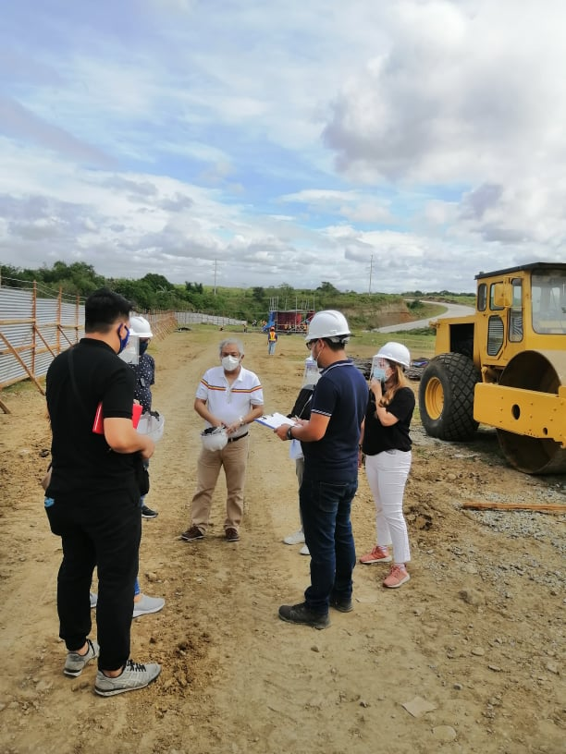
Next Steps
Resumption of development of facilities
Regionalization of the DOH - SAH Helpline 1550
Online Training and Accreditation of Physicians and Drug Rehabilitation Professionals

Slide 10

Next Steps
Information and Education Campaign
Mapping and Licensing of DATRCs
Others

Slide 11


Slide 12

Thank you
JOSE BIENVENIDO LEABRES, MD, FPCAM
Program Manager
DOH - DDAPTP
pmofc.ddaptp@gmail.com

