Slide 1

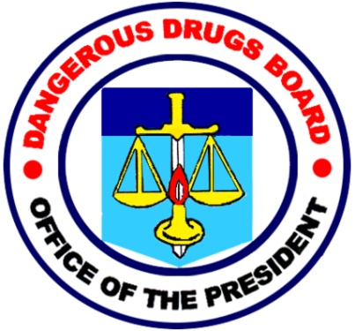
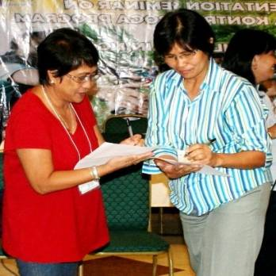
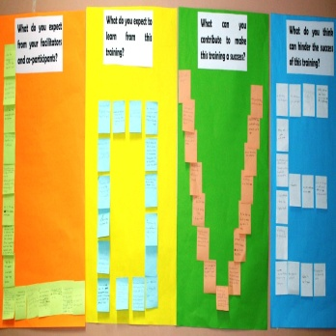


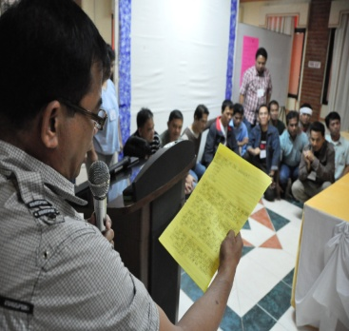

Ensuring Continuity of Services for PWUDs while in Quarantine
Notes:
Good day everyone! First of all I’d like to thank ISSUP Philippines for organizing this online conference to help understand how the pandemic affected our respective anti-drug campaigns…
I’ll be discussing how the Philippines responded in line with the Philippine Anti-Illegal Drugs strategy….

Slide 2
















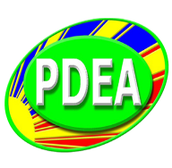




PHILIPPINE ANTI-ILLEGAL DRUGS FRAMEWORK
HOLISTIC AND BALANCED
APPROACH
CONSENSUS
BUILDING
SHARING
OF DRUG INFORMATION AND EXPERTISE
RULE OF LAW AND HUMAN RIGHTS
RESPONSIVE
ADVOCACY
PROGRAMS
SUSTAINABLE
ALTERNATIVE
DEVELOPMENT
PROGRAMS
REGULATORY
COMPLIANCE
Notes:
Just to introduce our agency, the Dangerous Drugs Board, the agency I represent, is composed of 15 other social development and security government agencies in the Philippines. It is the highest policy-making body on dangerous drugs matters charged to oversee the implementation of the Philippine Anti-Illegal Drugs Strategy or PADS

Slide 3


Background Situation
-The Community Quarantine in the Philippines started on March 16, 2020 when President Rodrigo Duterte declared the entire Luzon area (Northern Islands of the Country) under CQ because of the growing COVID19 Pandemic.
-This was later extended (Extended Community Quarantine or ECQ) to cover the entire country.
-Republic Act 11469 was enacted by Congress with a budget of around P400B (US$8B)
As of 4pm of Jan 25, 2021,… 514K had been infected by Covid 19 cases in the country, 476K ready recovered while 10,242 died
Currently, majority of the country is in Modified General CQ which allows movement subject to safety protocols
Notes:
-Now please allow me to give you a brief background on how the country responded after learning of the Pandemic….
The Community Quarantine in the Philippines started last March 16, 2020 when President Rodrigo Duterte declared the entire Luzon area (Northern Islands of the Country) under CQ because of the growing COVID19 Pandemic.
Basically, all movement are restricted, closure of non-essential businesses, set-up of check points nationwide and suspension of school and work were done.
-Republic Act 11469 was enacted by Congress to free up funds and enable the government to provide resources for the Social Amelioration Programs as well as procurement of necessary logistics for the health Sector with a budget of around P400B (US$8B)
As of 4pm of Jan 25, 2021,… 514K had been infected by Covid 19 cases in the country, 476K ready recovered while 10,242 died
Currently, majority of the country is in a Modified General CQ which allows movement subject to safety protocols

Slide 4
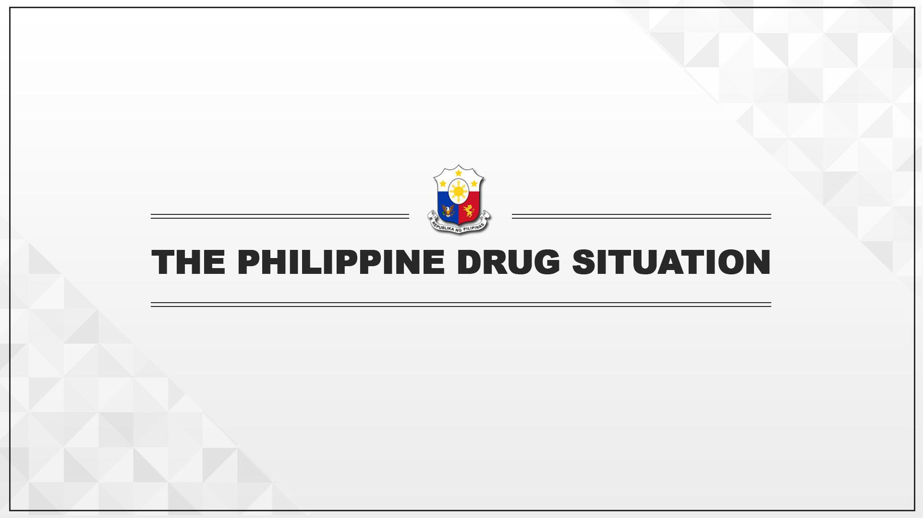
DRUG SUPPLY REDUCTION
ACCOMPLISHMENTS
Notes:
During this period I want to highlight major regulatory and enforcement accomplishments to curb the supply of drugs.
Suffice it to say, the Drug problem continued to hound the enforcement sector despite the pandemic…

Slide 5

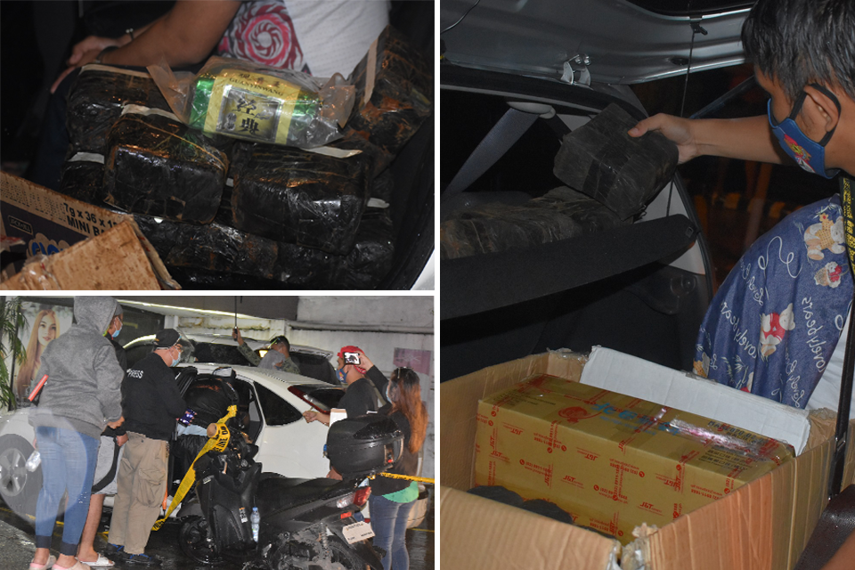
MAJOR SMUGGLING INCIDENTS
14 October 2020
30 kilograms of shabu worth Php 204 million (4.2M USD) were seized during buy-bust operations in the cities of Taguig and Parañaque. The Golden Triangle Drug Syndicate was involved.
Notes:
The succeeding slides will show some major buy-bust operations in the country despite the COVID-19 pandemic and the lockdown implemented nationwide.
The most recent being the seizure of 30 kilograms of shabu worth 4.2 million US dollars apprehended during a buy-bust operation in the cities of Taguig and Parañaque in Metro Manila last October 14.

Slide 6
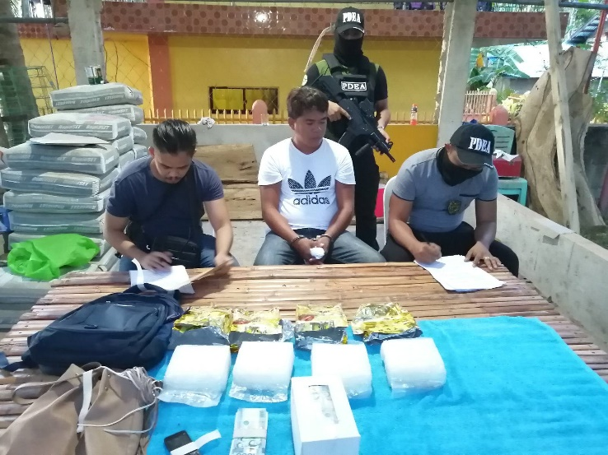
MAJOR SMUGGLING INCIDENTS
25 May 2020
Seizure of 4 kilos of shabu worth
Php 27.2M (555,102 USD) in Talibon, Bohol. A drug personality was arrested.
15 May 2020
Seizure of 4.95 kilos of dried marijuana leaves worth Php 595,000 (12,350 USD) in Tinglayan, Kalinga. A drug personality was arrested.
Notes:
In the month of May, we had two seizures.
One was half a million US dollars worth of shabu in Bohol, which also included the arrest of a drug personality.
The other was the seizure of marijuana worth more around $12,000 US dollars in Kalinga. A drug personality was also arrested.

Slide 7
MAJOR SMUGGLING INCIDENTS
4 June 2020
756 kilograms of shabu worth Php 5.14 billion (105M USD) were seized during a buy-bust operation at a warehouse in Marilao City.
Notes:
And on June 4, we were able to seize 756 kilograms of shabu worth 105 million US dollars in Marilao, Bulacan.
The biggest so far in 2020.

Slide 8
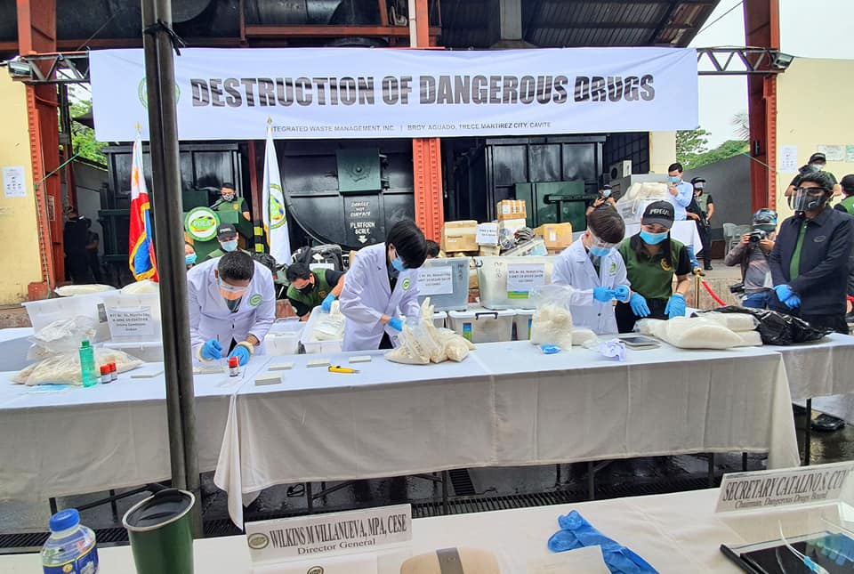
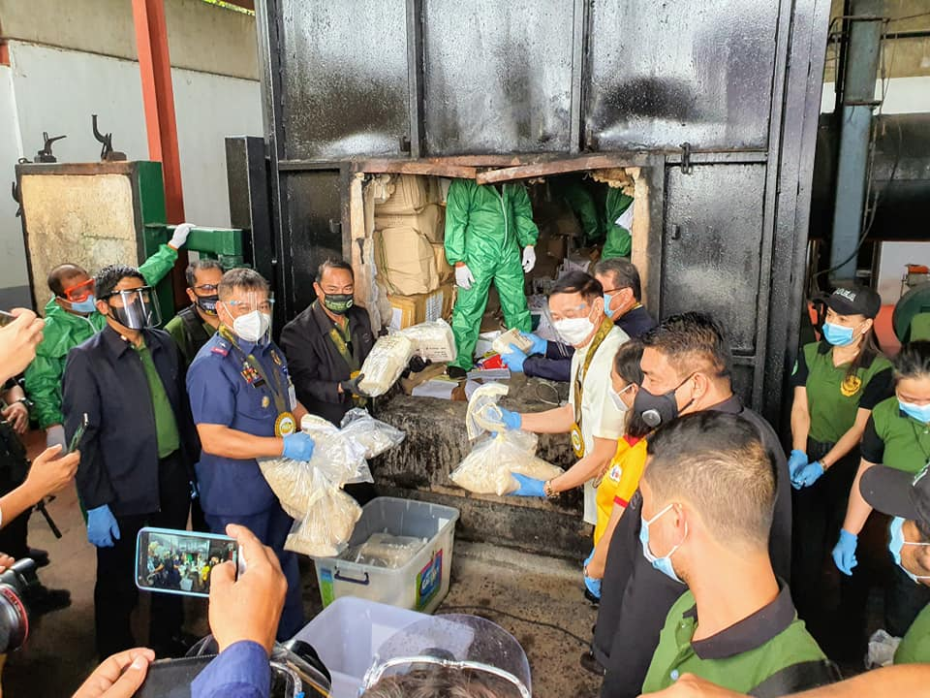
CURRENT SITUATION ON
DANGEROUS DRUGS, CONTROLLED PRECURSORS AND
ESSENTIAL CHEMICALS SEIZED AND DESTROYED
As of 15 October 2020, the Philippine Drug Enforcement Agency total quantity/volume of substances seized are as follows:
  7,073 kg
                12.5 liters
                80 ampules
                35,849 tablets
At the same time, the total quantity/volume of substances destroyed are as follows:
29,301 kg
100 liters of various substances
Valued at PHP 29.4B (USD 607.4M)
Notes:
On the screen is the latest total quantity and volume of seized drugs by the Philippine Drug Enforcement Agency, The Phil National Police and other enforcement agencies.
Last October 15, the President ordered the destruction of 607.4 million US dollars worth of seized drugs and chemicals.

Slide 9
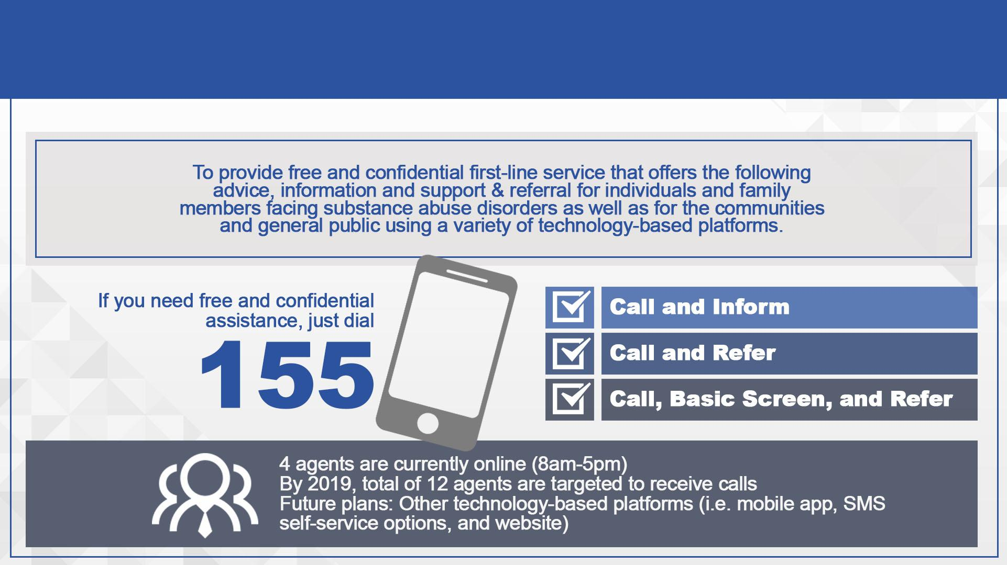
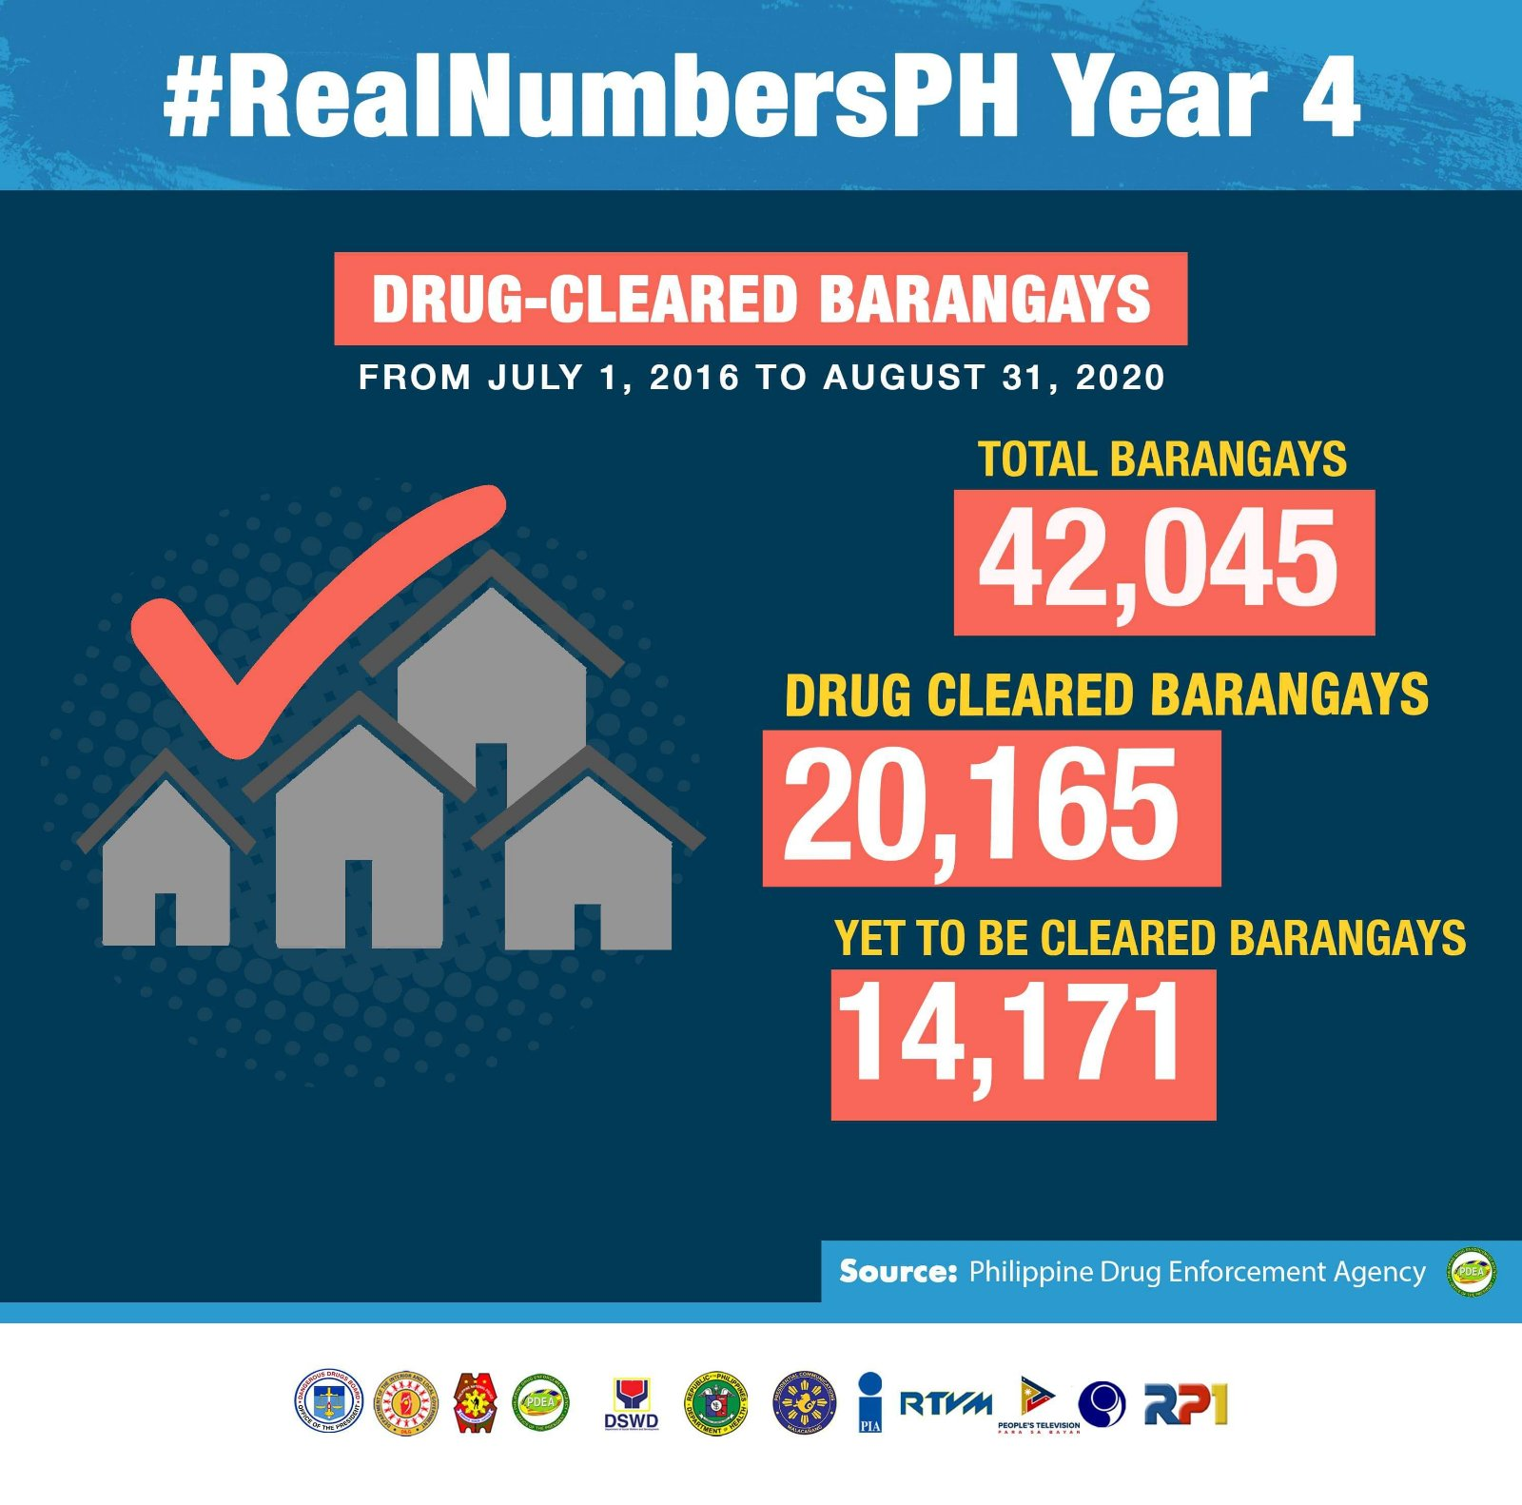

ANTI-ILLEGAL DRUG OPERATIONS
(JULY 2016 – SEPTEMBER 2020)
PHILIPPINE
DRUG
SITUATION
Notes:
Out of the 42, 045 villages or Barangays in the country about 80% or 34,336 were affected by the drug problem way back in 2016.
As of August 31, 2020, more than half or 59%, (0r 20,165) of the previously affected barangays have already been cleared.
In the next two years, we plan to clear the remaining 14,171 barangays.

Slide 10
DRUG DEMAND REDUCTION
ACCOMPLISHMENTS
Notes:
At this point, please allow me to share noteworthy demand reduction accomplishments also in line with the PADS.

Slide 11
Measures for PWUDs
-Immediate suspension of visitation privileges for in-patient facilities which was later expanded to include the suspension of admissions.
-Likewise, all community-based program service provision were suspended nationwide.
Allowing electronic prescription for regulated and non-regulated medications.
Pilot study by the Supreme Court (Administrative Circular No. 37-2020 dated April 27, 2020) on On-Line Hearing of cases
On-line platforms for inter-agency policy meetings (through Zoom, Microsoft Teams, Messenger, Skype and WebEx) and even provision of community-based programs
Notes:
Immediately after the announcement of the CQ period, the following initiatives were done to mitigate the spread of the disease…
- First is the Immediate suspension of visitation privileges for in-patient facilities which was later expanded to include the suspension of admissions. (after having covid cases inside rehab centers) Both patients and staff were infected.
-Likewise, all community-based program service provision were suspended nationwide.
Electronic prescription for regulated and non-regulated medications were authorized for continued access to essential medications.
A Pilot study done by the Supreme Court, (Administrative Circular No. 37-2020 dated April 27, 2020) allowed promulgation of services and Hearing of cases on-line.
We also adopted On-line platforms for inter-agency policy meetings (through Zoom, Microsoft Teams, Messenger, Skype and WebEx) and even for the provision of community-based programs
-As mentioned by Eric of CADCA and Olivier of UNODC yesterday, PWUDs undergoing community-based programs were utilized to help community mobilization of logistics during the lockdown

Slide 12
SUPPORT DURING COVID-19 PANDEMIC
Testing for COVID-19 is mandated for admissions, while regular testing is given to Rehab Center staff. The Department of Health is networking with other health facilities for proper triaging of cases. Moreover, all Drug Abuse Treatment and Rehabilitation Centers (DATRCs) are strictly implementing infection and control measures to prevent COVID-19 from infecting the patients within the facilities.
The Dangerous Drugs Board has been issuing the use of electronic prescription for dangerous drugs since the start of the Enhanced Community Quarantine.
Infection and Prevention Control Guidelines for Drug Abuse Treatment and Rehabilitation Facilities (DM 2020-0264) were put in place.
Infection Prevention and Control training is provided for all DATRCs and Outpatient TRCs.
Mental health support is available for patients and staff.
Notes:
In an effort to mitigate the effects of the COVID-19 pandemic, the Department of Health also mandated to strictly observe prevention protocols in all levels of treatment program services implemented in the country.
This was later adopted by the Dangerous Drugs Board for nationwide implementation.
Capacity building activities utilized online platforms which also allowed access to mental health services.
S

Slide 13
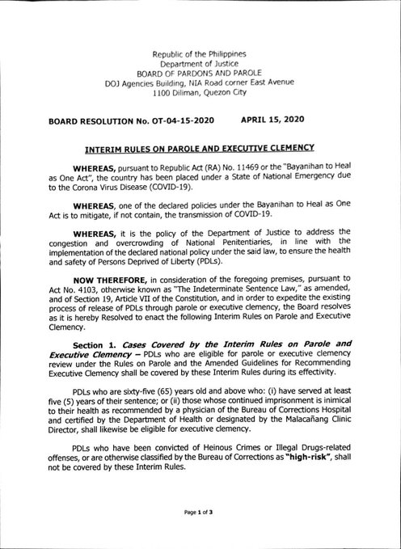
Measures for PWUDs
Supreme Court, Office of the Court Administrator issuance (OCA Circular No 91-2020 dated Apr 20, 2020) Re: Release of Qualified Persons Deprived of Liberty (PDL)
The Department of Justice, through Secretary Menardo Guevarra approved a board resolution (BR No OT-04-15-2020 dated Apr 15, 2020) on the Interim Rules on Parole and Executive Clemency which is part of DOJ’s “study for the release of prisoners on humanitarian considerations”.
- Those who are not eligible for parole may apply for Executive Clemency to be granted by the President.
Notes:
The SC Authorized the early Release of Qualified Persons Deprived of Liberty (PDL) through the issuance on the screen
The Department of Justice, approved the Interim Rules on Parole and Executive Clemency which is part of DOJ’s “study for the release of prisoners on humanitarian considerations”, wherein requirements for parole review and executive clemency cases are trimmed down to only include court certification of no pending case, court certification of no appeal, and records review, so that immediate release can be processed
-PDLs who are 65 years old and above who have served at least 5 years of their sentence or whose continued imprisonment is inimical to their health abecame eligible for executive clemency to be granted by the President..

Slide 14
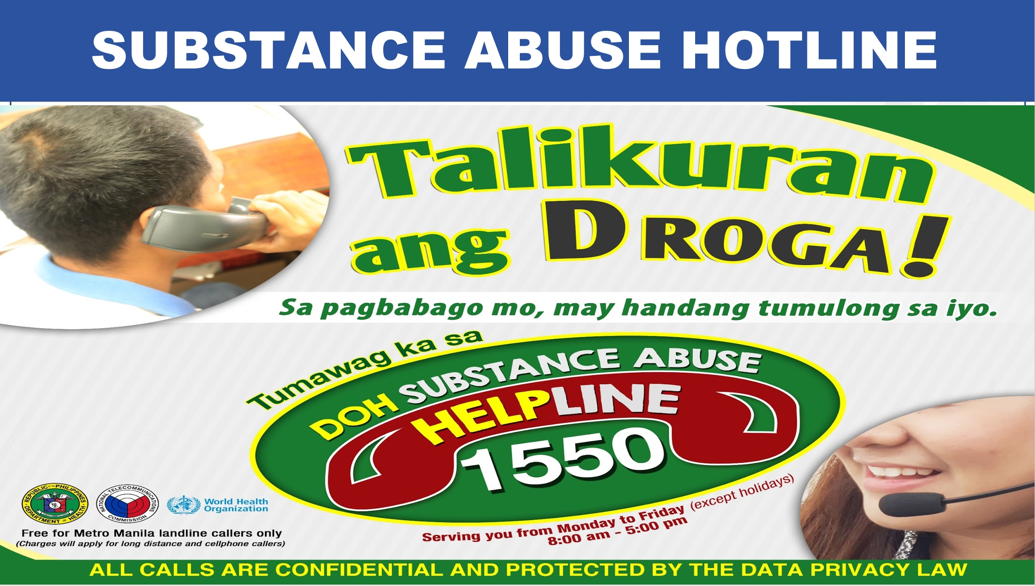
SUBSTANCE ABUSE HOTLINE
Notes:
The Department of Health also established a national hotline called the “Helpline 1550”.
It was launched during the the United Nation’s International Day on Drug Abuse and Illicit Trafficking or IDADAIT celebration last June 26.
The Helpline can be accessed for referral to support services and basic counselling needs on substance abuse.

Slide 15

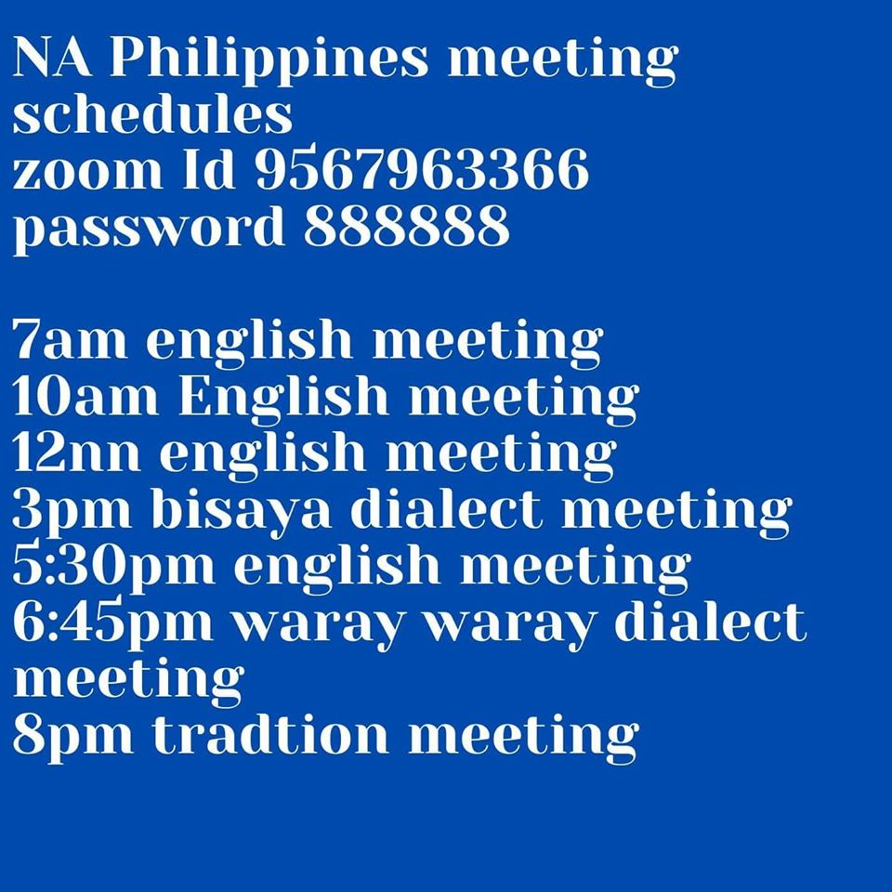
Online Platforms for PWUDs
-Fuel Ministry Recovery On-line support (fuelministry.org) with Christ Commission Fellowship- A faith-based intervention 40-day program facilitated by US-based pastors
-Narcotics Anonymous
Done twice weekly (Usually
Mondays and Thursdays)
Since March 12
Notes:
Networking with support organizations were also done to immediately facilitate on-line provision of services
Partners like faith-based organizations and NA provided accessible on-line services for PWUDs

Slide 16












Online Platforms for PWUDs
-Participated and supported the following free webinars for service providers with the following partners;
Notes:
-The DDB Supported and participated the following free webinars for service providers done in cooperation of the following partners;
The same partners have helped DDB develop evidenced-policies and implement model programs and “rights-based approaches” including the recently launched UN Human Rights Resolution for a cooperative response on Persons Deprived of Liberty and Persons Who Use Drugs.

Slide 17
RECENT DANGEROUS DRUGS BOARD POLICIES
The following Board Regulations and policies issued by the Dangerous Drugs Board ensure:
Adequate supplies of drugs available for medical and scientific uses
Diversion of drugs from licit sources to illicit channels does not occur
Board Resolution No. 3, Series of 2020
Placing Drug Products Containing Cannabidiol (CBD) with no more than 0.1 percent Tetrahydrocannabinol in Schedule IV of the Philippine Schedule
Board Regulation No. 1, Series of 2020
Immediate Adoption of Changes in the Scope of Control of Substances Pursuant to the Three (3) United Nations International Drug Conventions
Board Regulation No. 8, Series of 2019
Requirements for the Issuance of a License to Acquire, Possess, and Use Unregistered Drug Products Containing Dangerous Drugs for Personal Use
Notes:
Very quickly, I’d like to just flash on screen some of the policies developed with partners and adopted by the Board during the pandemic…

Slide 18
RECENT DANGEROUS DRUGS BOARD POLICIES
Board Regulation No. 4, Series of 2019
Inclusion of Gamma-butyrolactone (GBL), and all Compounds, Mixtures, or Preparations Containing any Quantity of the Same, by Whatever Official, Common or Usual Names, Chemical Name Or Designated Brand Name, in the list of Dangerous Drugs.
Board Resolution No. 9, Series of 2019
Approval and Adoption of the Unified Manual in the Investigation and Prosecution of Dangerous Drugs Cases
Board Regulation No. 13, Series of 2018
Establishment and Institutionalization of Drug-Free Workplace Policies in all Government Offices, Including the Conduct of Authorized Drug Testing for Elective Local Officials and Appointive Public Officers and for other Purposes
Joint Memorandum Circular No. 1, Series of 2018, of the Dangerous Drugs Board and Department of the Interior and Local Government
All Board Regulations and Resolutions may be accessed online at www.ddb.gov.ph.
Notes:
All Board Regulations and Resolutions may be accessed online via our website at www.ddb.gov.ph. We also have accounts on Twitter and Facebook providing more of our policies in the campaign against illegal drugs.

Slide 19
Current Challenges
Develop more on-line modules for capacity building and service delivery
Sustain linkages with stakeholders and partners
Continue to engage with Local Government Units for the drug campaign
Notes:
In conclusion,…
COVID changed the traditional practices and we should recognize that it will be with us for a long time… Strengthening Online Platforms for capacity-building and Service delivery is a must for the “new normal”
Sustaining the current linkages and cooperation with partner organizations to provide practical support to PWUDs is necessary to provide accessible services
There is a need to Continue to engage with Local Government Units for the drug campaign
The Philippines, considered a high-risk country for disasters (typhoons, volcano eruptions, earthquakes and now COVID) is trying to address simultaneous concerns. This stretches our resources (manpower and logistics) and causes us to prioritize current concerns. The challenge is to keep the drug campaign as a top priority or atleast maybe, one of the top concerns.
Maintaining the drug campaign in the consciousness of Filipinos can help us lobby for more support and continue developing models that work for Filipinos.

Slide 20
Thank You!
Undersecretary BENJAMIN P REYES, DMD, MPH, MDM, CESE
Permanent Member
Dangerous Drugs Board
Cell Phone No. +632 9998848203
Email Add: bmwbpr@yahoo.com
Notes:
Thank you all for your attention.

