Slide 1
“Community-based mental health care to address
mental health and substance use disorders”
PERU
Yuri Cutipé Cárdenas, MD/Psychiatrist
Executive Director, Mental Health Directorate
General Directorate of Strategic Interventions in Public Health
Ministry of Health
Notes:
Presentación

Slide 2
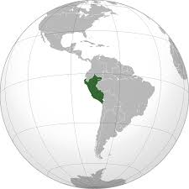

PREVALENCE OF LEGAL AND ILLEGAL DRUGS
AMONGST POPULATION AGED 12 TO 65 YEARS
DRUG TYPE | 1998 | 2002 | 2006 | 2010
Legal Drugs | --- | 75.2 | 67.0 | 54.7
Alcohol | 79.6 | 75.1 | 63.0 | 52.4
Tobacco | 44.5 | 37.5 | 34.7 | 21.1
Illegal Drugs |  | 2.8 | 1.0 | 1.5
Marijuana | 0.7 | 1.8 | 0.7 | 1.0
Cocaine | 0.4 | 0.7 | 0.3 | 0.4
Cocaine paste (“PBC”) | 0.6 | 0.7 | 0.3 | 0.5
Inhalants | 0.4 | 0.4 | 0.0 | 0.1
Ecstasy (MDMA) | --- | --- | 0.0 | 0.0
Medical Drugs | --- | --- | 3.1 | 1.4
Stimulants | --- | --- | 0.2 | 0.1
- Tranquilizers | 2.4 | 2.5 | 3.0 | 1.3
Peru:
32 million inhabitants
Source: IV Encuesta Nacional de Consumo de Drogas en Población General de Peru 2010. DEVIDA

Slide 3
POPULATION WITH SEVERE MENTAL HEALTH PROBLEMS
PERU, 2020
PREVALENCE | MEASUREMENT | POPULATION AFFECTED
8.8% | Risky alcohol consumption in adults | 2,028,616
2.5% | Harmful drinking and alcohol dependence in adults | 576,312
0.7% | Harmful tobacco use or dependence in adults | 161,3679
0.2% | Harmful marijuana use or dependence in adults | 46,105
0.1% | Harmful cocaine use or dependence in adults | 23,052
TOTAL |  | 2,835,452
Source: EESM ELMYC – INSM HD-HN 2012
PREPARATION: Eq. Tec. Salud Mental/DGIESP

Slide 4
MENTAL HEALTHCARE REFORM IN PERU
PARADIGM SHIFT IN PROVIDING CARE FOR PEOPLE WITH MENTAL HEALTH PROBLEMS
(Law 30947 and its Regulations)
Mentally ill
Citizen with mental health care needs and rights
Psychiatrist and psychologist
Interdisciplinary mental health team
Psychiatric hospital
Health care service networks with a community mental health approach
Psychiatric/psychological treatment
Mental health care
Social exclusion
Social inclusion (rights)

Slide 5
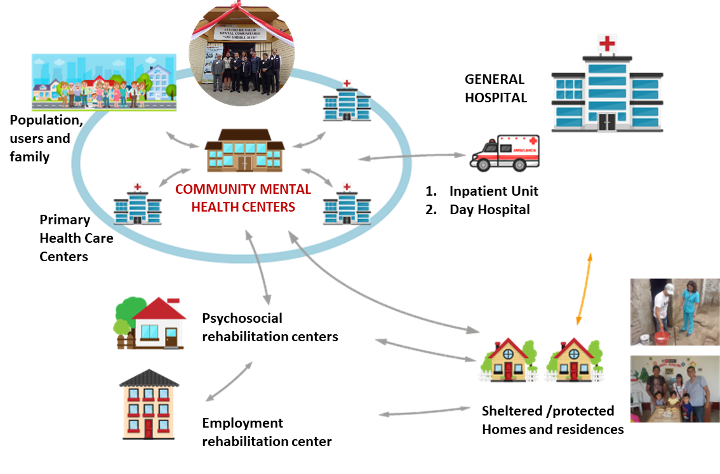
COMMUNITY MENTAL HEALTH CARE NETWORKS INTEGRATED INTO GENERAL HEALTH SERVICES NETWORKS IN DELIMITED TERRITORIES
(Law 30947, Mental Health Law)

Slide 6
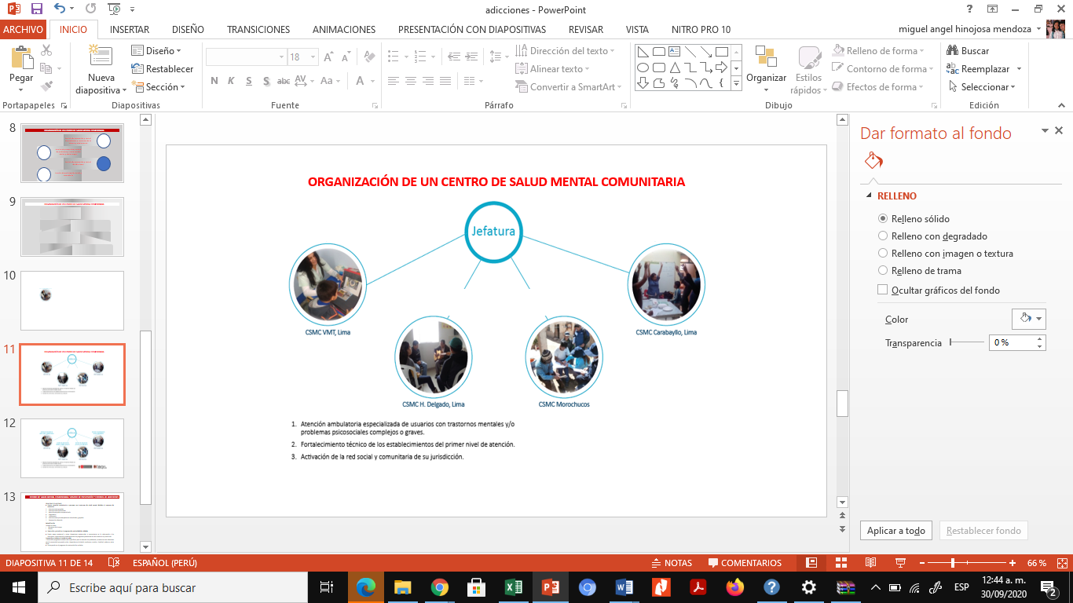
COMMUNITY MENTAL HEALTH CENTER
ORGANIZATION
Prevention and control: Problems and disorders of childhood and adolescence
Headquarters
Social and community participation
Prevention and control:
Problems and disorders of the adult and elderly
Prevention and control of addictions

Slide 7
COMMUNITY MENTAL HEALTH CENTER: PREVENTION AND CONTROL OF ADDICTIONS
MAIN FUNCTIONS:
1. To provide specialized interdisciplinary care to users with mental health disorders caused by substance abuse:
  Personalized diagnosis and treatment
  Individual and group psychotherapeutic interventions
  Family interventions and home visits
  Continuity of care program
  Referrals and/or counter-referrals to health care centers
2. To provide clinical supervision to first-level health care facilities:
  Interdisciplinary counseling in clinical and psychosocial management of mental disorders and psychosocial problems.
To activate the social and community network in his/her territory:
  Identifies community assets for the social and occupational rehabilitation.
  Implements preventive programs.
  Trains community health agents to identify people with addiction problems and to prevent addiction issues.
  Coordinates self-help groups (Alcoholics Anonymous, Narcotics Anonymous and their families).
  Coordinates inter-institutional networks.
Prevention and control of addictions

Slide 8
MENTAL HEALTH SERVICES IMPLEMENTED IN PERU
Regions with Community Mental Health Centers until 2017
Regions with Community Mental Health Centers by 2018
Regions with Community Mental Health Centers by 2019
Tumbes
Loreto
Tumbes
Loreto
Tumbes
Loreto
Piura
Amazonas
Piura
Amazonas
Piura
Amazonas
Lambayeque
Cajamarca
Lambayeque
Cajamarca
Lambayeque
Cajamarca
San Martín
San Martín
San Martín
La Libertad
La Libertad
La Libertad
Áncash
Huánuco
Ucayali
Áncash
Huánuco
Áncash
Huánuco
Ucayali
Pasco
Pasco
Ucayali
Pasco
Lima
Junín
Madre de Dios
Junín
Madre de Dios
Junín
Madre de Dios
Cusco
Lima
Cusco
Lima
Huancavelica
Cusco
Huancavelica
Huancavelica
Apurímac
Puno
Ica
Apurímac
Puno
Ica
Ayacucho
Apurímac
Puno
Ica
Ayacucho
Ayacucho
Arequipa
Arequipa
Arequipa
Moquegua
Moquegua
Moquegua
Tacna
Tacna
Tacna
MENTAL HEALTH SERVICES | EXISTING UNTIL 2017 | ESTABLISHED FROM 2018 TO 2019 | TOTAL RUNNING | NEW SERVICES IN PROCESS 2020 | TO BE ESTABLISHED | 2021 GOALS
COMMUNITY MENTAL HEALTH CENTERS | 31 | 124 | 155 | 50 | 77 | 281
MENTAL HEALTH AND ADDICTION HOSPITALIZATION UNITS | 14 | 10 | 24 | 6 | 12 | 42
SHELTERED HOMES | 6 | 5 | 11 | 35 | 99 | 145
CHILD PROTECTIVE SERVICES (MAMIS) | 20 | 16 | 36 |  | 14 | 50

Slide 9
CASES OF MENTAL AND BEHAVIORAL DISORDERS
DUE TO ALCOHOL AND OTHER PSYCHOACTIVE SUBSTANCE USE
PERU 2009-2019
Source: OGTI-MINSA. Oct, 2020)

Slide 10
CASES OF MENTAL AND BEHAVIORAL DISORDERS
DUE TO PSYCHOACTIVE SUBSTANCE USE
PERU 2020 (JAN-AUG)
CASES ATTENDED (TOTAL): 24,021
Source: OGTI-MINSA, Oct. 2020

Slide 11

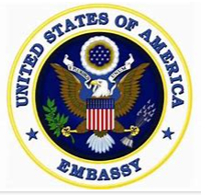
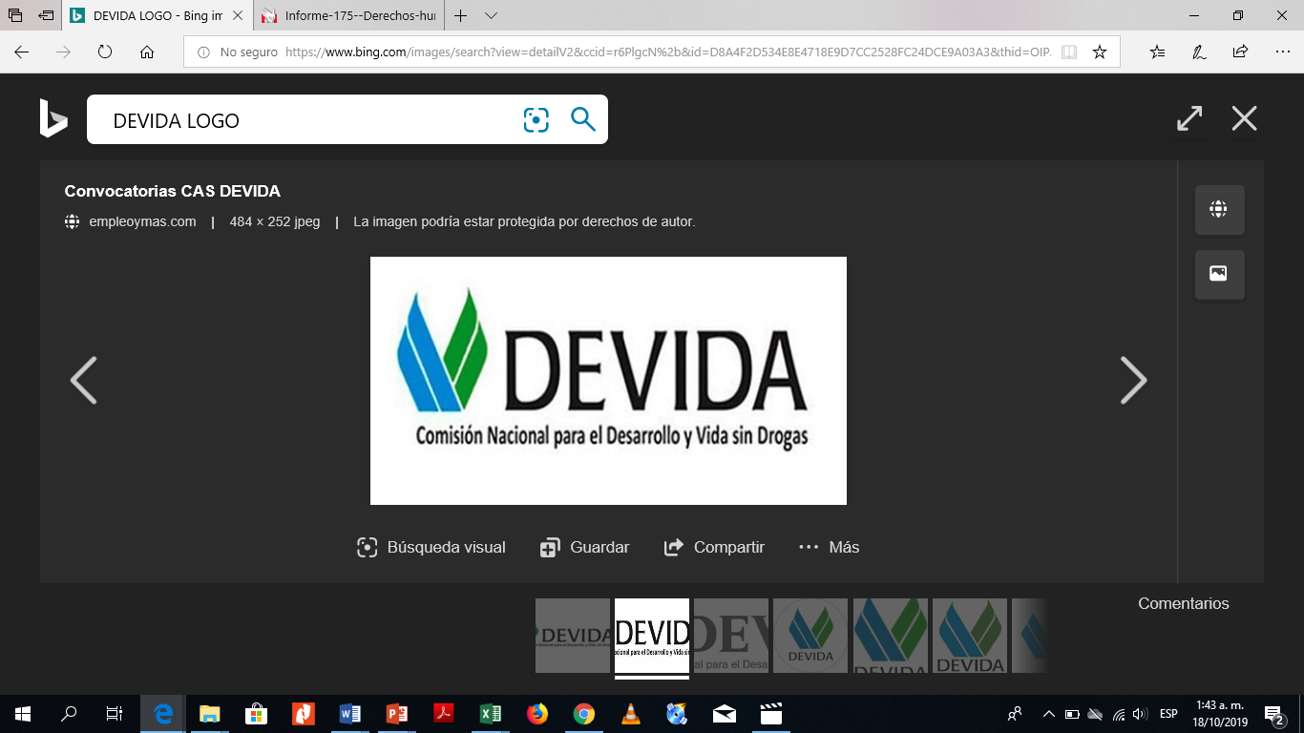



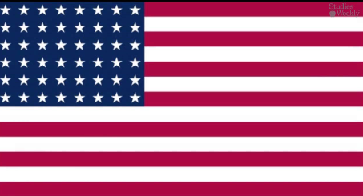
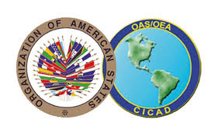




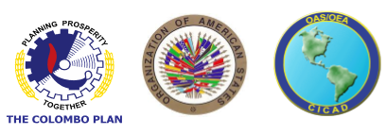

ORGANIZATIONS ENGAGED IN THE MENTAL HEALTH CARE REFORM THAT IMPROVES THE TREATMENT OF MENTAL DISORDERS DUE TO PSYCHOACTIVE SUBSTANCE USE
LGBTI GROUPS
UNITED STATES OF AMERICA EMBASSY IN PERU
CARE Peru
CICAD OEA
PSYCHOLOGY DEPARTMENT FACULTY
UNIVERSIDAD NACIONAL AUTÓNOMA DE MÉXICO
Source: OGTI-MINSA, 05 de octubre 2020)
PREPARATION: Eq. Tec. Salud Mental/DGIESP
THE COLOMBO PLAN

